Slide 1

Water Quality Standards
Human Health Criteria
Technical Workgroup
Meeting #1
Alaska Department of Environmental Conservation
Division of Water- Water Quality Standards

Slide 2

Webinar instructions:
For audio please dial: 1-800-315-6338
Access code: 51851
Note that all lines will be muted during the presentations
Public testimony will be taken at ~11:45 and 4:15
PLEASE BE RESPECTFUL OF ALL PARTICIPANTS

Slide 3
Division of Water
Mission Statement: Improve and Protect Alaska’s Water Quality
How?
Establishes standards for water cleanliness
Regulates discharges to waters and wetlands
Provides financial assistance for water and wastewater facility construction and waterbody assessment and remediation
Trains, certifies, and assists water and wastewater facility system operators
Monitors and reports on water quality
Notes:
The department protects water in a lot of ways- I have listed 5 of them here.

Slide 4

Purpose of Technical Workgroup
Provide technical feedback on issues associated with development of human health criteria (HHC) in state water quality standards
  Develop a Summary Report
Identify key sources of information that may be applicable to the process
Ensure a variety of stakeholder voices are heard
Notes:
Over the new few months DEC will provide you with information on this issue, how other states have acted and the information/process they used, and potential options DEC has identified. A final Workgroup report will be generated based on the comments generated over the course of this process.
DEC will use this report to inform our decision-making process as we move forward in our revisions to the HHC

Slide 5
Outline
Ground Rules and Expectations
Introduction to human health criteria (HHC)
BREAK for lunch
Introduction to HHC formula
Introduction to Fish Consumption Rates
BREAK
  DEC Literature Review
  ADF&G Subsistence data
Regional Concept
Notes:
Note- depending on how our conversations go- we may finish early or we may table the Regional Concept for another time.

Slide 6
Ground Rules for Workgroup
DEC understands that many different interests will be represented, and that it might not be possible to come up with consensus recommendations.
Regardless of the degree of consensus attained, all information and recommendations will be of value to DEC in the process.
Be Respectful of all participants at all times- Summary of ground rules in the HHC Technical Workgroup notebook
Notes:
Refer to the Groundrules page in the notebook.
Rather than go over the whole document- this is a summary of the content there.
Please be respectful, helpful, and mindful that this is a process with many different points of view to be taken into account. The more you’re engaged, the more you’ll get out of this process.

Slide 7



State Efforts to Address Water Quality Issues
System
Intervention Strategy
Agency Activities
Contaminant Sources
Water
Fish
People
“Upstream”
Prevention
    DEC: Division of Water
    Water Quality Standards
    Toxics Monitoring (water, fish tissue)
    RISK PREVENTION
Prevention-based toxics reductions
Behavioral-based interventions to prevent exposures to toxics
      DEC: Division of Environmental Health
      DHSS: Fish Consumption Advisory Program
      RISK MANAGEMENT
“Downstream”
Safety Net
Notes:
This graphic is a depiction of the way multiple departments and divisions are looking at the issue to assure that we have all our bases covered. We are not in this alone and we are not working in silos

Slide 8
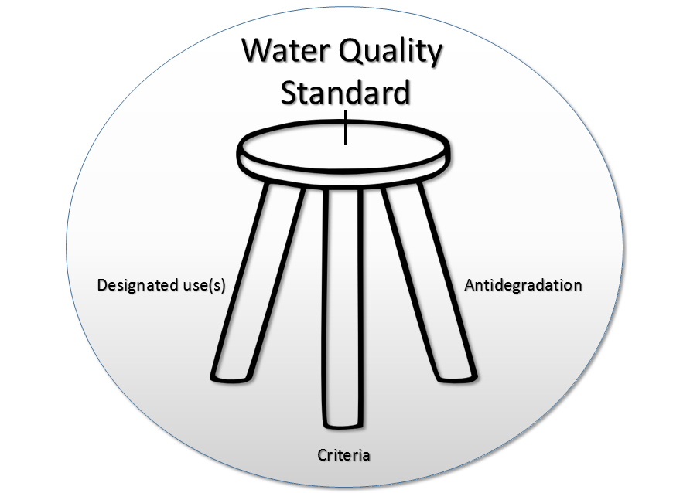
Foundation of a Water Quality Standard
-Defined-
Designated Uses – how water is used (e.g. recreational, industrial, aquatic life)
Criteria - are numeric or narrative values. Consider how much and how long you may be exposed to a substance or condition
Antidegradation –process for protecting high quality waters
Notes:
If you wanted to visualize a WQS- it could look like a three legged stool
All three need to be considered or the regulation will be “out of balance”
Most designated uses are general enough to be able to incorporate numerous activities under one heading
Criteria is based on dose and duration

Slide 9
What are Water Quality Standards (WQS)
The foundation of state/tribal water quality-based pollution control programs under the Clean Water Act (CWA)
Are designed to protect public health or welfare (designated use)
Provide maximum (generally) concentration of a particular pollutant in the water (criteria)
Help identify polluted waters; clean-up polluted water, and make sure our waters don’t get more polluted
Notes:
used for:
Benchmarks for monitoring/assessment
Water quality based limits in permits
Goals for waterbody restoration/recovery plans- TMDLs
Derived by rigorous scientific procedures
Are designed to protect public health or welfare
Provide maximum (generally) concentration of a particular pollutant in the water

Slide 10
Where do Water Quality Standards (and discharge limits) apply?
(AS 46.03.900) "Waters" include lakes, bays, sounds, ponds, impounding reservoirs, springs, wells, rivers, streams, creeks, estuaries, marshes, inlets, straits, passages, canals, the Pacific Ocean, Gulf of Alaska, Bering Sea, and Arctic Ocean, in the territorial limits of the state, and all other bodies of surface or underground water, natural or artificial, public or private, inland or coastal, fresh or salt, which are wholly or partially in or bordering the state or under the jurisdiction of the state.
(18 AAC 70.020(b)): [t]he water quality standards regulate human activities that result in alterations to waters within the state’s jurisdiction.
Notes:
Apply to all waters within Alaska’s geographic boundaries (e.g., within three nautical miles of shore
May not necessarily apply to certain types of sources (e.g., atmospheric)
Need to be approved of by EPA
It is important to note these definitions because Alaska does not have the authority to regulate water quality outside of its territorial waters. Essentially-if it’s not state property, Alaska has no jurisdiction to develop rules/regulations

Slide 11
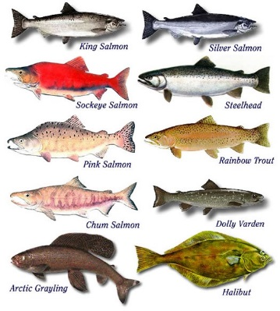

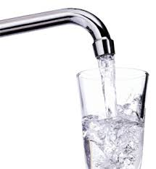
Human Health Criteria (HHC)
A human health criterion is the highest concentration of a pollutant in surface water that is not expected to pose a significant risk to human health
  designed to minimize the risk of adverse effects from exposure to different contaminates
  Based on a chronic (lifetime) exposure to contaminants
  Includes the ingestion of drinking water from surface water sources and/or
  The consumption of aquatic life obtained from surface waters.
*
Notes:
Essentially, the criteria are designed to protect people who consume fish.
Oregon has completed revisions to their criteria, Idaho and Washington are in the process. Alaska is evaluating what has taken place in other states. It’s a dynamic rather than a static process with lots of stakeholders to consider.
Human Health Criteria (HHC) are set at a level that enables residents to safely consume the amount of fish they want to consume.

Slide 12
What are HHC (cont.)
Human Health Criteria consider two different exposure scenarios
  Marine Waters (Consumption of aquatic organisms only)
  Freshwaters (Consumption of aquatic organisms & ingestion of surface water)
Several factors to consider…
  Population of concern
  Mode of effect of the contaminant (acute v. chronic, carcinogenic, etc.)
  Definition of “aquatic life” and where does your meal come from?
  Other exposure issues and sources of contaminants (e.g. air)
Notes:
Need to consider recreational, commercial, traditional, and aquaculture when determining where the fish come from.

Slide 13
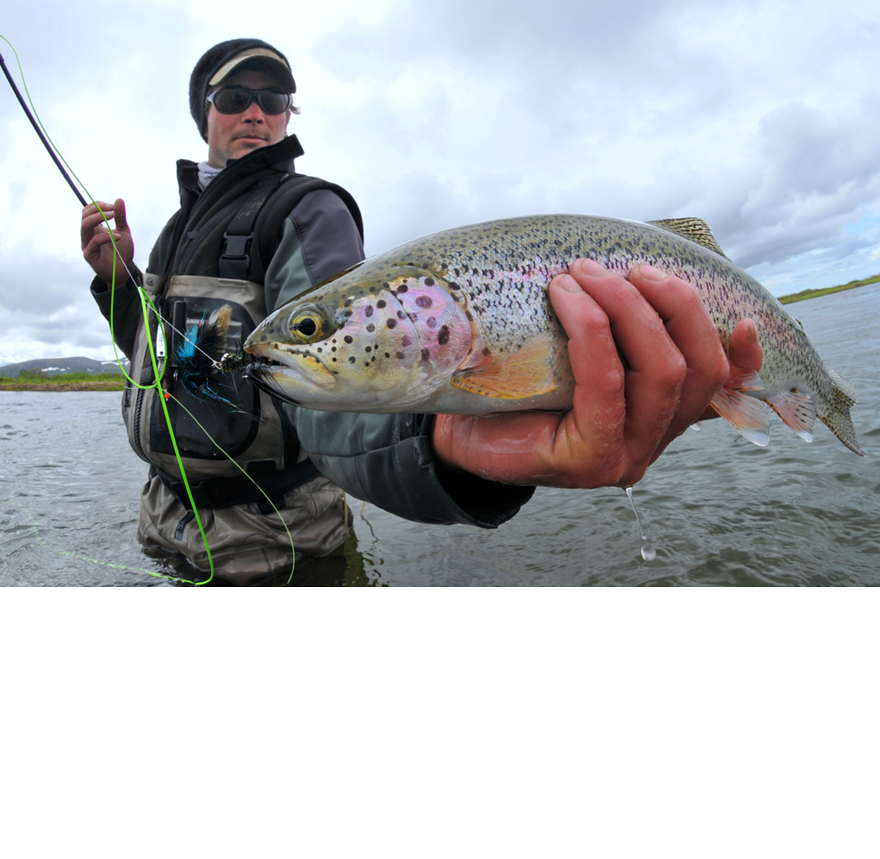
When does HHC apply- Designated Use?
HHC are tied to the designated uses
Drinking water
Growth and propagation of fish, shellfish, other aquatic life and wildlife
Harvesting for consumption of raw mollusks or other raw aquatic life
Removal or modification of uses and/or criteria may be subject to a high level of scrutiny when 303(c) fishable/swimmable uses
Notes:
For contextual purposes- Essentially, HHC are on the same footing as aquatic life and any changes (SSC or Reclassification) will require a significant amount of resources on the part of the applicant as well as the state. Think of it as the highest burden of proof.

Slide 14
Historical Context: National
1980 – EPA derived 64 recommended HHC. Criteria were based on national dietary information (where 6.5 g/day comes from)
1992 - National Toxics Rule promulgated carcinogens for Alaska
2000 - New HHC methodology was published.
  Updated FCR to 17.5 g/d
  Subsistence user value of 142.4 g/d
2002 – 2015 Updated HHC based on 2000 methodology
  Includes updated toxicity values for 122 different pollutants
2015 - Updates to exposure rates including FCR to 22.0 g/day

Slide 15
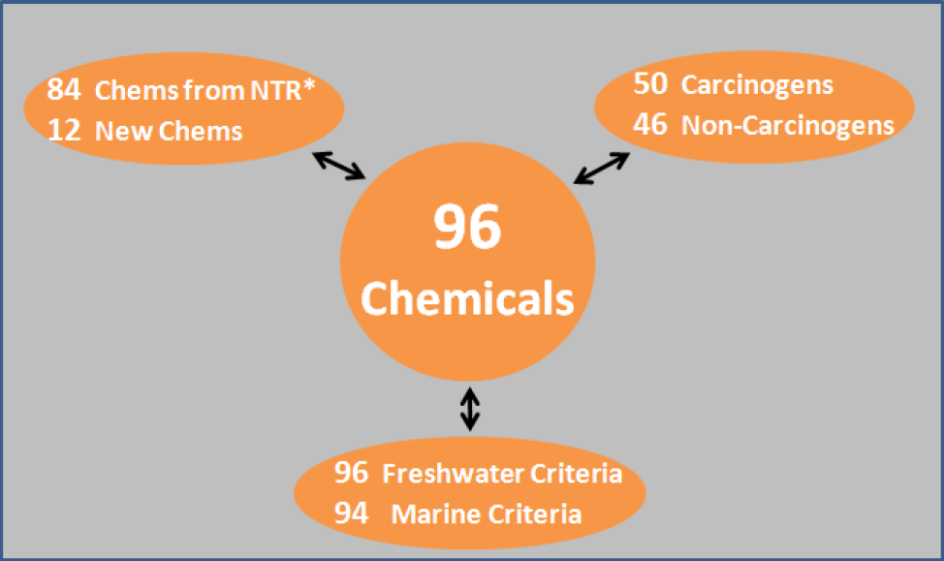
How do the 2015-recommended HHC compare with existing HHC?
There are 96 freshwater HHC and 94 marine criteria proposed
  70% of the 2015 HHC are lower concentrations than 1980 criteria
  30% of the 2015 HHC are equal in concentration to 1980 criteria
  Numerous pollutants were not updated at this time (e.g., PCBs, metals)
See DEC/EPA section of the Technical Notebook for a list of the chemicals and proposed values.

Slide 16
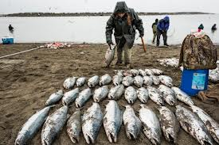
Why is Alaska interested in the HHC issue?
Clean Water Act requires states to adopt updated criteria when new information is available
Alaska is subject to the promulgated National Toxics Rule
  Not based on Alaska-specific or even Northwest data
Criteria must be scientifically defensible
Notes:
Alaska adopted its HHC in 2003 and recognizes that it was based on limited data
Identified as part of the 2013 Triennial Review process and in Triennial Review comments previously. Oregon has completed revisions to their criteria, Idaho and Washington are in the process. Alaska is trying to learn by evaluating what has taken place in other states. It’s a dynamic rather than a static process with lots of stakeholders to consider.

Slide 17
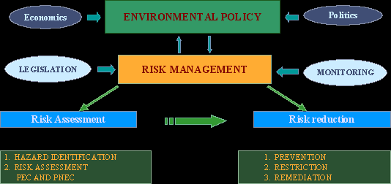
What has DEC heard or learned to date?
Comments submitted in Triennial Review process call of a revision
  Existing values are outdated
  Desire for the state to adopt Alaska-specific values
Litigation in Northwest
Concerns from the regulated community that potential revisions may be very difficult to meet in the short term
  May not be the right mechanism for reducing toxics in the environment
  $$$$$

Slide 18
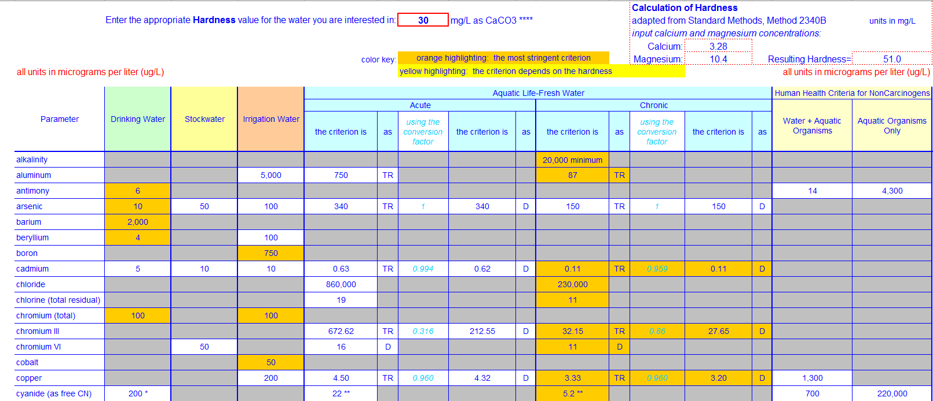
HHC in the Inorganic Toxics Criteria Worksheet
Notes:
Note that carcinogen criteria are found in the (2008) Water Quality Manual for Toxics. DEC currently regulates 94 different carcinogenic pollutants based on 1992 NTR- refer to your packet for the different chemicals of concerns- Inc. pesticides

Slide 19
Goals of this rule-making?
Ensure water quality standards are protective of human health so our fish, shellfish, and drinking waters (surface) remain clean and healthy to consume;
Apply a regulatory process based on a realistic timeframes to allow dischargers to reduce pollutants and still be in compliance while they are doing their work; and
Acknowledge that there are technology limitations and give recognition that non-permitted sources may be a significant part of the problem with being able to meet the criteria.
Notes:
Special thx to WA staff for supplying this language

Slide 20
Questions to be considered by the Workgroup
Issue #1: What information about fish consumption and fish consumption rates is available to inform the HHC process?
Issue #2: What options does DEC have for developing criteria on a statewide/regional/site specific basis?
Issue #2a: What modeling approach(es) should DEC consider (Determinstic v. Probabilistic)?
Issue #3: What is the appropriate level of protection for Alaska and its residents?
Issue #3a: How should DEC apply bioconcentration v. bioaccumulation factors?
Issue #3b: How should DEC address concerns about its carcinogenic risk value?

Slide 21
Questions to be considered by the Workgroup
Issue #4a: What species should Alaska include for deriving a fish consumption rate?
  Marine Fish (i.e., salmon?;)
    If we include- Can we adjust FCR values based on lipid content?
  Marine Mammals (AK would be the only state that considers this issue)
Issue #4b: What is the role of Relative Source Contribution (RSC) in relation to fish consumption rates and what are Alaska’s options?
Issue #5: What are Alaska’s options for implementing the proposed criteria?
  Existing tools (compliance schedules) and new tools (variances, intake credits)

Slide 22
Who else is working on this issue?
Florida: Started this process in 2003. Awaiting EPA response on 2015 package
Washington: Began work in 2011. Working on draft package…
Idaho: Began work in 2011. Working on a draft package…
Maine: HHC were disapproved of in 2015 for not being protective of tribal populations Currently being litigated (Maine v. EPA)
EPA-Region 10: May promulgate criteria for WA if state doesn’t meet a September deadline
Numerous tribes…both in Alaska and Northwest
Notes:
Issuance of the 2015 criteria will require ALL states to consider their criteria (especially those who are currently applying a 6.5 FCR) but these are the states that DEC has been monitoring
Oregon: Began work in 2008 as result of consent decree. Approved in 2011. Still working on issues with implementation

Slide 23

Questions?
Notes:
Let’s take a short break to address any questions you may have

Slide 24


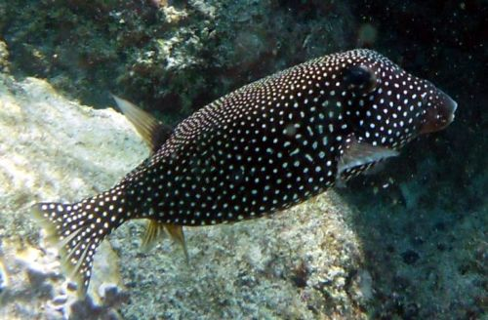
Establishing a Human Health Criterion
Notes:
Public Policy (Black Box) plus Fish equates to a Black Box Fish (Ostracion meleagris)

Slide 25
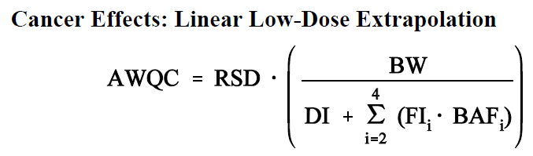
Use the EPA HHC Formula!
The HHC formula determines the degree of risk
  Risk = Toxicity * Exposure * Uncertainty
Notes:
So- to put these numbers into the right context- determining what these can/should be can be complicated…
Toxicity considers the allowable dosage that will not be dangerous to humans over the course of a LIFETIME OF EXPOSURE for both carcinogens and non-carcinogens.
Fish consumption exposure considers how much and what parts you eat, where does it come from, and what are other sources of that pollutant have you been exposed to?
The U.S. Average for BW is 70 kg, DI is 2 liters/day. Fish consumption and Bioaccumulation each have different values to consider. These values can be further refined by drinking water-specific regulations and other health advisories.
Uncertainty factors into both the carcinogenic and non-carcinogenic equations in various ways- accounted for in both the toxicity value as well as exposure values
RSD-Risk specific dose

Slide 26
Input Variables (2015 recommended)
BW = Human Body Weight (adult = 80 kg = 176 lbs
DI = Drinking Water Rate (2.4 liters/day)
CSF = Cancer Slope Factor (mg/Kg-day) AKA
FCR = Fish Intake Rate (? grams/day)
BCF/BAF = Bioconcentration v. bioaccumulation factor (L/Kg, chemical specific
RfD = Reference Dose, Non-Carcinogens (mg/Kg-day)
RL = Risk Level (10⁻⁵) in Alaska (EPA uses 10⁻⁶ )
RSC = Relative Source Contribution
Notes:
Note that the formula is slightly different depending on whether you are describing a carcinogenic or non-carcinogenic substance.
Relative Source Contribution can be a difficult factor to determine- considers ALL of the sources a person may be exposed to. In the new HHC guidance states are encouraged to use a 80/20 ratio in which only 20% of the total contribution is attributed to water and FC unless states can prove a higher amount is warranted.
This is a point of contention between states and federal agents

Slide 27
Toxicity
Toxicity values are established by EPA
  RfD = Reference dose (mg/kg-day), values are derived from IRIS or other sources of toxicological data
    Used to be called the Allowable Daily Intake (ADI)
    Applies to NON-Carcinogens
  CSF = Cancer Slope Factor (mg/Kg-day) or Risk-Specific Dose
Notes:
Issue of concern by states- many of the IRIS values are outdated or based on a limited number of studies. EPA 2015 noted that other sources of information (i.e., CalEPA, Health Canada)

Slide 28
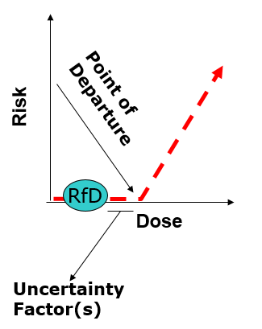
Reference Dose (NonCancer)/Cancer Slope Factor
RfD: An estimate, with uncertainty spanning perhaps an order of magnitude, of a daily oral exposure to the human population (including sensitive subgroups) that is likely to be without an appreciable risk of deleterious effects during a lifetime.
EPA’s policy- RfD should not be exceeded
Notes:
Exposure with RfD is expressed as a HAZARD QUOTIENT (HQ)
HQ= daily dose/RfD
RfD info general comes from IRIS or other reputable sources of chemical toxicity reference information
Thx to Oregon DEQ for the content and image
Cancer Slope Factor or Risk Specific Dose is Target Incremental Cancer Risk/Cancer Potency Factor

Slide 29
Exposure
Exposure = contact between an agent and the visible exterior of a person
Exposure considers the magnitude, frequency, and duration of exposure to a particular agent over time (E(mag,freq,dur)/T)
HHC Exposure Factors
  BI= Body weight ( fixed at 70 kg (80kg))
  DI= Drinking water intake (fixed 2 liters (2.4 L))
  FI = Fish Consumption (varies per state)
  BAF= Bioaccumulation Factor (varies by trophic level but fixed at specific values)

Slide 30
Body Weight
Bodyweight is based on a fixed EPA-recommended value
Updated 2015 = 80 kg
Update based on NHANES data
Little to no reason for Alaska to question this value-may even be higher based on Dept. of Public Health/ANTHC data
Notes:
Note that I’m going in alphabetical rather than any particular order of importance
2000 = 70 kg

Slide 31
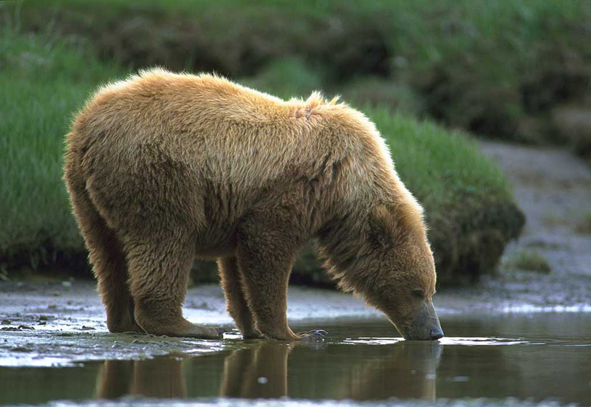
Drinking Water Intake
Drinking Water is based on an fixed EPA-recommended value.
2000: 2 liters per day. Inc. all sources of water (e.g., drinking water, coffee, other beverages/food derived water)
2015: Settled on 2.4 liters per day. Consistent with 2011 EPA Exposure Handbook values
Notes:
2014 Draft crtieria recommended 3 liters per day. This was in direct conflict with published EPA 2011 Exposure values.

Slide 32
Fish Intake Rate/Fish Consumption Rate (FCR)
Per EPA: States/Tribes should consider developing criteria to protect highly exposed population
Geographic/demographic differences are anticipated
EPA hierarchy of data sources
  EPA default intake rates (22 g/d for general /142.4 g/d for subsistence)
  Data from national surveys (NHANES or other)
  Data reflecting similar geography/population groups (Region 10 states (175))
  Local Data (Alaska-specific)
Notes:
1992: 6.5 g/d
2000: 17.5 g/d
2015: 22 g/d
EPA values represent 90th percentile of the population.
Subsistence- Been the same since 2000.

Slide 33
FCR Preference Hierarchy, Cont.
Use of Local or Regional Data
  Use local data for freshwater/estuarine species
  Use of uncooked weight intake values
  Use high-end values (90th or 95th percentile) or average values for high consuming fish population (if using mean, should base on consumers only).
Fairly common practice for states to develop HHC values based on local data (ME, NY, MN, WI, OR, WA (Regional approach), ID (in progress))

Slide 34
Bioaccumulation Rate
Ratio of concentration of a pollutant in fish to the concentration in water (L/Kg)
Bioaccumulation accounts for exposure through diet, exposure to pollutants in the water, and trophic position (where in the food chain)
No bioaccumulation = BAF of 1
BAF can reach into the 1000’s for highly bioaccumulative compounds (e.g., PCBs)
  Low bioaccumulation = exposure from drinking water
  High bioaccumulation = exposure from eating fish
Notes:
Bioconcentration refers to the uptake and retention of a chemical by an aquatic organism form water only while bioaccumulation consider all surrounding media (water, food, sediment)
Use of bioaccumulation rates were recommended in 2000 but have been rarely used due to complications with having the “right” kind of data to include in the model-fairly site-specific in nature unless you have a large data set.
Bioconcentration data is easier since it simply involves putting a fish in sample water in a lab.
Bioaccumulation is a function of the bioavailability of contaminants in combination with species-specific uptake and elimination processes. Toxicity is determined by the exposure of an animal to bioavailable contaminants in concert with the animal’s sensitivity to the contaminant.
Persistent and/or hydrophobic chemicals may be more likely to bioaccumulate rather than bioconcentrate

Slide 35
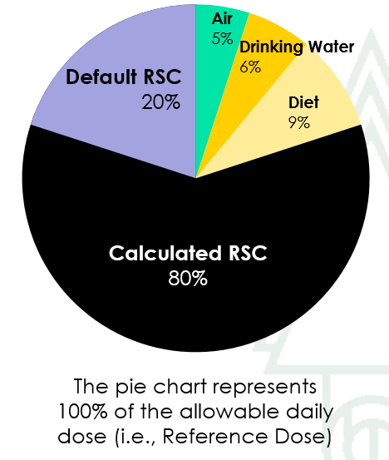
Uncertainty
EPA addresses uncertainty at various points
  Toxicity values: uncertainty is incorporated into the base toxicity value (IRIS).
  May have compounded conservativism issues (10*10*10) you always use the most conservative factor
  Relative Source Contribution: (0.8 to 0.2)
Notes:
Goal is to prevent exceedance of the Reference Dose when water exposure is added to other daily exposure.
RSC essentially accounts for everything but ingestion of aquatic life and surface waters.
Sounds great in theory but isn’t necessarily widely practiced beyond this particular EPA practice.
Credit to Federal Water Quality Coalition/American Forest & Paper Association for image

Slide 36
Relative Source Contribution
Meant to account for non-water sources of exposure to non-carcinogens
Estimates total amount of exposure from water and FC and potential exposure to other sources (e.g., marine fish)
2015: EPA Default value of 0.20 in most cases- the lower the value, the more is attributed to other sources. Can be adjusted up to 0.80 max.
Lowering of HHC provides additional room for other sources-but not their regulation.
Notes:
Accounts for sources of exposures other than consumption of aquatic life
EXAMPLE: If you assume ~20% of your daily exposure to a toxic substance comes from sources OTHER than eating fish and drinking from a stream/lake, then 80% is available to use in calculating the HHC
RSC of 1 means that 100% of daily exposure is available for use in the criteria calculation
There’s a fundamental concern that use of the Clean Water Act to regulate toxics is problematic. That said, its not our place to determine whether this is or isn’t a good policy but rather to determine whether there is information that would allow for certain criteria to be adjusted depending on available information on source contribution (e.g., adjust upward based on source information like Florida has done)
DEC plans to hold an entire follow-up webinar on this issue

Slide 37
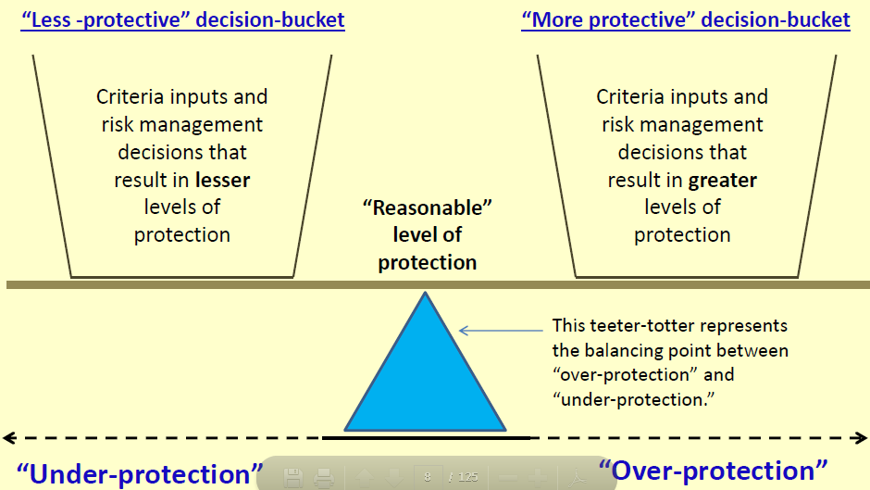
Notes:
Image developed by Washington Ecology- http://www.ecy.wa.gov/programs/wq/swqs/PolicyForum6Presentation.pdf#page=21
Terms over and under protected are very subjective- opinions vary widely amongst interest groups
For HHC, acceptable levels of protection are somewhat defined by EPA guidance but policy and risk management choices will play a huge role in setting the “appropriate” level of protection in regulation.

Slide 38

Questions?
Notes:
Lunch Break

Slide 39
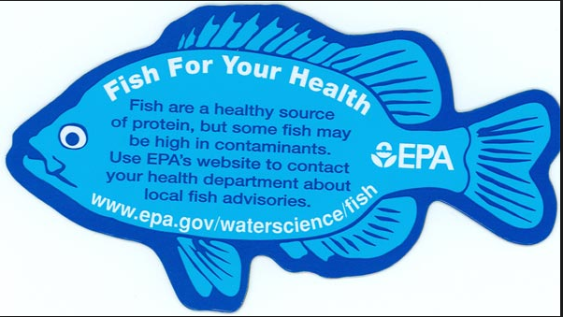
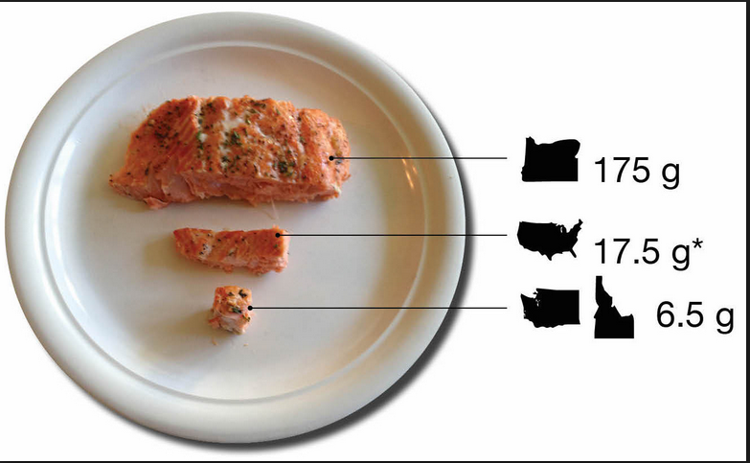
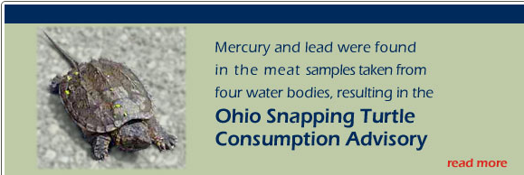
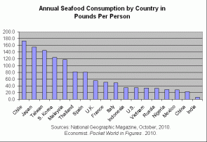
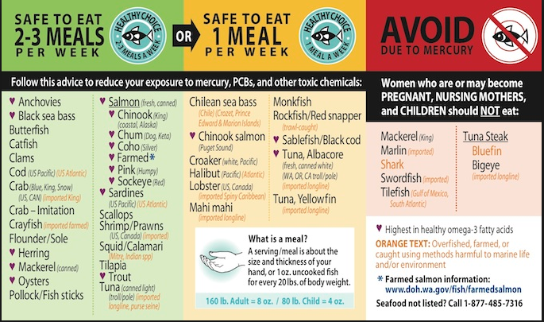
Fish Consumption Rates?
Issue #1: Fish Consumption Rates

Slide 40
Fish Consumption Rates
Purpose
Target
Survey Design
  Representativeness
  Accuracy
Data Analysis
Special thanks to Lon Kissinger who developed the information for many of the following slides (EPA Idaho FCR Presentation (02/06/13))

Slide 41
Fish Consumption for Criteria v. Advisories?
Fish consumption in HHC equates to g/day of fish a person consumes on average over a lifetime
Fish consumption in a Fish Advisory context
(# of meals per time period that is safe for a person to consume)
E.g,: two 8oz meals of halibut (of a certain size) per week over a lifetime

Slide 42
It is important to use Fish Consumption in the correct context
Development of WQC | Fish Advisories
Sets standards or screening levels | Are the calculated end result
“How clean do the fish need to be to always eat?” | “How much can I safely eat?
Target 90-95% of consumers | Applies to everyone
Conservative: 1 X 10⁵ or 10⁶ | Less conservative (use a range of cancer and non-cancer risk values)
Does not consider benefits of eating fish | Balance of benefit and risk
Proactive | Reactive
Used for determining risk | Not intended to determine risk

Slide 43
Purpose of FCR Surveys
Determine trends in seafood (aquatic life) consumption
Determine fishing pressures on certain waterbodies
Assess waterbody or site-specific risks posed by contaminates in seafoods
  Environmental regulation
  Fish consumption advisories
    Identification of waterbodies where fish consumption advisories are needed
    Determine effectiveness of fish consumption advisories
**To support development of water quality criteria**

Slide 44
What does an FCR look like?
Meal size * Frequency of Consumption
8oz portions * once every two weeks = ~15 g/day
22 g/day = Value used in EPA 2015 recommendations
Units? g/day or mg/Kg-day? (grams of fish per kg of a person’s body weight)
  Note that kids might eat less but their lower bodyweights influence their overall consumption rates
Notes:
Frequency can be culturally/regionally influenced
Meal size is age and weight dependent

Slide 45
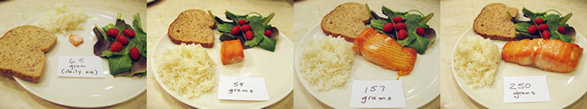
6.5 Grams works out to ~ one 8 oz serving per month
54 grams is ~one to two meals per week
142 grams is a 5oz serving every day
175 grams is a 6oz serving every day
Notes:
17.5 would equate to ~ three cracker sized portions a day
6.5 = 7oz meal once a month
17.5 = 4 oz meal once per week
142 = 5 oz meal every day
175 = 6 oz meal every day

Slide 46
Fish consumption data needed for water quality standards development
Representative of population of interest
Data required for general population and high consumers
Characterizes consumption of desired groups
Rates not suppressed due to environmental contamination

Slide 47
Fish consumption data needed for water quality standards development
Provides a range of statistics suitable for HHC development (mean, median, 5th, 90th, 95th)
Addresses consumption of relevant species
Addresses consumption of relevant fish preparation
Identifies sources of fish
Accounts for temporal variation in fish consumption

Slide 48
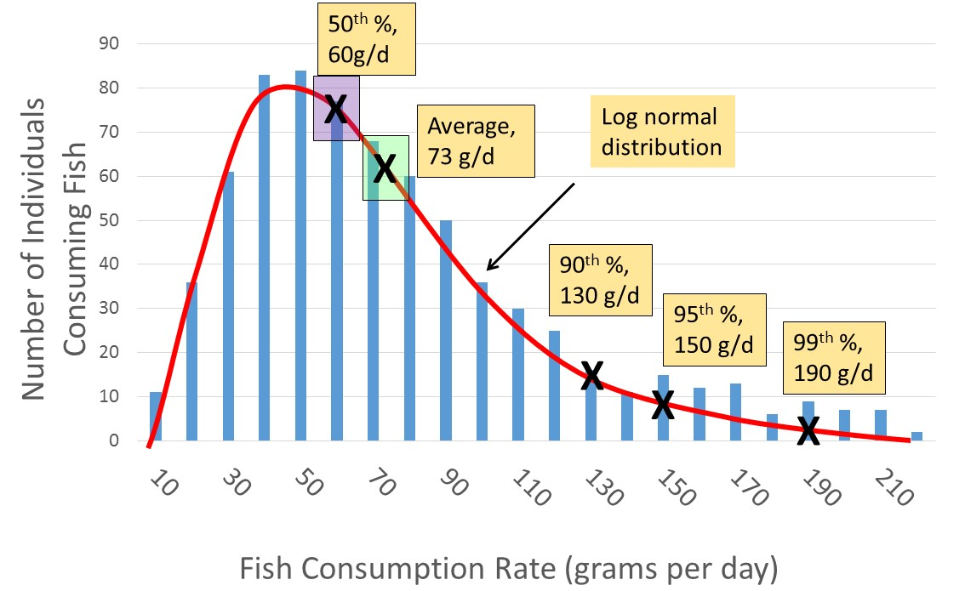
HHC: Population of interest: General or subset?
The fish consumption rate (FCR) in the HHC should reflect the rate of consumption by the population of concern
(Mean, 90th, 95th, 99th)
Notes:
Alaska will need to make a TECHNICAL and a POLICY decision on what part of this curve they want to use for the basis of protection. Setting the value at the 99th would be very problematic (although that is how EPA got 142 g/d for the national subsistence criteria in the 2000 recommendation) because it would create a situation that may be unrealistic- Do folks really eat that much fish ALL their lives? Doesn’t account for a margin of error. Setting it too low may not accurately capture the concerns of the most “at risk” population.
Different states have taken different approaches. EPA methodology does not prescribe a particular approach.

Slide 49
HHC Population of interest: Consumers or Non-Consumers
Concept: All populations will have different consumption habits
  Just because you’re a low consumer doesn’t mean that you’re a non-consumer
  Mis-classifying low consumers as non-consumers can lead to over-estimation of FCR mean and median values- shifts the mean and median when you trim out nonconsumers.
HHC based on consumers only must consider this during the survey and analysis phase to ensure people are accurately identified
Consensus among other R10 states and stakeholders for consumers only
Notes:
Non-consumer is someone who did not eat fish on any day surveyed
Including non-consumers decreases estimates of average and FCR percentiles relative to “true” values.
Issues of how to treat non-consumers are particularly an issue when attempting to develop estimates of usual fish consumption from short term dietary recall data. This was an issue for previous analyses of national data. EPA’s recent re-analysis of short term dietary recall national data using a modeling approach by the National Cancer Institute has addressed this problem.
•Using consumer only data Short observational period increases estimated FCR relative to true values. Increased days of observation decrease FCRs by averaging in days without consumption.
Consumption rates reflect distribution of portion sizes.
We plan to focus on this issue at a later webinar

Slide 50
Suppression?
Suppressed FCR can be attributed to contamination (i.e., polluted water/fish) and/or depletion (lower population)
EPA HHC Frequently Asked Questions (2013): “It is also important to avoid any suppression effect that may occur when a fish consumption rate for a given subpopulation reflects an artificially diminished level of consumption from an appropriate baseline level of consumption for that subpopulation because of a perception that fish are contaminated with pollutants.”
EPA 2015 does not provide new information or guidance although the Response to Comments does
Notes:
Essentially- what this means is that if your FCR baseline is artificially suppressed, how are you supposed to determine whether your WQC is protective? Race to the bottom argument….
DEC plans to revisit this issue with you at a future technical workgroup meeting
Suppression is multifaceted. In addition to the points you noted, factors related to suppression include:
Reduction in fish consumption from historic rates due to a variety of causes.
Fears of chemical contamination
Reduced fish populations due to loss of habitat or chemical contamination
Changes in social structure such that harvesting is reduced
Loss of access to fishing locations
Laws or regulations restricting fishing
Inadequate fishing gear
The key point regarding suppression is that we don’t want to use suppressed fish consumption rates to compute ambient water quality criteria that maintain the status quo of a degraded environment. The purpose of criteria should be to restore the environment to appropriate quality and maintain it there.

Slide 51
Establishing a FCR
Use of a Food Frequency Questionnaire (paper or computer based)
  Provides the distribution of long-term estimates of consumption rates
  Should account for seasonal variations/different species
  Characterize consumption of general population as well as special populations
Use a 24-hour Dietary Recall (Interview method)
  Considers what you ate over last 24-hr period.
  Survey will occur on several times over course of the year(s)
Identify the Method of Preparation-
  Key data points are portion per time (e.g., week, month) and portion of uncooked weight
Notes:
Dietary surveys are complex instruments that require a great deal of resources to use effectively. Often requires multiple contact points with participants, fairly robust sample size, and good commitment from participants to give accurate results.
Can you remember all the times you ate fish in the last week? Month? Source of the fish?
National Cancer Institute (NCI) method utilizes a repeat dietary recall approach. Allows you to see whether low consumers or recall-bias (faulty memory) is corrupting your data.
Essentially- you may want to use both to get a decent answer-or at least something more reliable to work with
In regards to the method of preparation- note that the dried fish represent a larger portion than uncooked. Cooked/Processed fish may also have a different body burden than uncooked that needs to be accounted for.
DEC has not adopted NOR endorsed a particular method of collecting dietary information at this point. This is another issue that we will be considering as we move forward on this issue.

Slide 52
Survey Components
Short Term: 24-hr interview | Food Frequency Questionnaire
Pros: -Recall over 24-hrs (“yesterday”) is more accurate than over longer periods of time -NCI FCR is more likely to be more accurate than FFQ | Pros: -Statistical analysis is straightforward, FCR immediately usable for AWQC development -Data requirements are lower than the NCI method -Can be used to develop FCR for specific fish groups/species
Cons: -Complex modeling required -More data needs to be collected than FFQ -Potential issues if not enough repeat sampling (double hits) of respondents occurs -Inability to characterize FCR for fish groups for which sufficient repeat sampling are not avail. Issue: Larger within-person random error | Cons: -Uncertainty is greater when recalling Issue: Larger systematic error
Notes:
Note: Double hit is a case where an individual reports consumption of fish/shellfish on both 24 hour recall interview occasions.
What we know:
Consumption varies between constituents
Usual intake is comprised of the probability to consume and the consumption- day amount (what you ate on any given day)
Errors can happen- whether they are Random (day-to-day or reporting) or systematic (additive, intake-related bias, or person-specific bias)
Bias?
Some of the most robust FCR efforts to date use both approaches

Slide 53
EPA Handout: Comparison of data collection approaches for fish consumption surveys
Please refer to the handout in your packet.
Key Terms
  Representativeness
  Accuracy

Slide 54
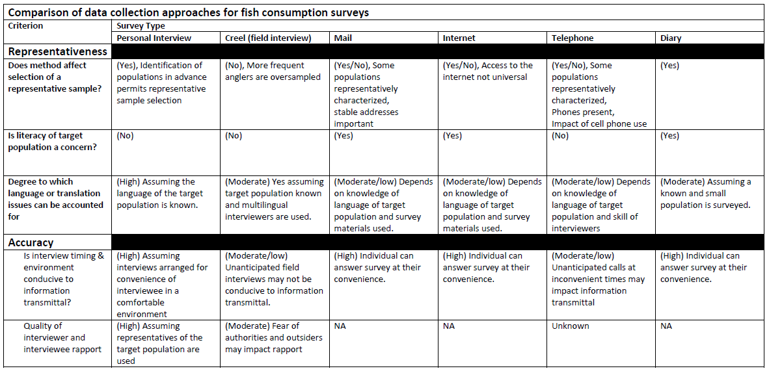

Slide 55
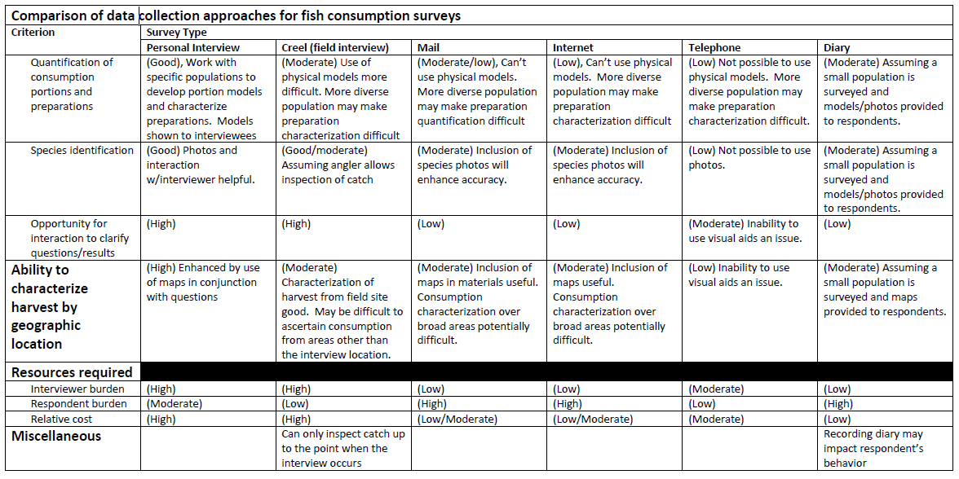

Slide 56
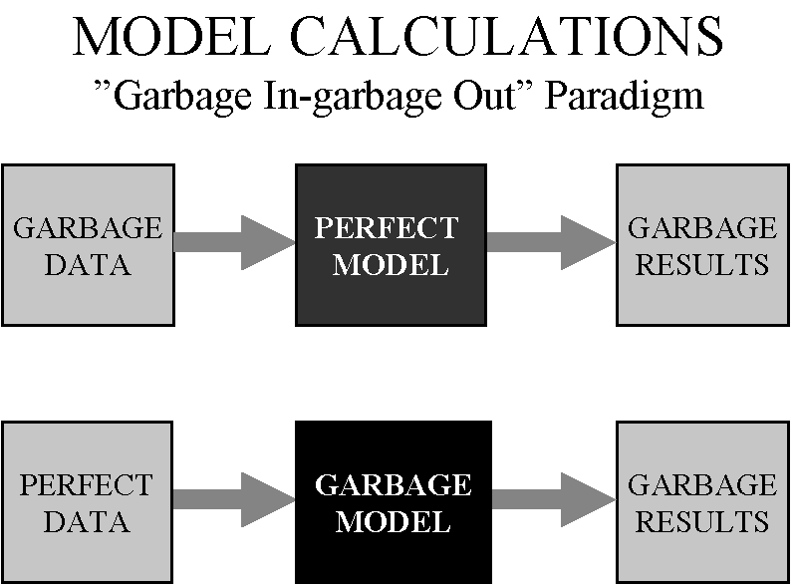

Slide 57
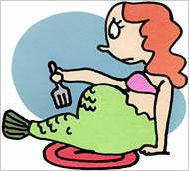
Questions?
Notes:
We are what we eat.
Let’s take a break

Slide 58
2015 Fish Consumption Research Literature Review
Identified by DEC as a first step in the HHC process
  Goal: Identify existing data, identify data gaps, and identify potential research needs
Contracted with The Cadmus Group, Inc. in 2014

Slide 59
Research Methods
Conducted telephone interviews with subject matter experts
Performed literature review (31+ different papers)
Criteria for Inclusion
  Specific to Alaska
  Fish or seafood from Alaskan waters (i.e., not tuna or canned sardines)
  Data sourced for consumption-not commercial sale
  Included data on collection method & QA/QC (when available)
  < 20 years old.

Slide 60
Available Dietary Surveys
Four Alaska dietary surveys with reported FCR were identified
  Two surveys conducted in Cook Inlet Region
  One in Aleutian Region
  One with statewide sample population
Four surveys that may have collected applicable data but did not report FCR in the study

Slide 61
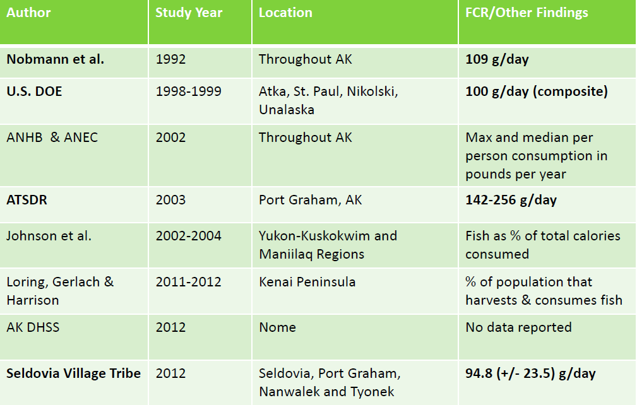
Alaska Dietary Surveys

Slide 62
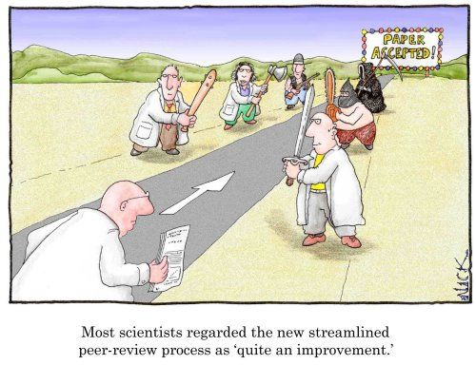
HHC Literature Review: Peer Review
DEC solicited four experts to conduct a peer review
  Lon Kissinger, Ph.D. U.S. Environmental Protection Agency
  Elizabeth Nobmann, Ph.D. EDN Nutrition Consulting
  Angela Matz, Ph.D. U.S. Fish and Wildlife Service
  Philip Loring, Ph.D. University of Saskatchewan (UAF affiliate faculty)
Panel provided:
  Comments on report (e.g., representativeness of findings, seasonal differences)
  Four additional sources to consider
Notes:
Panel provided extensive comments on how the document could be expanded to act as a primer to the HHC issue, key challenges-both technical and policy, and applicability to the state HHC revision process.
DEC wants to ensure that all parties interested in the issue have a chance to review the document as well as expert opinions on the subject.

Slide 63
Key Points from Peer Review
A need to consider ADF&G Harvest data as logistical and fiscal challenges exist
Consider inclusion of marine fish, marine mammals, and seaweeds
Consider federal data sources
Numerous issues with representativeness in the reviewed documents
A need to consider sampling of certain high fish consuming populations

Slide 64
Literature Review-what next?
Make the document(s) available to the general public for feedback
  Posting on DEC website
  Notification to stakeholders via WQS Listserv of
  Presentation at Statewide workshop
Engage with ADF&G and USFWS Subsistence staff to identify additional sources of information
Review new sources of data as they become available- Several tribes have indicated an interest in collecting consumption data.
Notes:
Sun’naq tribe (Kodiak) is in the process of conducting a FCR study
Talk of other tribes but DEC has little first hand knowledge as studies are funded by EPA through IGAP. No requirement to inform DEC about efforts as QAPP is reviewed by EPA. The burden of quality assurance is going to fall on EPA rather than DEC since we do not have a mechanism to ensure compliance with state quality assurance policies. Also important to note that the collection of this kind of data is not something that DEC-Water typically does. More of an ADF&G practice. Will take time for DEC to develop the expertise to review FCR surveys in any meaningful way.

Slide 65
ADF&G Subsistence Harvest Data
ADF&G collects harvest data from four defined fisheries
  Commercial, Sport, Personal Use, and Subsistence
Personal Use and Subsistence fishery data may be more predictive of consumption (may not necessarily be true in urban settings)
Alaska Subsistence Fisheries Database
  Total harvest by species, timing, and number of fishery participants
Community Subsistence Information System
  Info on most subsistence food types
  Includes info on local demographics and economies; description of data collection methods
Notes:
Harvest can be simply defined as the number of fish available for taking or have been taken. It does not directly mean that consumption took place as a person could give away, barter, or simply fail to eat an item. Thus, harvest data may overestimate actual consumption of aquatic life on an individual basis unless additional information is available.
ADF&G notes that 30% of households often produce 70% of the community’s harvest in terms of usable pounds of subsistence foods. (ADFG Economies and Subsistence doc)

Slide 66
ADF&G Subsistence Harvest Data cont.
Large volume of data to consider
  Understanding available data sources will require collaboration with ADF&G
  Additional information on usage, storage, preparation, and community characteristics may be available
Methodologies exist to convert harvest data to consumption estimates

Slide 67
Sources of Information: ADF&G Subsistence Division
Technical Paper, No. 261
Introduces a method for estimating measures of consumption based on annual harvest data from household surveys
ADF&G has some consumption rate information (Six statistical measures (e.g., mean, 50th, 95th)) for ~220 communities
Amount of information is dependent on level of detail (1-3)

Slide 68
ADF&G- Subsistence Presentation

Slide 69
Next Steps
Technical Workgroup Meeting #2: What is the appropriate Level of Protection for Alaska (September 29?)
  FCR: Consumers v. Nonconsumers
  FCR: General v. Highly Exposed population(s)
  Other Exposure factors
  Cancer Risk Value?
October Public Workshop (Tech. Workgroup Mtg #3?)

Slide 70
HHC Public Workshop
When: October 29-30
Where: Anchorage, Alaska Ctr. For Performing Arts
Why: Inform stakeholders on the issues, challenges and process
Additional details will be made available on DEC-Water website and DEC-Water-Standards listserv
Notes:
Alaska Tribal Conference for Environmental Managers (ATCEM) is taking place early in the week at the Hilton. Trying to coordinate with those who will be actively interested in this issue.
Goal is to provide stakeholders with similar information/ address questions about the process/ and identify individuals who may have technical expertise.
Other states have used this approach with success
Will not be using this as a venue for providing public comment-educational in nature. Opportunity for DEC and the public to learn about HHC and it’s different facets from experts in the field.

Slide 71
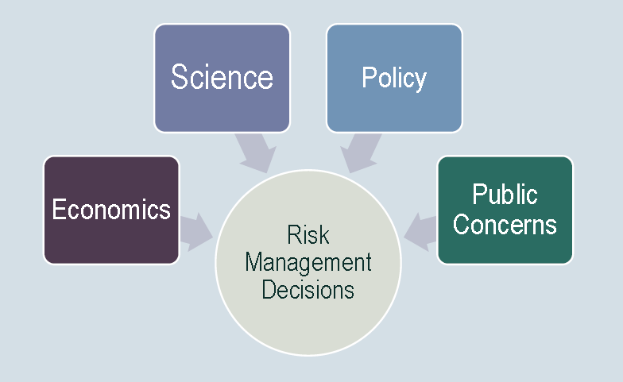
Decisions on HHC and various factors will account for multiple factors
Taken from WA State FC Presentation 2012
Notes:
Lots of factors to consider, different stakeholders and perspectives to consider, Cannot take a myopic approach as people’s lives and livelihoods are at stake.

Slide 72

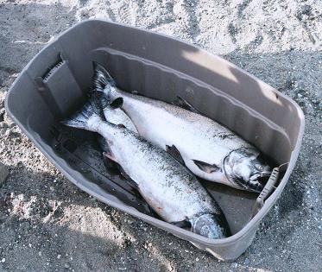
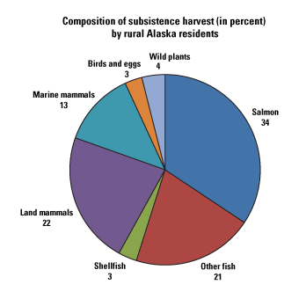
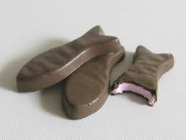
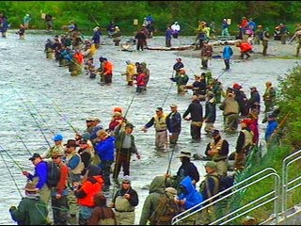
Thank you for your time!
ADFG 2010

Slide 73
Alaska Department of Environmental Conservation
Brock Tabor
Section Manager
(907) 465-5185
brock.tabor@alaska.gov
Denise Elston
Environmental Program Specialist
(907) 465-5018
denise.elston@alaska.gov
Division of Water http://dec.alaska.gov/water/index.htm

