Slide 1

Juneau Air Quality and Cruise ship Emissions Monitoring
DEPARTMENT OF ENVIRONMENTAL CONSERVATION DIVISION OF AIR QUALITY and DIVISION OF WATER QUALITY
January 29, 2019
1

Slide 2
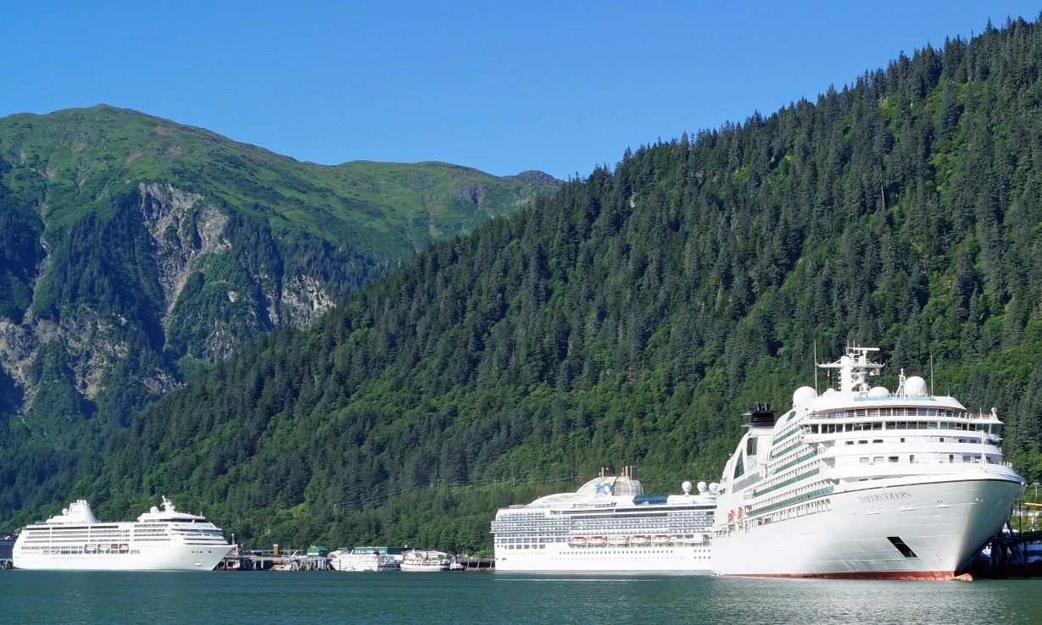
Who at DEC Monitors Cruise Ships?
Wastewater
Cruise Ships
Opacity
Air
Ambient Air Quality
Yellow – Division of Water Quality; Cruise Ships – Ed White
Green – Division of Air Quality; Air Monitoring- Barbara Trost

Slide 3
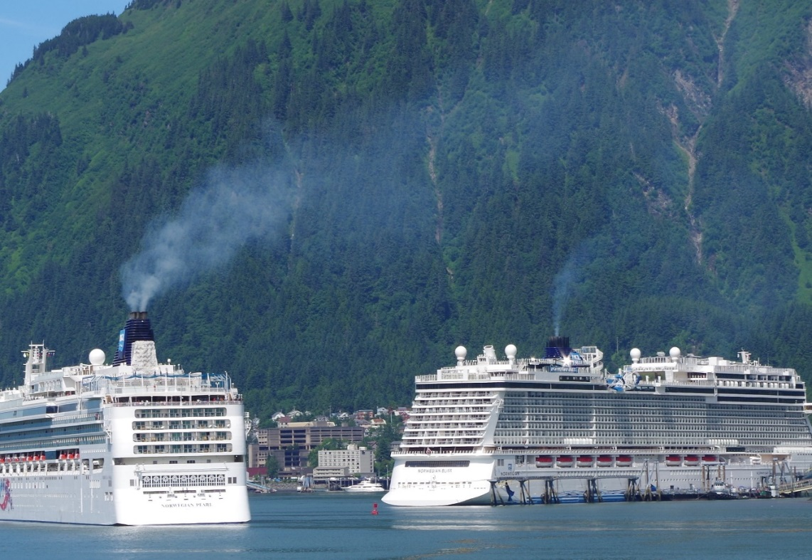
2018 Concerns and Questions
Public complaints and questions
Large increase in 2017 and 2018
Complaints from outside Juneau
Types of complaints
Increase in ship traffic and size of ships
Changes in ship operations

Slide 4
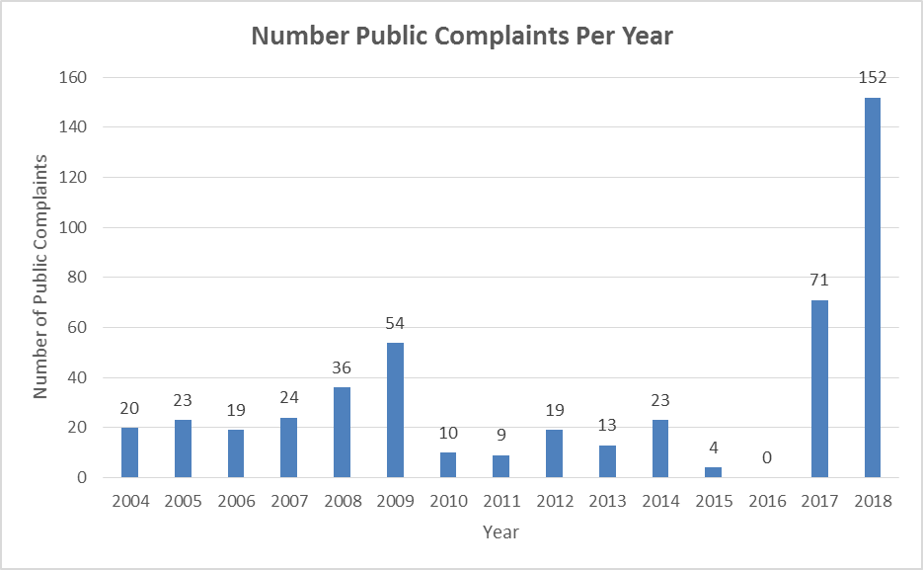
Public concerns and questions

Slide 5
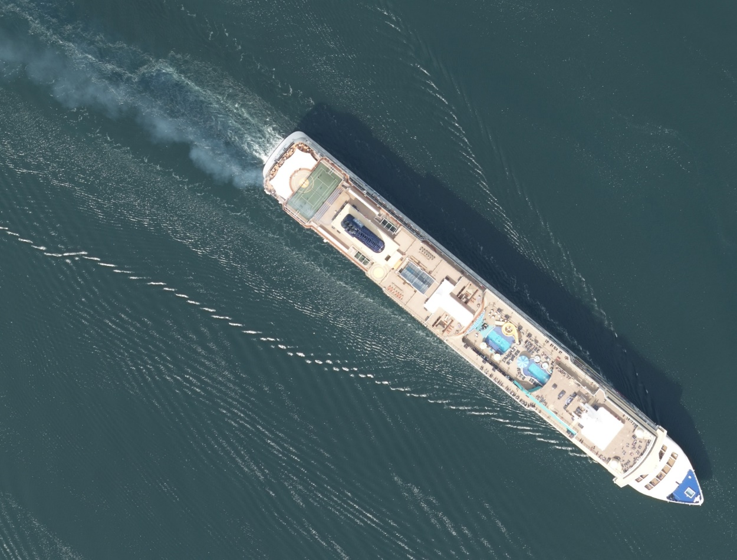
Opacity
All ships must comply with State’s Opacity limits
State of Alaska has been monitoring vessel air emissions since 1970s

Slide 6
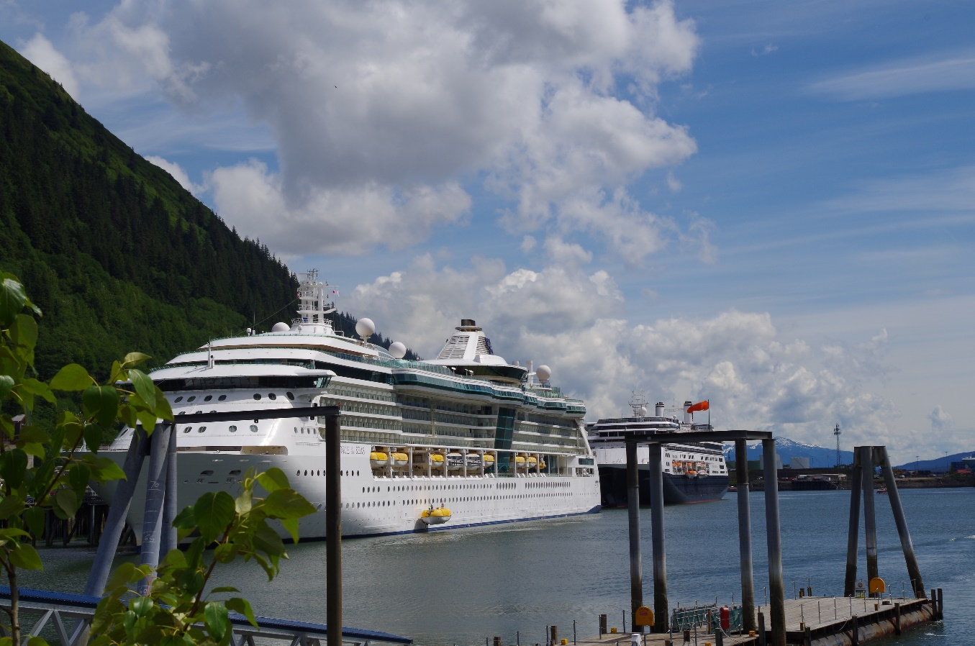
Ambient Air Quality
In 2000 an Ambient Air Quality study was conducted in Juneau due to concern about cruise ship opacity.
No exceedances of air quality standards were found in the 2000 study

Slide 7
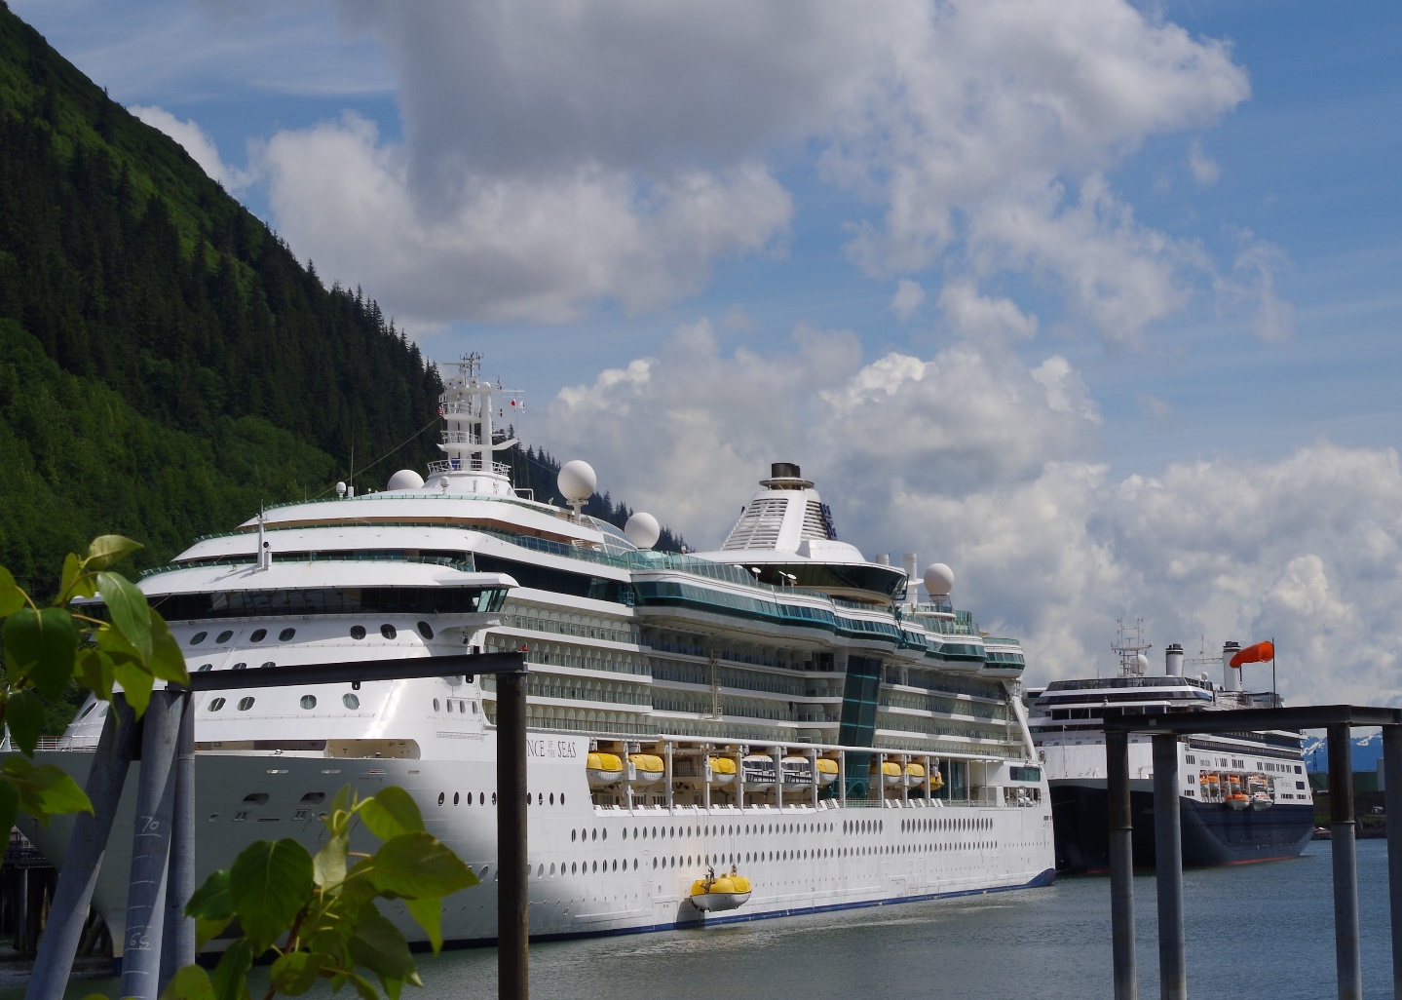
Information
DEC Cruise Ship website https://dec.alaska.gov/water/cruise-ships/

Slide 8
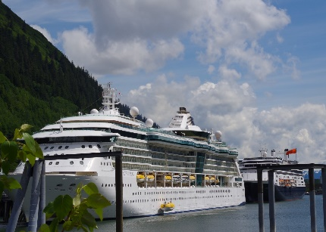

Cruise Ship Industry Impact on Air Quality
DEPARTMENT OF ENVIRONMENTAL CONSERVATION DIVISION OF AIR QUALITY and DIVISION OF WATER QUALITY
January 29, 2019
1

Slide 9
2019 Ambient Air Quality Screening Level Study
Objectives:
To address ambient air quality complaints centered on the cruise ship emissions
To determine which areas of downtown Juneau are most affected
To assess if the scale in terms of frequency, duration, spatial variability and severity of these impacts have the potential to significantly affect public health and/or violate Clean Air Act air quality standards.

Slide 10
2019 Ambient Air Quality Saturation Study
Saturation study:
study floods a small area with a large number of low-cost non-regulatory sensors for a short period of time, typically to answer a defined set of questions
• 20 non-regulatory PM2.5 sensors set up in a grid in downtown area
• 10 non-regulatory passive SO₂ samplers at selected sites on days with many cruise ships in port
• Site selections yet to be made: city and state buildings; volunteers
• Results of screening level study and available funding will determine future actions.

Slide 11
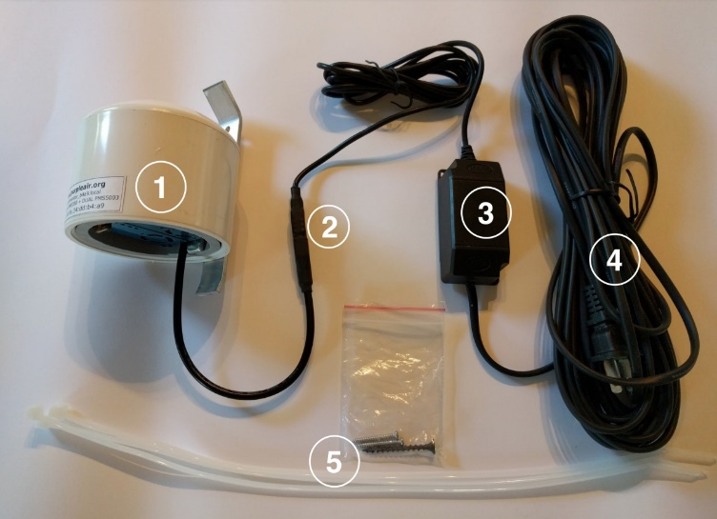
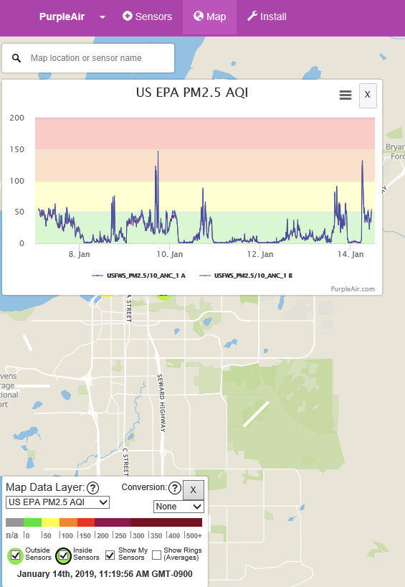
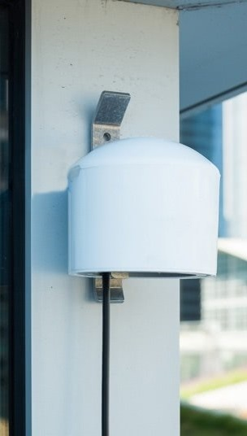
Saturation Study Equipment
PM_{2.5} → Purple Air
Continuous
Non-regulatory
Posts real-time data on website
20 sites –
Mar-May 2019 pre season
Jun –Oct 2019 maximum impact
SO₂ → Ogawa Passive Sampler
Integrated (12-24 hours)
Non-regulatory
Detection limit (24 hours) ~3.8 ppb (depends on lab analysis)
10 sites; 2 per week for 4 weeks

Slide 12
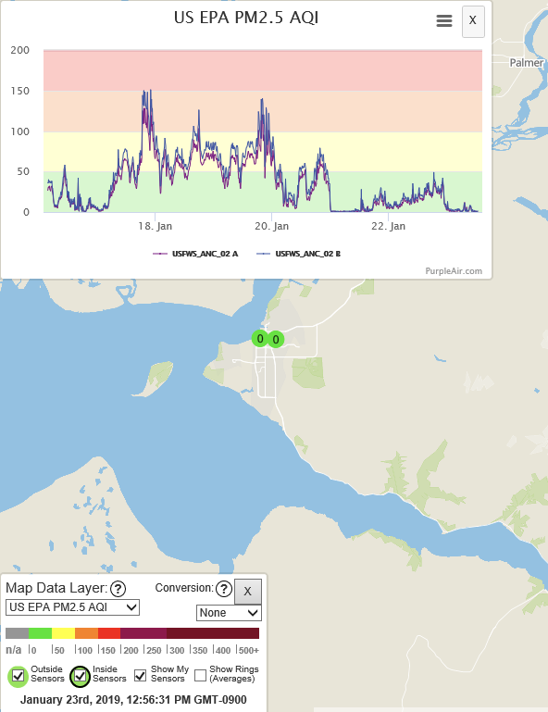
Access to data
Purple Air PM_{2.5}
• Wireless communication & SD cards
• DEC will develop website for the study
• May look something like this
• Still in planning phase
Ogawa Passive SO₂ monitors
• Not ‘real time’
• Exposed 12 - 24 hours
• Wait for lab analysis

Slide 13
Preliminary monitoring plan
Background Monitoring
Before the start of the cruise ship season on April 28, 2019
Purple Air:
grid pattern covering downtown Juneau
Power cost ~ $1/ month
Operating entire study period
Passive SO₂ sampler :
3 days chosen to have similar weather conditions to expected ‘worst’ days
Plume identification monitoring
• Passive Ogawa SO₂ monitoring
Located at a subset of Purple Air sites
Targeted sampling at days with large number of cruise ships in port (example 6 cruise ships in port on 5/28/19)
No power required

Slide 14

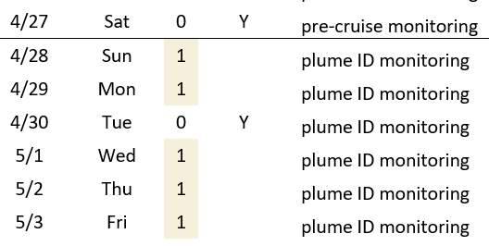
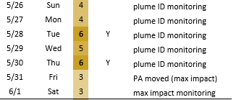
Passive Ogawa SO₂ monitoring
Targeted at days with large number of cruise ships in port (example 6 cruise ships in port on 5/28/19)

Slide 15
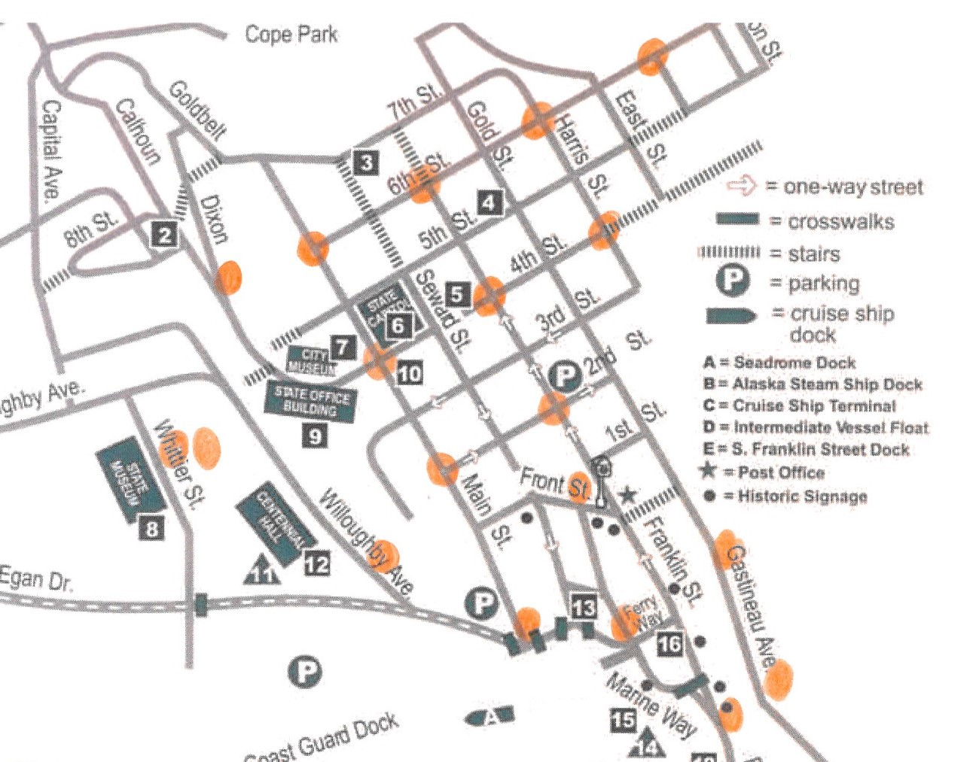
Example Sensor Grid
PM_{2.5} sensor locations
(Purple Air)
SO₂ samplers will be collocated with some of the Purple Air sensors

Slide 16
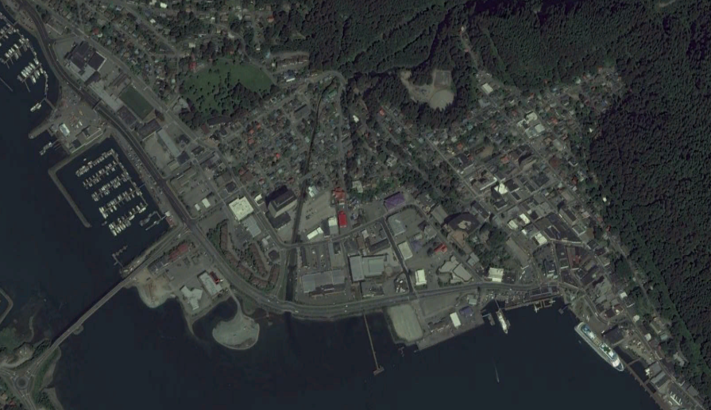


Help us help you…
Add information to the laminated map with sticky flags
Contact us!
Barbara Trost
AMQA Program Manager
barbara.trost@alaska.gov
907-269-6249
Anna Breuninger
Saturation Study Coordinator
anna.breuninger@alaska.gov
907-269-7573
Are you willing to host a monitor?
…. please leave your name, phone number, email and address & location proposed on the green signup sheet

Slide 17
Commercial Passenger Vessel Environmental Compliance Program “Cruise Ship Program” January 29, 2019
Large Cruise Ships (>250 passengers)
Small Cruise Ships (50 to 249 passengers)
Alaska State Ferries

Slide 18
Background Information
18 AAC 50.070 – Marine Vessel Visible Emission Standards
Exemptions are granted for initial startup & maneuvering
EPA Reference Method 9

Slide 19
Opacity Limits
18 AAC 50.070. Marine vessel visible emission standards
1)(A) While vessel is at berth or anchor (over 20% for up to three minutes )
(1)(B) While vessel is at berth during initial startup of the vessel preparing to cast off or weigh anchor (over 20% for up to six minutes)
(2)During the hour immediately after weighing anchor or casting off (up to 40% for an hour or up to 100% for nine minutes)
(3) During the hour before completion of maneuvering to anchor or making fast to shore (up to 40% for an hour or up to 100% for nine minutes)
(4)Vessel underway and not covered under 1-3 above (over 20% for up to three minutes )

Slide 20
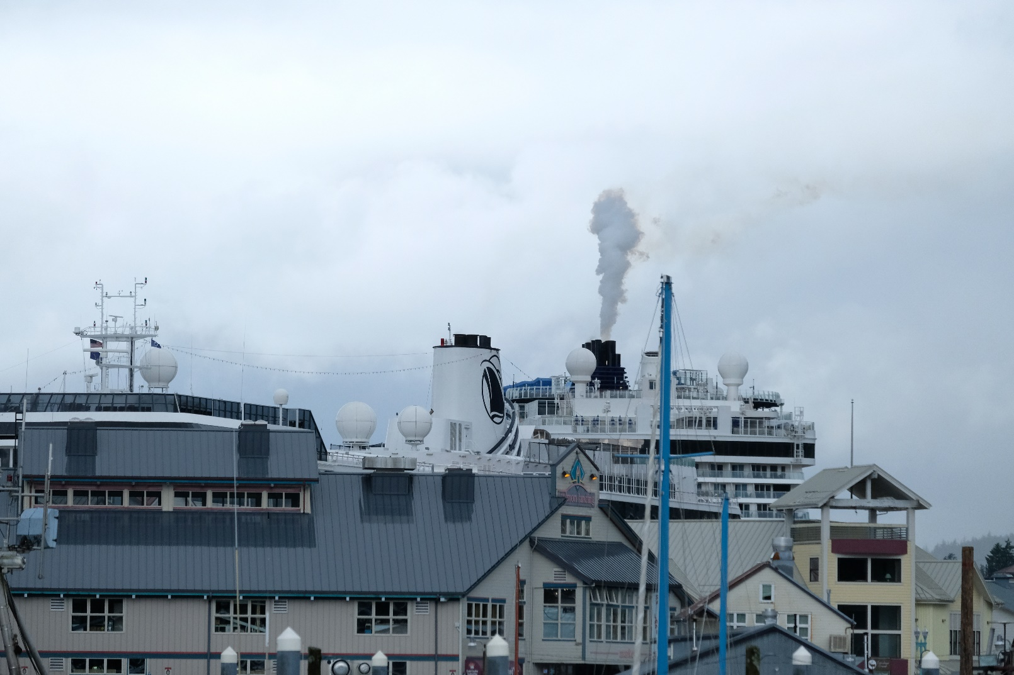
Opacity Monitoring of Cruise Ships & State Ferries

Slide 21
Opacity Monitoring Program
ADEC staff
ADEC Contractor
Minimum of 225 reading per cruise ship season
US Forest Service Rangers
Address Public Complaints
Conduct a Method 9
Contact the cruise line
Self-monitor (Continuous Emissions Monitoring)
Self-report under 18 AAC 50.240

Slide 22
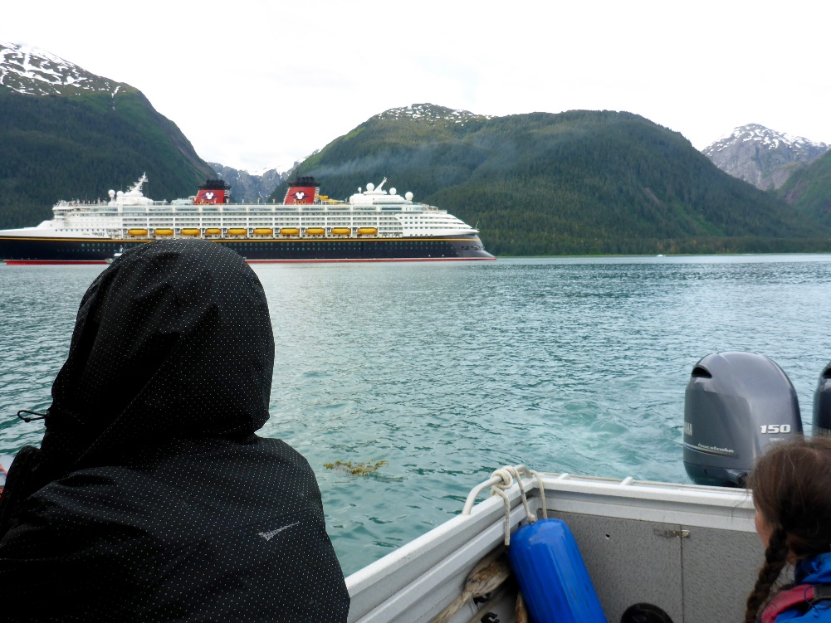
Opacity Monitoring in 2018
Opacity Readings Per Year Summary
Year | 2014 | 2015 | 2016 | 2017 | 2018
Number of Readings | 382 | 343 | 388 | 552 | 480
DEC and Contractor Opacity Reading Count by Port (2018)
Port | Number of Readings
Anchorage | 2
Haines | 2
Hoonah | 2
Juneau | 233
Ketchikan | 196
Seward | 3
Sitka | 16
Skagway | 26
Wrangell, AK | 3

Slide 23
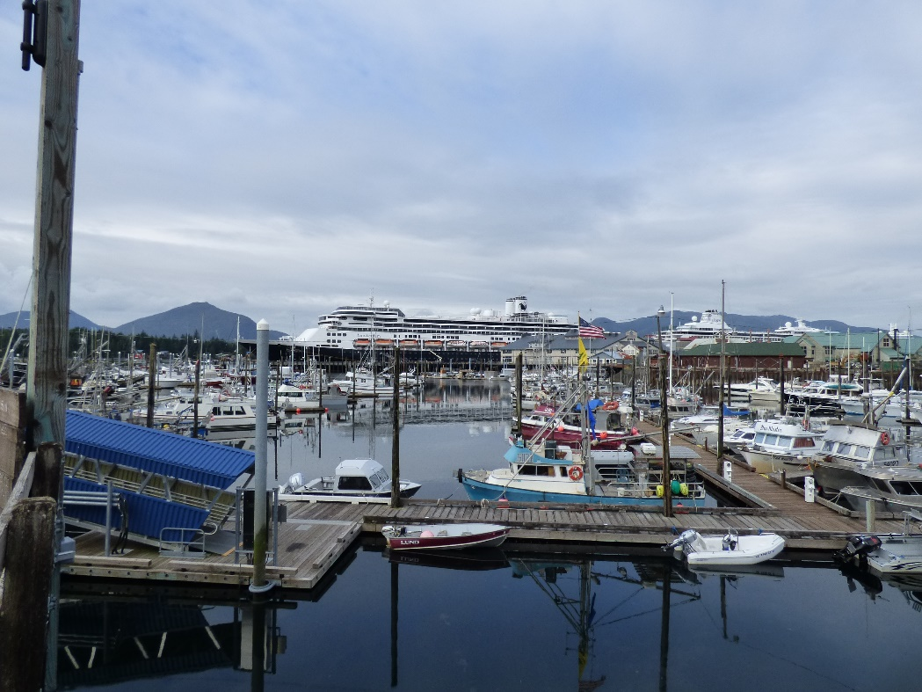
Opacity Enforcement in 2018
Opacity Enforcement Action Per Year Summary
Year | 2010- 2014 | 2015 | 2016 | 2017 | 2018
Violations | 49 | 0 | 0 | 2 | 9
Settlement totals | $533,125 | $0 | $0 | $75,000 | TBD
Opacity Violations Issued (2018)
Vessel | Date | Port | Status
HAL Nieuw Amsterdam | 6/19/18 | Skagway | Pending
HAL Westerdam | 6/20/18 | Haines | Pending
NCL Norwegian Jewel | 7/11/18 | Ketchikan | Settled
PCL Emerald Princess | 7/31/18 | Ketchikan | Pending
PCL Golden Princess | 7/31/18 | Juneau | Pending
HAL Eurodam | 8/2/18 | Ketchikan | Pending
RCL Radiance of the Seas | 8/8/18 | Ketchikan | Pending
RCL Radiance of the Seas | 8/17/18 | Seward | Pending
HAL Amsterdam | 8/24/18 | Ketchikan | Pending
5

Slide 24
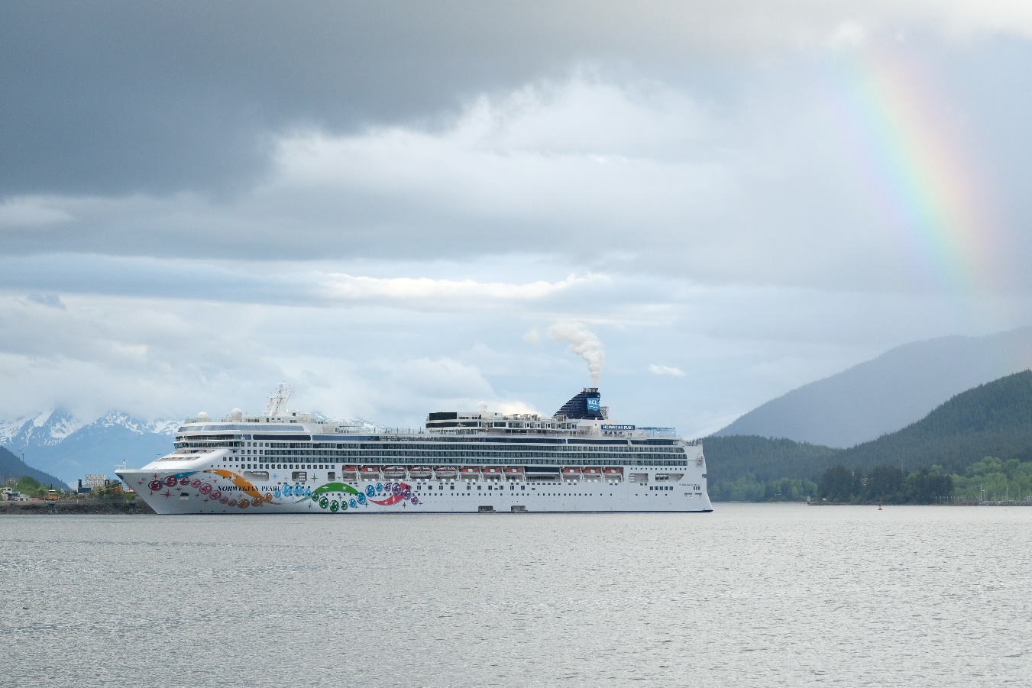
Questions?
Contact us!
Ed White
CPVEC Program Manager
edward.white@alaska.gov
907-465-5138
Denise Wiltse
Program Specialist
denise.wiltse@alaska.gov
907-465-5278

