Slide 1
Alaska Department of Transportation & Public Facilities
Spill Management Work Shop
March 30th, 2017
Northern Region Maintenance and Operations Engineering

Slide 2
Spill Management Workshop
ROW permitting necessary to perform work within the Departments ROW. Temporary Driveway permit if necessary.
Traffic control plans to ensure safety of the cleanup operations both for field crews and the traveling public.
General excavation limitations specifically with regards to roadway structure stability.
Material requirements – Backfill
Conditions of the site once cleanup activities are complete. (Embankment slopes, drainage, etc.)
Installation of permanent monitoring devices. (Monitoring wells etc...)

Slide 3

Spill Management Workshop – ROW Permitting
Information Required for Permit Application:
1.) Name and Contact Information of entity requesting permit.
2.) Location of proposed work.
2.) Description of work.
3.) Traffic Control Plan, which meets the requirements of the MUTCD.
4.) Anticipated Duration of Work.
Notes:
Insurance language is a common issue, state of alaska is certificate holder, cerificate holder not additionally insured (State must be additionally insured)

Slide 4
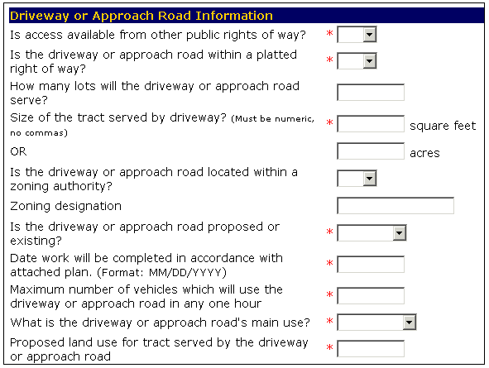
Spill Management Workshop – Driveway Permits
Online system
Will require a “planset” be attached.
Be Specific, vague plans cause delays.
Notes:
“planset” can be simple scratch pad drawing as long as important information is presented (email to M&O as well for expediancy)
Changes to plan are easier than being vague on initial submittal

Slide 5
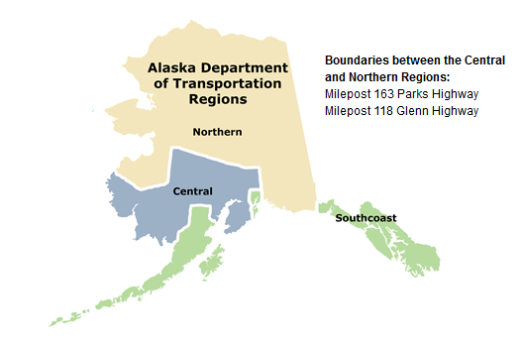
Spill Management Workshop – Common Permit Issues
Choose Correct Region – NR cant see CR permits and vice versa
Insurance – State of Alaska must be additionally insured, commonly certificate holder that is not additionally insured.
Description is too broad– Be as specific as you can we can work together to alter things after approval

Slide 6
Spill Management Workshop – Traffic Control Plans (TCP’s)
The Department will review proposed TCP’s prior to issuance of a ROW permit.
Due to variability of cleanup work a Traffic Control Supervisor (TCS) should visit the site throughout the project to ensure the TCP is functioning properly.
If the work description and or TCP changes this should be coordinated with the Department.

Slide 7
Spill Management Workshop – General Excavation Limits
Limits of excavation will vary depending upon the following and should be directly coordinated with the Department.
Depth of Embankment.
Time of Year (Frozen/Non-Frozen).
Subgrade Foundation of Roadway.
Roadway Geometry.
Duration of proposed activities and associated traffic control devices.
Impacts to roadway mobility and safety.
Notes:
If TCP is approved and protects area

Slide 8
Spill Management Workshop – Material Requirements
Material Requirements will be variable as well, based upon extent of excavation and roadway structure.
Normally most roadway materials and associated requirements are listed in the 2015 Standard Highway Construction Specifications and they can be found at: http://www.dot.state.ak.us/stwddes/dcsspecs/index.shtml

Slide 9
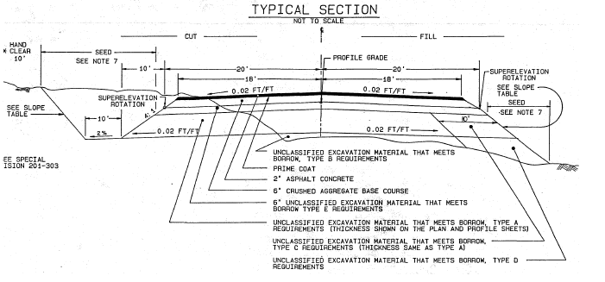
Spill Management Workshop – Material Requirements (Cont.)

Slide 10
Spill Management Workshop – Conditions of the Site After Cleanup
Drainage shall be uniform and re-established to pre-work conditions.
Roadway slope shall be finished and match pre-work conditions.
New disturbed soils shall be stabilized to prevent erosion.(seeding)
Notes:
Clean smooth slope is need for ease of maintenance, mowing, plowing, etc.

Slide 11
Spill Management Workshop – Installation of Permanent Features
Installation of ANY permanent features shall have additional permitting through our ROW Division.
Items to consider with permanent features:
Normal Routine Maintenance and Operations of the roadway and associated impacts (clearing, ditching, etc…)
Roadside safety of proposed feature.

Slide 12
Questions?

