Slide 1
Spill Response on Public Lands
A Land Manager’s Perspective

Slide 2
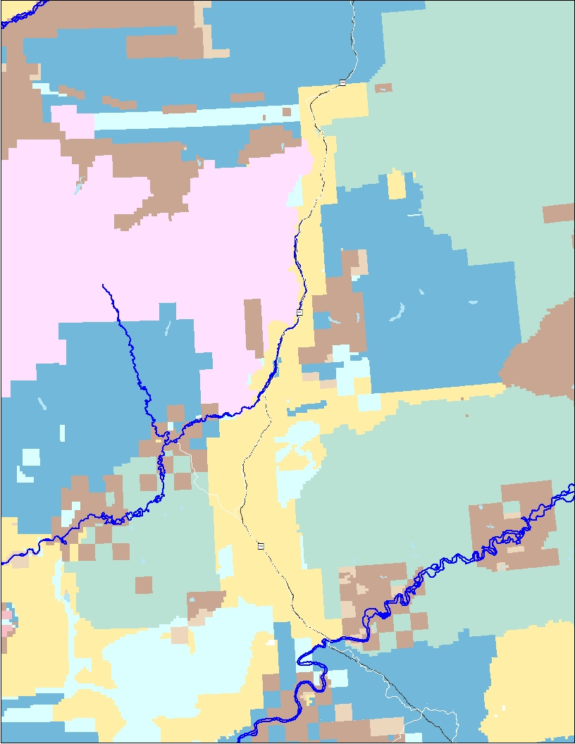
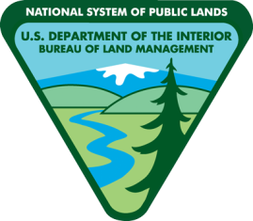
Federal Public Land
The majority of the land from the Yukon River to mile post 301 is Federal Public Land.
Unlike many highways in the state, the Dalton highway occupies a Federal right of way; the underlying estate is Federal Public Land.
TAPS occupies a Federal right of way. The underlying estate is Federal Public Land.
MILEPOST 301
(just south of
Slope Mountain)
COLDFOOT NODE
(State Land)
MAP
YUKON CROSSING

Slide 3
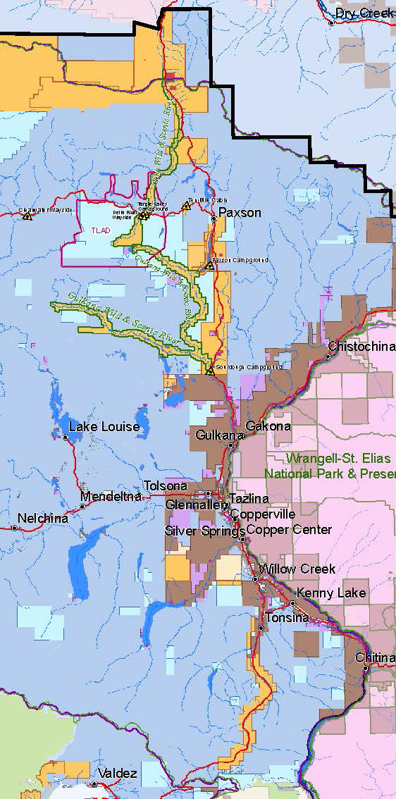
Federal Public Land
A large portion of the land from the Valdez to Delta Junction is Federal Public Land.
Unlike many highways in the state, portions of the Richardson highway occupies a Federal right of way; the underlying estate is Federal Public Land.
TAPS occupies a Federal right of way. The underlying estate is Federal Public Land.

Slide 4
Infrastructure on Public Lands
Developed and maintained by other agencies or companies
  Examples: Highways (DOT)
        Transalaska Pipeline (Alyeska Pipeline Co.)
BLM authorizes access via Right of Way (ROW) or Easement
Notes:
Think about administrative authority – JPO is only alyeska
The Dalton Highway is infrastructure owned by the State of Alaska. It occupies a right of way across land owned by the American Public and managed by the BLM under administration of the Central Yukon Field Office (CYFO).
TAPS is infrastructure owned by Alyeska. It occupies a right of way across land owned by the American Public managed by the BLM, with TAPS-related actions under administration of the Branch of Pipeline Monitoring and other actions under the administration of the CYFO.
As right-of-way holders, both Alyeska and ADOT have valid existing rights to use Federal Public land, and part of BLM’s job is ensuring that those valid existing rights are protected.

Slide 5
Spill Response Authority
Department of Environmental Conservation (DEC) leads response
Inside ROW or Easement
Outside Right of Way or Easement
Notes:
Inside ROW or Easement
Agency responsible for infrastructure coordinates with DEC
Outside Right of Way or Easement
BLM coordinates with DEC
BLM manages Trespass and Ancillary Land Use

Slide 6
Spill Response Outside ROW
Response/Cleanup Action
Site Restoration
Trespass/Administrative Costs/NEPA
Ancillary Land Use permitting

Slide 7
Response Actions and Restoration
Emergency Response
Remediation
Restoration
Monitoring
Notes:
Emergency Response Phase
Land Manager stays informed and provides information on resource concerns
NEPA will begin, but emergency response will not be required to wait on completion
Emergency phase is complete when site is stabilized (separate phase fuel is recovered and fuel will not migrate)
Not always black and white decision
Remediation
Actions must be authorized prior to execution
Still requires ongoing consultation with spill response agencies and other stakeholders as appropriate
BLM considers cleanup complete when:
ADEC’s cleanup requirements are satisfied
There may be times when BLM’s requirement is more stringent than ADEC’s, but it will never be less stringent.
Documentation of sampling methods and results are received by BLM, and both ADEC and BLM HAZMAT staff concur that the sampling is sufficient to demonstrate that cleanup standards have been met
Restoration
Site is regraded/recontoured to match surrounding terrain
Site-appropriate erosion control is established
BLM is satisfied that future land uses won’t be inhibited by the level of cleanup that is accepted
Reclamation is complete when:
Interests of all holders of valid existing rights are adequately addressed (ADOT, TAPS, other ROW or permit holders)
All Public safety hazards resulting from the spill or the response have been eliminated
Revegetation objectives have been met
Self-sustaining native vegetation, trending toward natural diversity
Sufficient cover and root density for natural erosion control
Absence of invasive species
Impacts to other resource values are mitigated (viewshed, forest health, recreation, etc.)
importation of fill to Public lands may require BLM pre-approval, even as part of emergency response
Weeds are a major concern when importing fill
Monitoring
Purpose is to document reclamation success and detect reclamation failure so corrective actions can be taken.
Involves formal monitoring, documentation, and reporting (not just drive-by assessments)
Depending on site-specific issues, may include things such as photo documentation of greenup, vegetative cover and diversity measurements, invasive weed inventory, root mass samples, post-breakup erosion assessments.
How long? Depends on site specific conditions, but generally not until monitoring results show that reclamation objectives are being met in the second growing season after reclamation is completed.

Slide 8
Trespass
(43 CFR 2808.10)
Using, occupying, or developing the public lands/resources without authorization
Non-willful trespass is by mistake or inadvertence.
An accidental release of hazardous materials to Public lands is a non-willful trespass.

Slide 9
Ancillary Land Uses
Other uses of Public Land ancillary to the spill response (monitoring wells etc.)
Requires a land use permit (Form 2920-1 project plan)
Accessing fill material requires separate authorization with associated fees
Notes:
Examples are Camps, staging/storage areas
Ancillary uses of public lands may require separate NEPA and issuance of a land use permit

Slide 10
Key Information for Project Plan
Site map with either lat/long or legal description
Thorough description of emergency response activities
Equipment staging (locations, quantities, durations)
Fuel and POL management (storage, quantities, spill prevention, spill preparedness, drip pan usage, etc.)
Camping or crew lodging arrangements
Refuse and waste management
Interim stabilization measures (berms, barriers, ditching, erosion control, etc.)
Plans to ensure Public safety (in conjunction with ADOT & TAPS)
Documentation of coordination/concurrence with other stakeholders (ADOT, TAPS, Utilities, etc.)
Excavation plans (equipment, sequence, etc.)
Water management plan, if applicable
Disposal plan for contaminated materials (location, method, documentation)
Material source needs
Invasive weed prevention and management measures
Measures to protect other resource values (forest health, viewshed, recreation, etc.)
Final site reclamation plan
Revegetation Objectives and methods for achieving them
Monitoring Plan to verify reclamation success
NO NEED TO WRITE IT ALL DOWN!
We’ll work with you if you end up in the situation where you need to submit a plan.
The point is that the plan has to be a thorough
and detailed project plan covering everything from beginning to end.

Slide 11
Administrative Costs
Trespass
Rental
Rehabilitating/Restoring land damages
Monitoring
Permitting for ancillary purposes
Notes:
Trespass
Must reimburse the U.S. for all costs incurred in investigating and terminating the trespass
Additional penalties for repeated non-willful trespass or unreasonable delay
Administrative Costs
Rental for lands occupied
Spill site, until remediation and monitoring is complete
Ancillary sites until reclamation (and monitoring if required) is complete
Material Sales
Fill obtained from Public Lands must be obtained through a mineral materials sale
Obtaining from ADOT or Alyeska is not a legal option in many cases
Cost recoverable permit process + yardage royalty
< 5000 yards can be authorized under a CX (relatively quick process); anything greater requires an EA (lengthy process)

Slide 12
National Environmental Policy Act Compliance
Documentation per the National Environmental Policy Act (NEPA) is required.
  Processing under trespass the BLM prepares the NEPA analysis, usually an environmental assessment which requires full cost recovery.

Slide 13
Questions?

