Slide 1

Mile Post 164.5 Incident
Lessons Learned Presentation to ADEC
Hank Herglotz, Colville Safety Manager

Slide 2
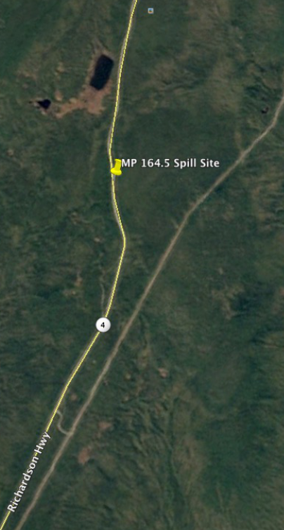
Incident Overview
Date: January 09, 2017
Time: 3:15 p.m.
Location: Mile Post 164.5 of the Richardson Highway
What Happened: A Semi-Truck with a Double Set of Trailers Departed the Roadway
Root Cause: Driver Steered Into Over-Plow of Road
MP164.4 Richardson Hwy

Slide 3
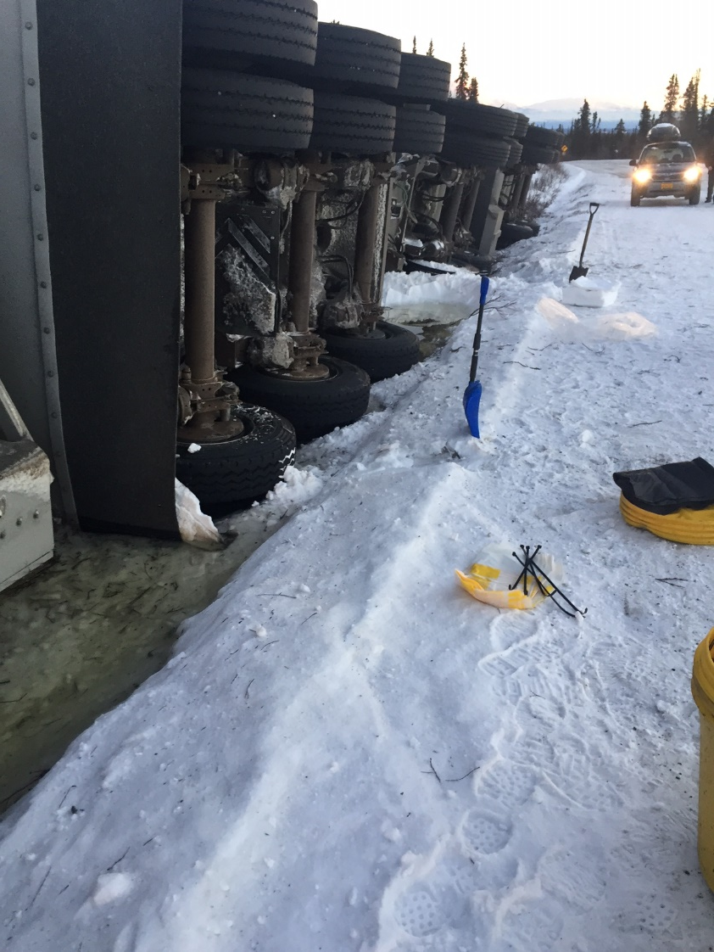
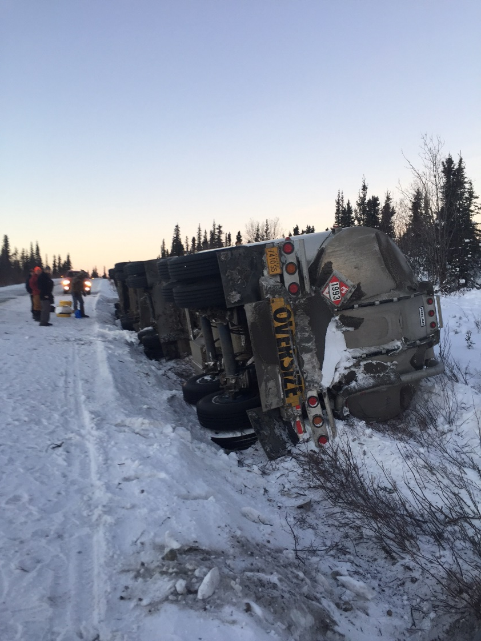
Mile Post 164.5 Incident

Slide 4
Incident Outcome
Driver Injured with 18 Lost Days of Work
Lead Trailer, Forward Compartment breeched upon impact
Approximately 4000 Gallons of ULSD Spilled on the roadway
Tractor, Lead Trailer & Pup Trailer Damaged
Recovery Operations
Environmental Clean-Up

Slide 5
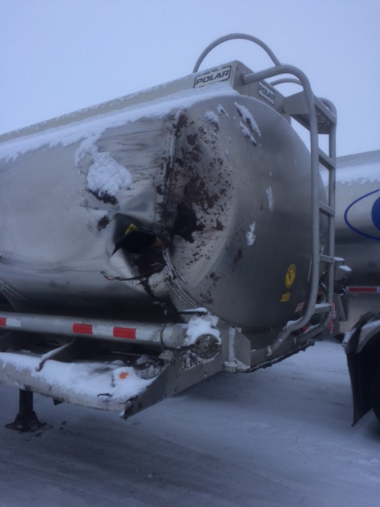
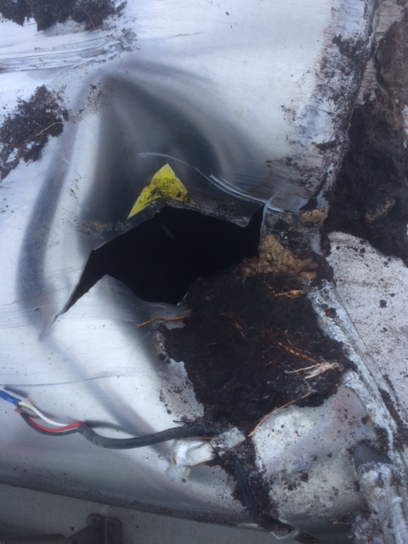
Incident Outcome…Cont’
Notes:
Compartment breech of the Lead Trailer

Slide 6
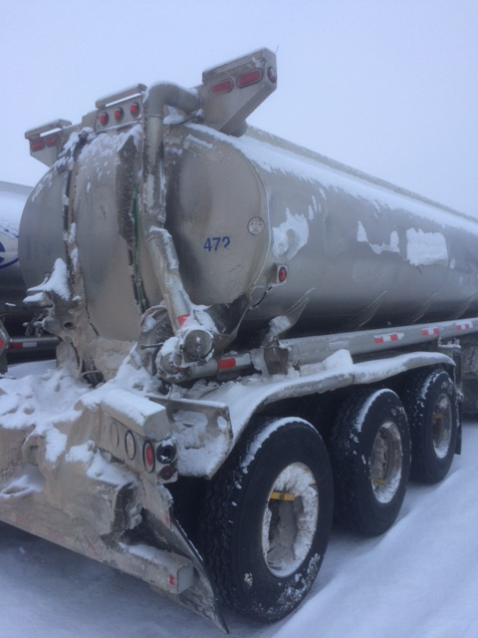
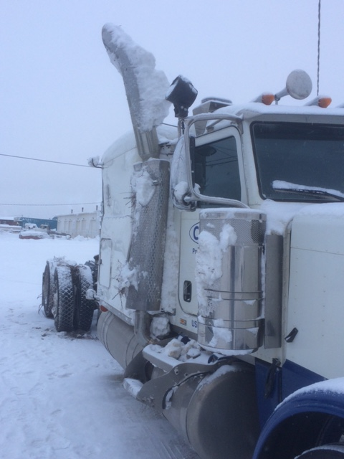
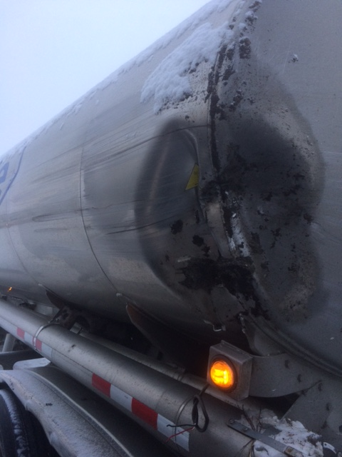
Incident Outcome…Cont’
Notes:
Left Photo - Damage of Semi Truck
Right Photo – Damage to the aft and forward section of the Pup Trailer
Estimated Cost of Repair – Pushing in the upward amount of $100,000

Slide 7
Timeline of Events
9 Jan – Incident Occurred
Activated Incident Command; Agencies notified
On site recovery operations initiated
10 Jan – Response Plan in place
11 Jan – Mobilized Equipment to Site
Executed Response Plan

Slide 8
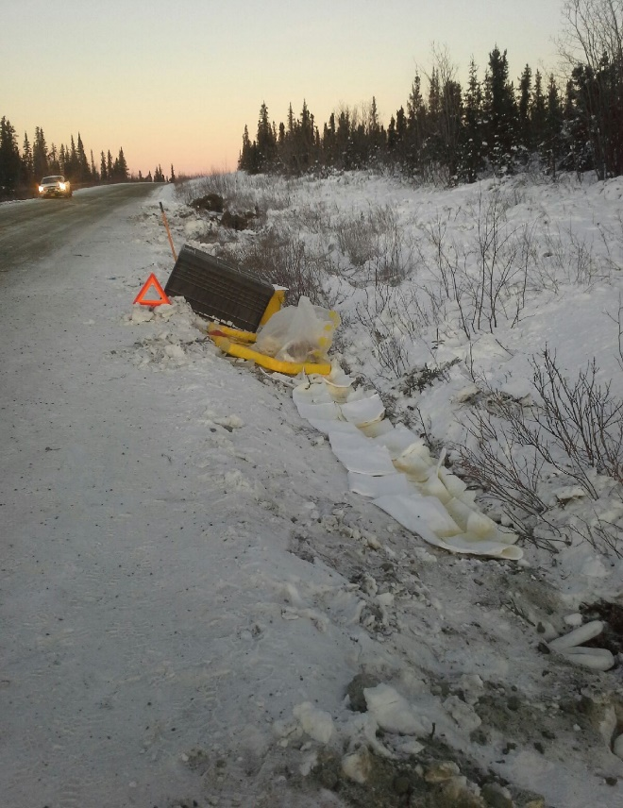
Site Reconnaissance
Survey Environmental
Sensitive Areas
Terrain
Critical Infrastructure
Potential Impact
Resources Required
Equipment
Personnel
5017760 -- Vehicle 32-123 right steer tire blow out
Notes:
Investigation of site allowed accurate delineation of site, much more effective in the long run. When able this is advisable.

Slide 9
What Went Well?
Tanker Recovery Operation
Response Van Availability
Site Investigation
Delineation of Impacted Area
Snow/Free Product Removal
Excavation Progressed Smoothly
No Injuries or Incidents!
Notes:
Tanker Recovery Operation
- Swift response, Very good collaboration
- Spill kits from other companies (Buckets for Leaks and Absorbs for Free standing)
- Lodge owners – Meyers lake lodge.
Response Van - Available and loaded with equipment
Site Investigation – Went well (Minor Comments in Equipment Slide)
Delineation of Site
- Product remained in a relatively small area
- No threat of Waterways
- Just slightly under road prism
Snow/Free product Removal initially/recovery of product later
Management of Dig
- simultaneous operations (More efficient/Increased risk)

Slide 10
Challenges / Surprises
Dog Race in Vicinity During Spill Response
3rd Party Insurance Consultant assigned as follow-on Incident Commander
Unfamiliar with Alaska’s Operating Conditions
Stakeholder limited in Contractor Selections
Equipment
Availability, Quality, Condition
Environmental Factors
Notes:
Spill occurred right in the middle of a Dog Race Event
Concern of spill impact for event
Lodging for spill personnel at Meier’s Lake Lodge
Assigned by 3rd Party Insurance
Unfamiliar with Alaska’s Operating Conditions
Stakeholder not involved in Selection Process
Communication between agencies
Incident Site & Local Terrain
Culvert in road prism
Planned road construction in the future
Limited on the Dig. 1:1 Ratio
Truck turn around distance
Equipment
- Excavator Bucket
- High Quality GPS
Environmental Factors
Weather Conditions
Wildlife concerns (Mylar in response trailer)

Slide 11
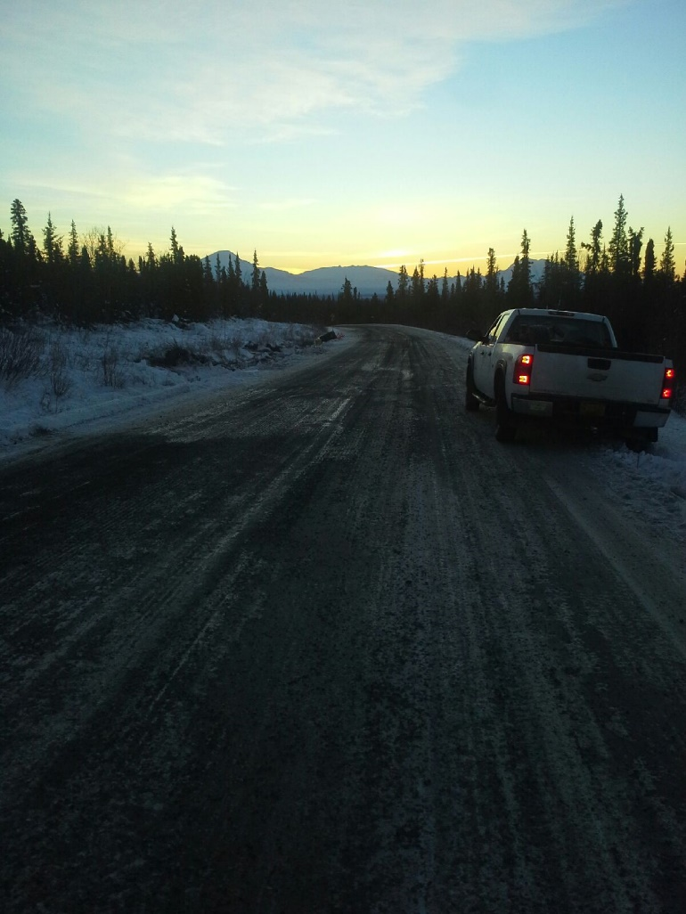
Milestones
Excavated Contaminated Soil & Materials from Site
Backfilled with Approved Gravel Source
Monitoring backfill area for erosion, Future Plans to be Determined
Insert Photo Here of Google shot
Notes:
Excavated materials were thermally treated in North Pole
Will monitor for erosion of backfilled area, further work not expected until road construction
Monitor Site Until Spring, When Operations Resume only monitor for erosion of backilled area, further work not expected until road construction
Excavated Materials On- Site Removed and thermally treated in North Pole
Backfilled with Approved Gravel from BLM pit at Miers Lake, its very sandy which is an issue from erosion standpoint, local backfill important to limit importation of weeds
Incident On-Going , Further Plans to be Determined major work complete, surface restoration likely needed

Slide 12
Simple “Take-Aways”
Communication
Up channel Information
Agencies (ADEC, BLM, DOT, etc.)
Internal Communication
Establish timeline of events
Single Gatekeeper
Information Flow, Catalog & Retrieve
Photographs, Reports & Statements

Slide 13
Questions?

