Slide 1
Alaska Trucking Spill Management Workshop
Anchorage
April 4th 2017
Bob Whittier
Matt Carr
EPA

Slide 2
Notification Procedures
Federal Regulations and Jurisdictions

Slide 3
Notification Procedures
§ 110.6 Notice.
Any person in charge of a vessel or of an onshore or offshore facility shall, as soon as he or she has knowledge of any discharge of oil from such vessel or facility in violation of section 311(b)(3) of the Act, immediately notify the National Response Center (NRC) (800–424– 8802)

Slide 4
Definition of Discharge
Authorities… CWA, OPA
US Waters
Oil Spill Liability Trust Fund

Slide 5

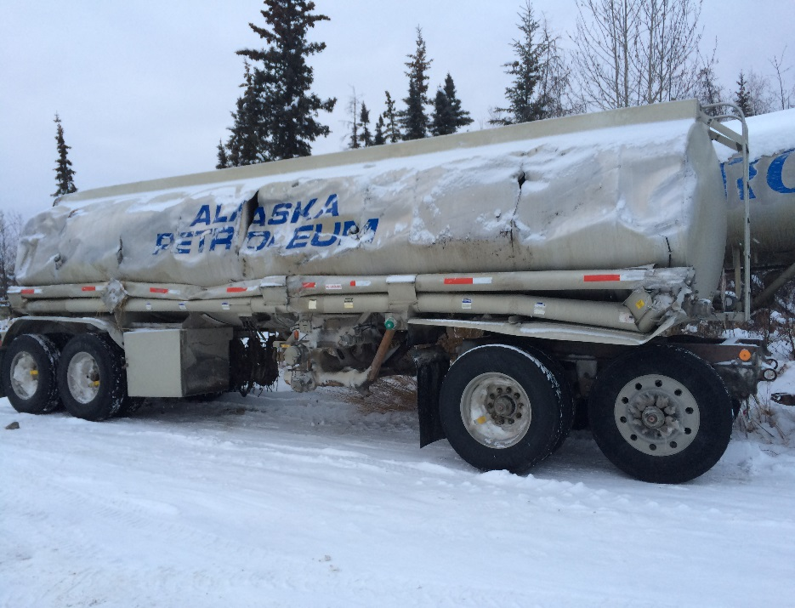
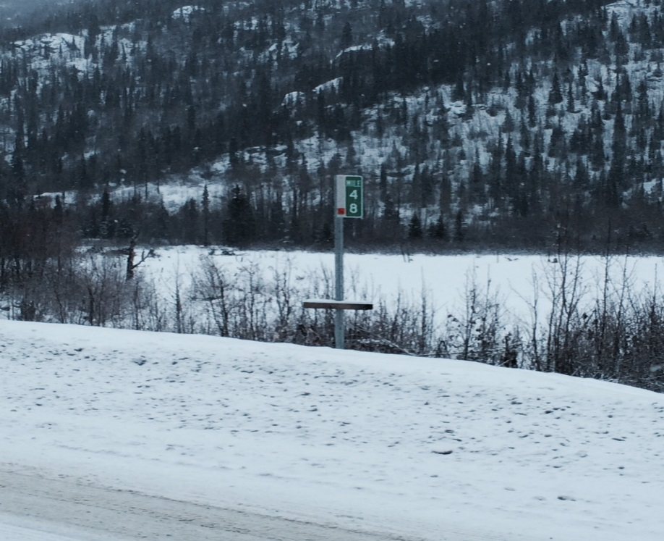
RESPONSE
MP 48 Richardson highway Diesel Discharge
ADEC photo

Slide 6
BACKGROUND:
On December 09, 2014 a “pup” tanker rolled over on the Richardson Highway at MP 48 discharging its contents.
4400 gallons of low sulfur diesel fuel
Discharged directly to a frozen creek bed
Why EPA?
Large quantity directly to a Navigable Waterway of the US
PRP’s inability to pay
Sensitivity of the area; salmon habitat, tributary to the Copper River, subsistence use, etc.

Slide 7
Chronology:
Incident occurrence December 09, 2015
December 11, 2014: Arrived on site and formed UC. PRP contractor to represent PRP. PRP issued a NOFI.
December 12, 2014: clean up activities commenced with PRP contractor and consultant.
December 17, 2014: PRP contractor notified EPA, and ADEC that insurance/funding was insufficient.
The PRP was issued an EPA Administrative Order. “Could not comply due to lack of resources”.
December 20- January 5: Funding secured via OSLTF, Work plans developed with EPA contractor.
January 5-17, 2015: Clean up activities, soil removal and creek restoration.

Slide 8
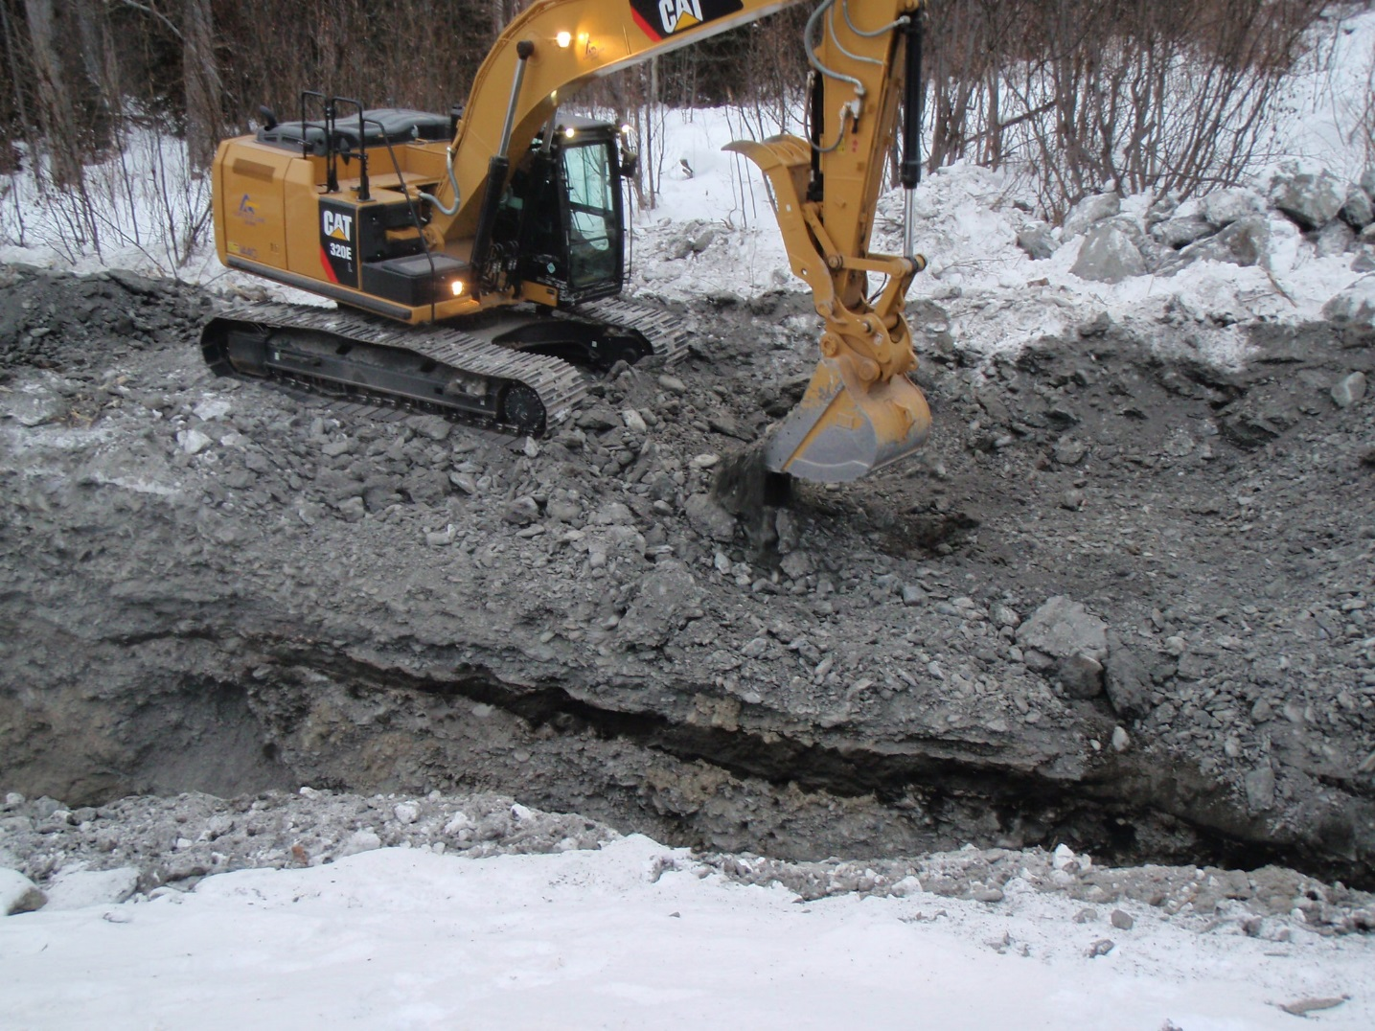
Excavation Operations “Note contaminated sill”

Slide 9
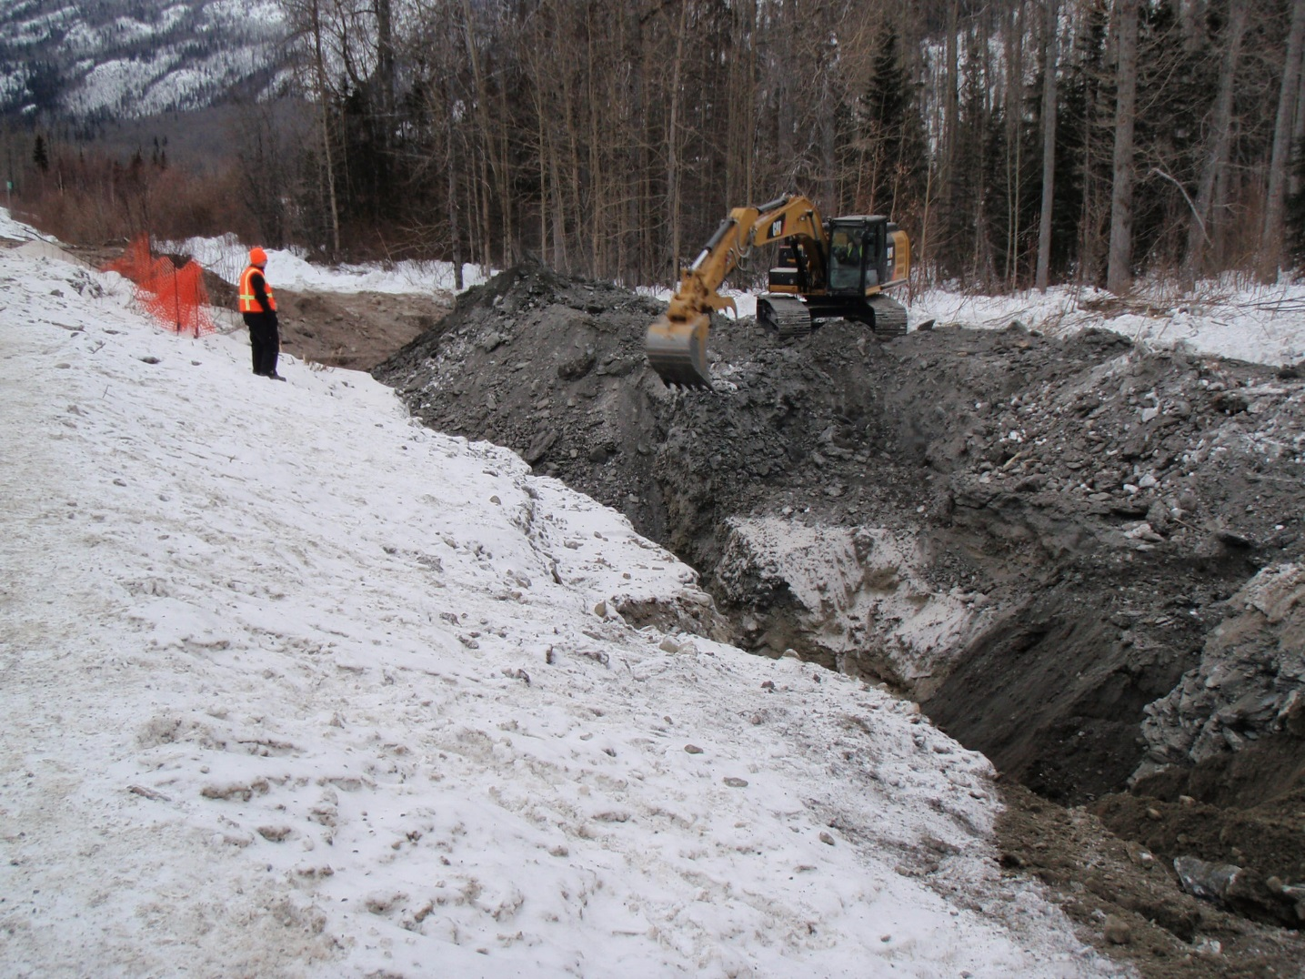
“Benching” to Access Contamination at Depth

Slide 10
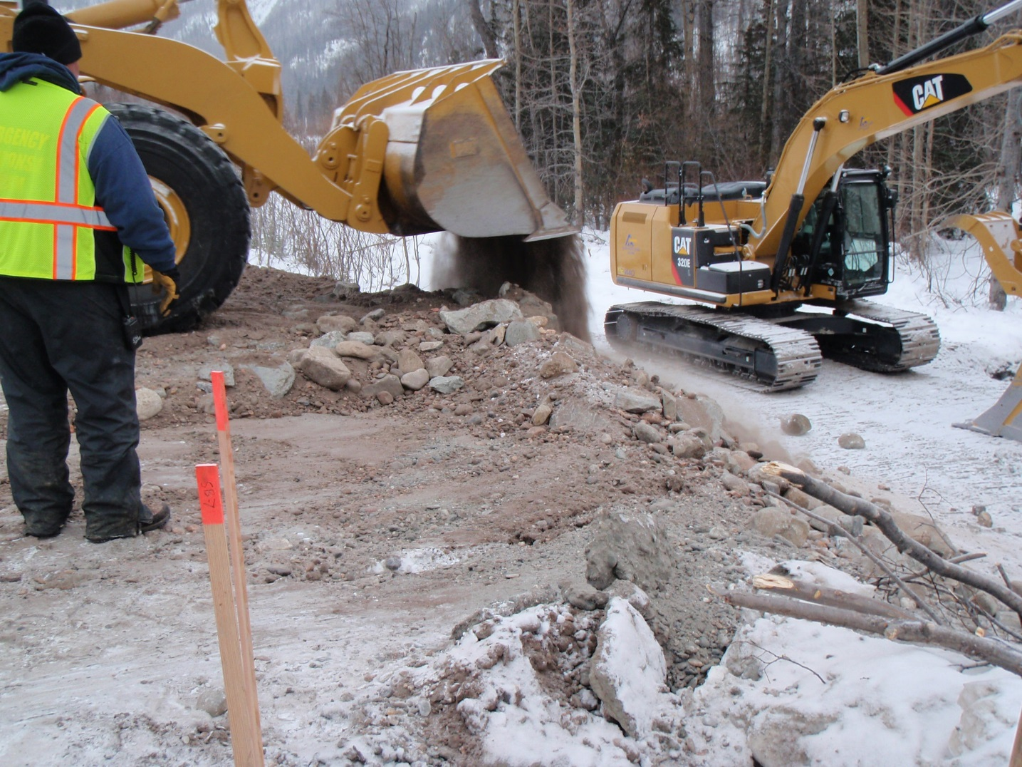
Backfilling with Comparable Materials

Slide 11
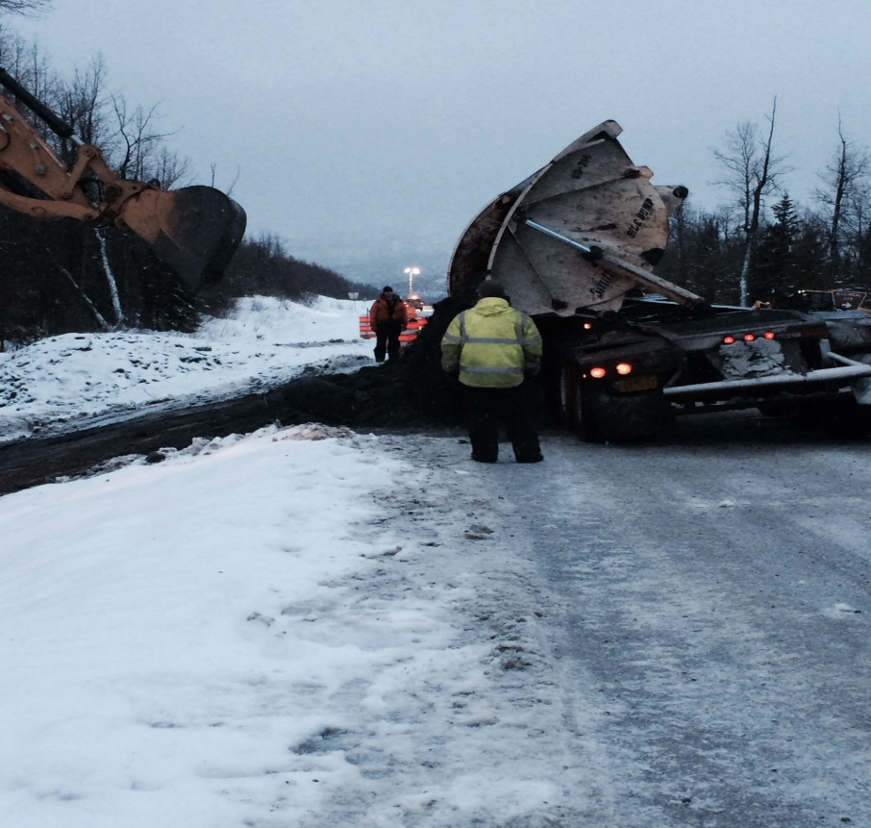
Issues/Concerns
Sub-zero temperatures, snow, freezing rain
“Cold soaked” equipment
Poor road conditions
Long distance travel
Material frozen in “Side Dumps”
No connectivity, Sat connections very poor

Slide 12
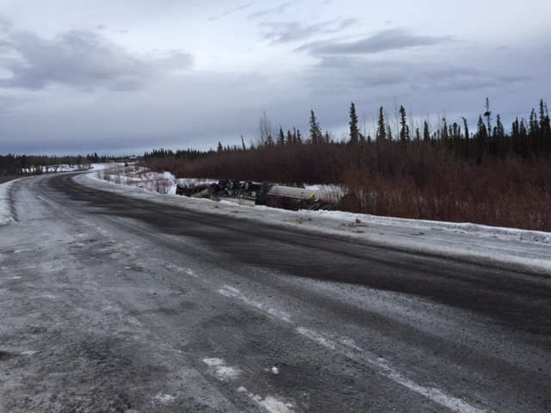
Others
MP 89 Richardson HWY

Slide 13
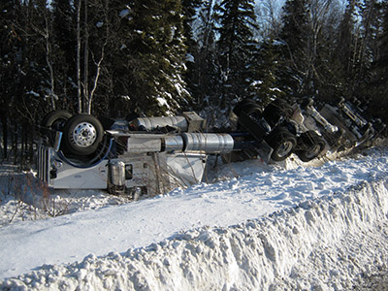
MP 86 Dalton HWY

Slide 14
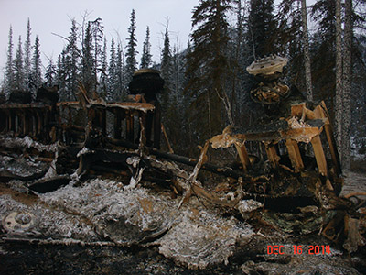
Wiseman Corner-Dalton HWY

Slide 15
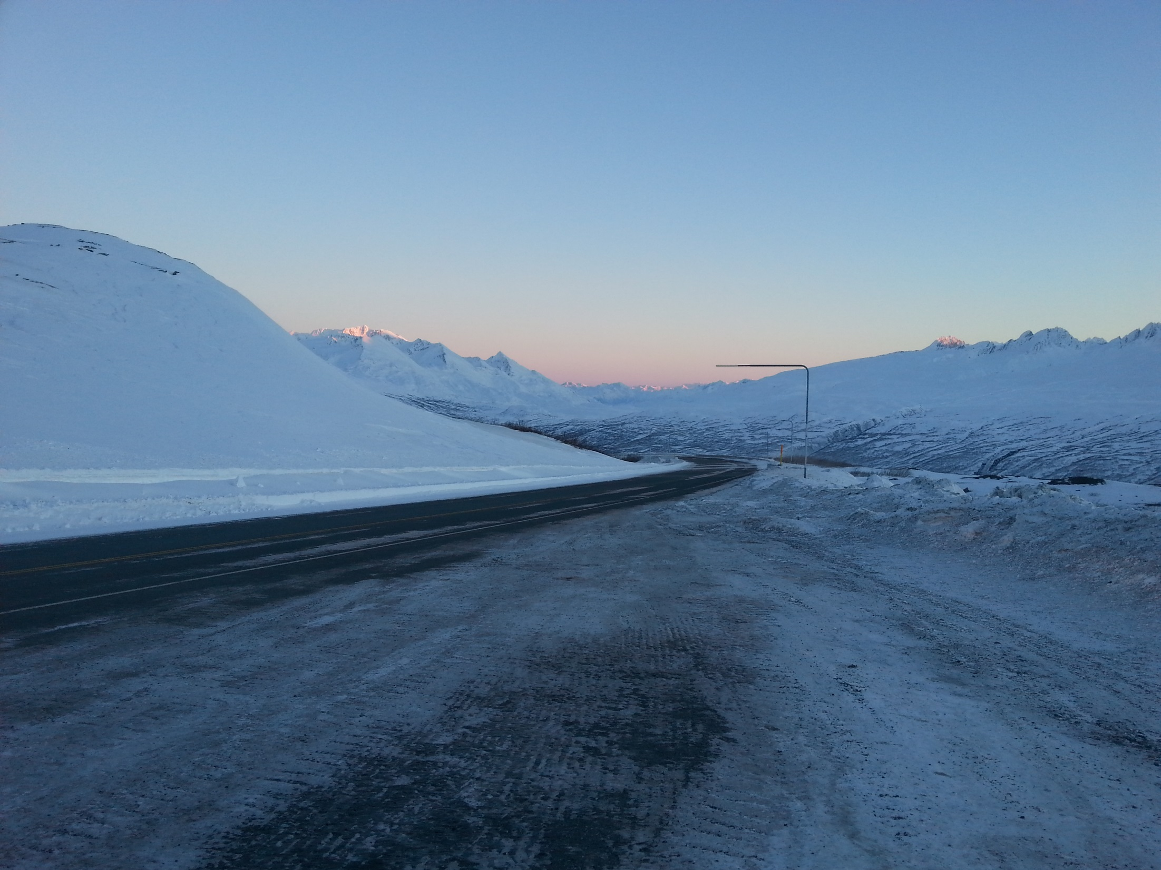
Questions

