Slide 1
Office of Hazardous
Materials Safety

Slide 2




PHMSA’s Hazmat Safety Mission
PHMSA's mission is to protect people and the environment by advancing the safe transportation
of energy and other hazardous materials that are essential to our daily lives.

Slide 3
OHMS Divisions
PHH-10
Standards & Rulemaking
PHH-60
Program Development
PHMSA
Administrator
PHH-1
Office of the Associate
Administrator
PHH-20
Engineering & Research
PHH-30
Approvals and Permits
PHH-40
Field Operations
PHH-50
Outreach, Training, & Grants

Slide 4



Hazmat Shipments in the U.S.
Up to one million shipments daily
1.6 billion tons shipped annually by all modes
Over 34 million containers entering U.S. ports annually
Over 12 % of all freight tonnage shipped annually

Slide 5
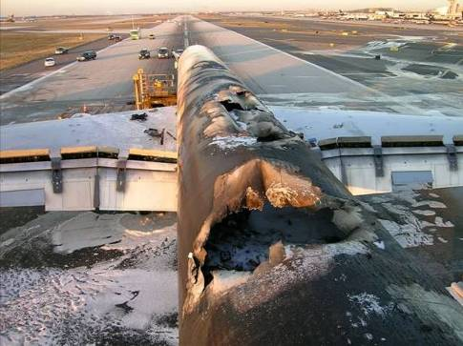
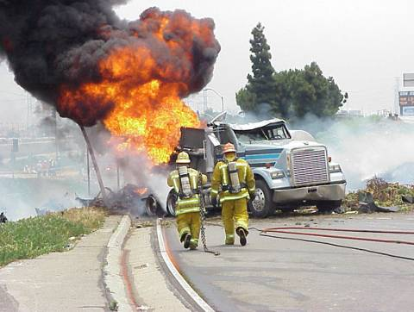
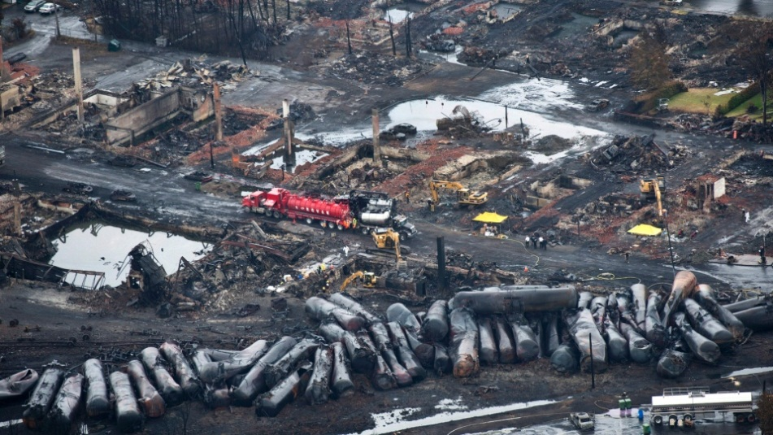
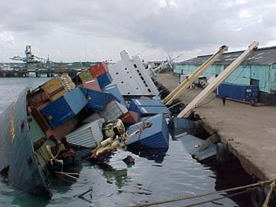
What We are Trying to Prevent

Slide 6

A Globally Harmonized System

Slide 7
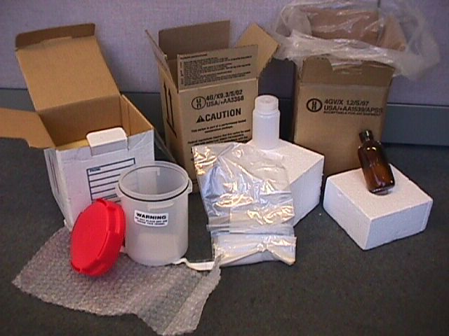
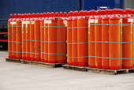
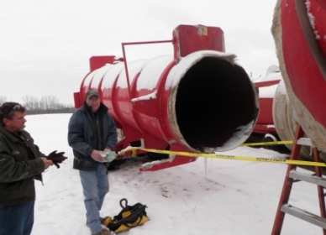
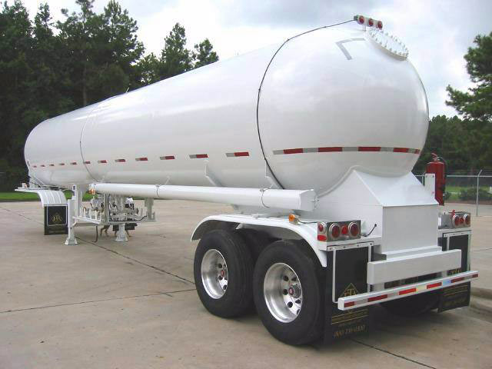




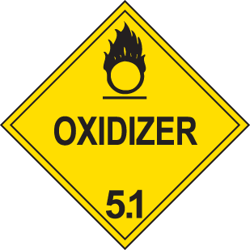
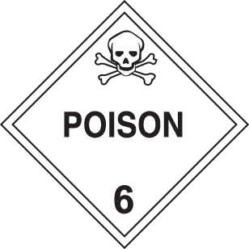
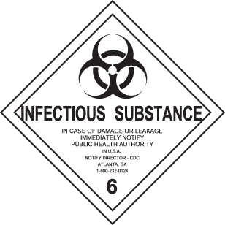



Areas of Expertise
Radioactive Materials
Cylinders
Bulk Packaging
Explosives
Non-Bulk Packaging
Classification
Emergency Response Guidance
Failure Analysis
Explosives
Gases
Flammable
Liquids
Flammable
Solids
Oxidizers and
Organic Peroxides
Poison and
Infectious Substances
Radioactive
Corrosive
Miscellaneous

Slide 8

Types of PHMSA Services
Regulations
  Rulemakings
  Interpretations
  Hazardous Materials Info Center
Approvals and Special Permits
Education and Compliance Assistance
Grants
Emergency Response Guidebook
Multimodal Hazmat Intelligence Portal

Slide 9

Education and Compliance Assistance
  We Set the Standard for all Hazmat Training Nationwide
  HM Industry
  Federal, State, and Local agencies
  First Responders
  Tools
  Web-based training
  Videos
  Publications
  Exhibits
  Outreach
  Grants

Slide 10
INCIDENT REPORTING
DOT 5800.1
REQUIRED:
  49 CFR 171.15
  49 CFR 171.16
  NEW SYSTEM FORTHCOMING!

Slide 11

Questions?

Slide 12
Thank You

