Slide 1

US Coast Guard
Sector Anchorage

Slide 2
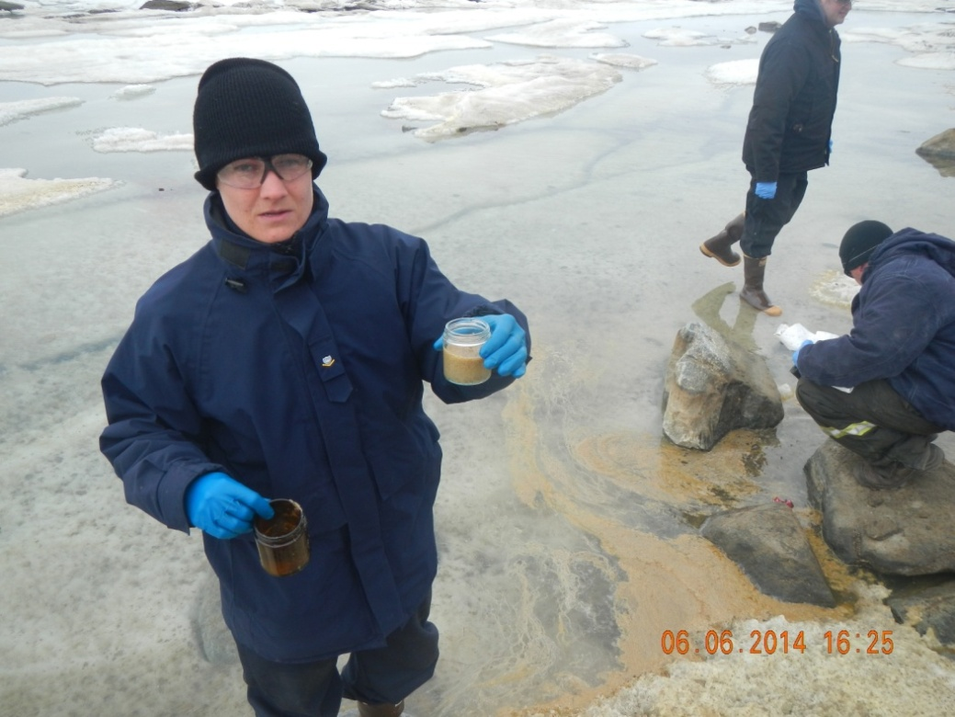
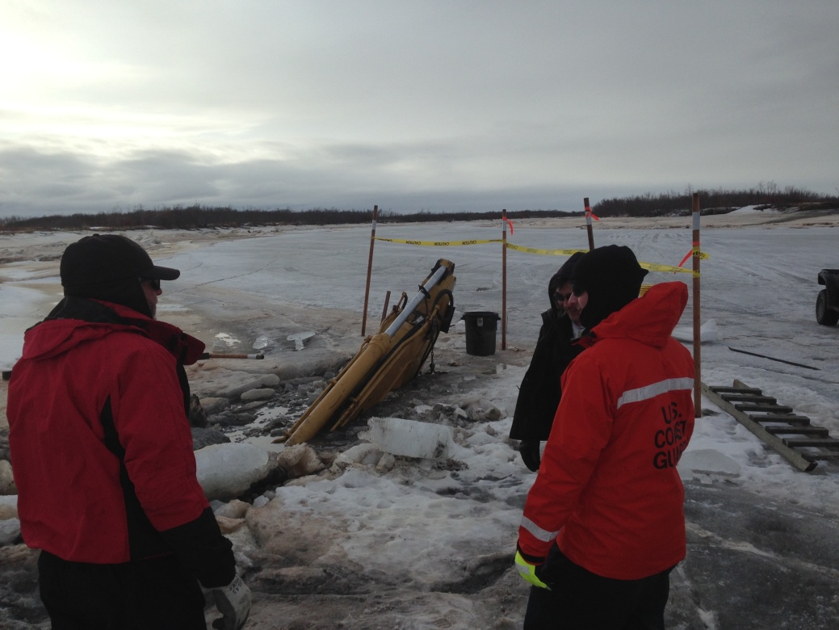
USCG Incident Management
Notes:
Topics will include:
Who we are (Describe yourself and the personnel who conduct pollution response in Alaska).
What we do
Where we do it
When we respond

Slide 3
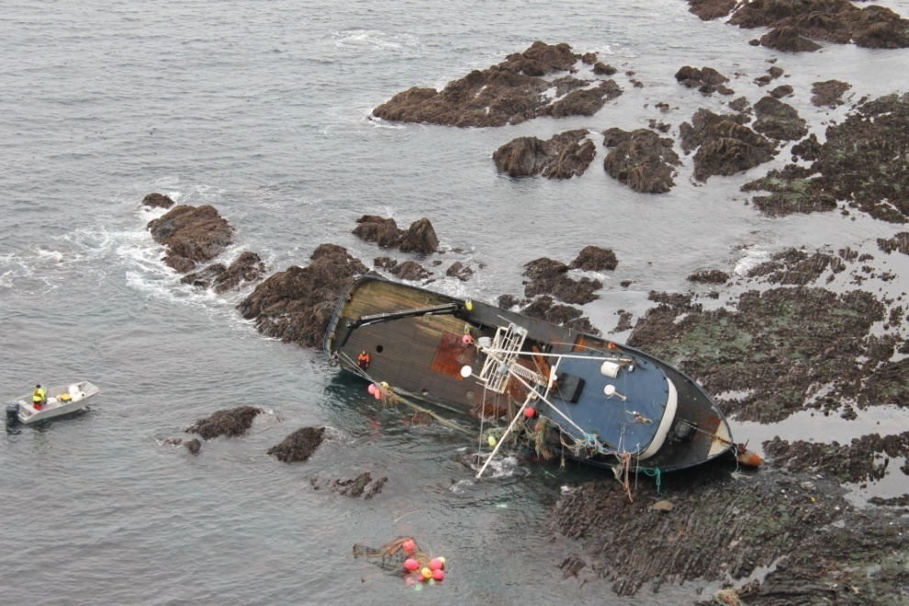
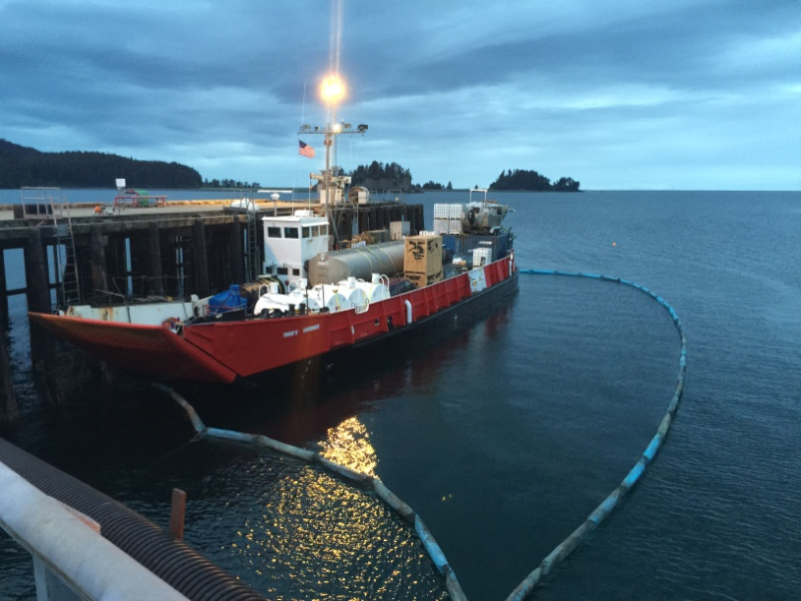
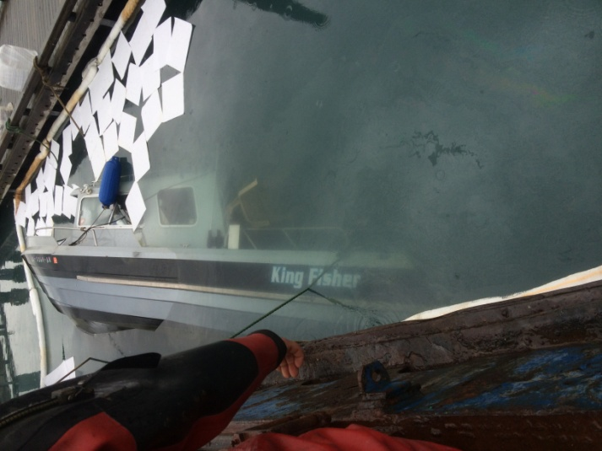
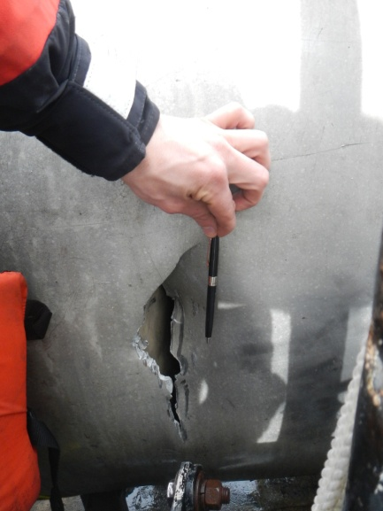
What We Do
Conduct investigations into pollution incidents .
Notify concerned communities and agencies.
Clean-up pollution and prevent further pollution.
Notes:
F/V Arctic Hunter on the rocks in Dutch Harbor
Van Flipped over, leaking gas and lube oils in Turnagain Arm
Thors Hammer Investigative Photo

Slide 4
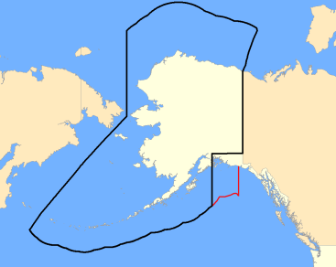
Where We Do It
Coastal waters, major rivers, and up to 1000 yards inland.
Pollution incidents from a Coast Guard regulated vessel or facility.
When called upon for assistance by other agencies.

Slide 5



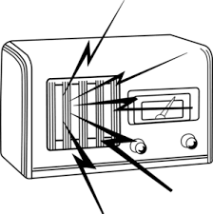
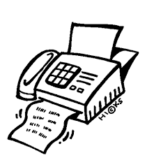
When We Respond
WHENEVER NOTIFIED OF A POLLUTION INCIDENT
Notes:
Hand out stickers and handouts with NRC number on here during this portion of the presentation.
Cover the “Why” of our job here as well.

Slide 6

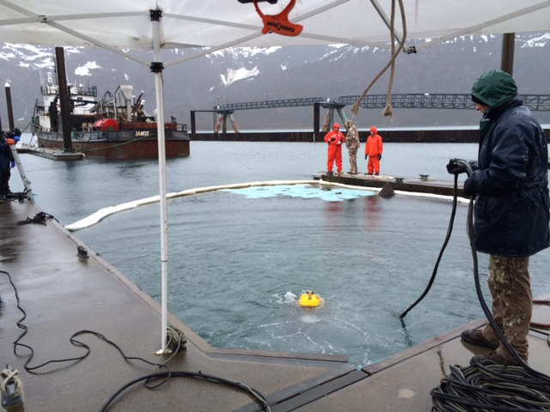
General Response Priorities
Safety of human life
Stabilize the situation
Contain & cleanup contamination
Address all priorities concurrently.
>
Notes:
This slide covers the general way we respond, the “how” of our job so to speak. Then explain the priorities , as they guide how we do our job.
Safety is always the primary concerns for FOSC’s. No ones life is worth an extra recovered gallon of oil or hazardous substance.
Stabilizing the situation is the next priority. Typically this involves stopping the spill (e.g. plugging the hole, turning off the pump), but can also encompass preventing further damage to the environment or human health (e.g. evacuating personnel out of hazardous areas, setting up site security, etc.)
Containment and cleanup involves the use of sorbent materials, skimmers, manual removal with tools, and the like. Much like a physician, we do not want to do harm while enacting a cleanup as well. For example, stomping around in a marsh might push oil into the earth, which can choke the plant life. In cases like this, the desire to cleanup must be weighed carefully against the damage cleaning up might cause.

Slide 7
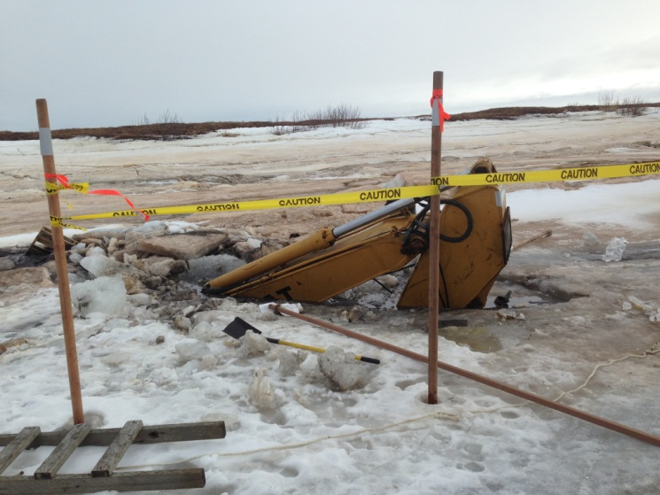
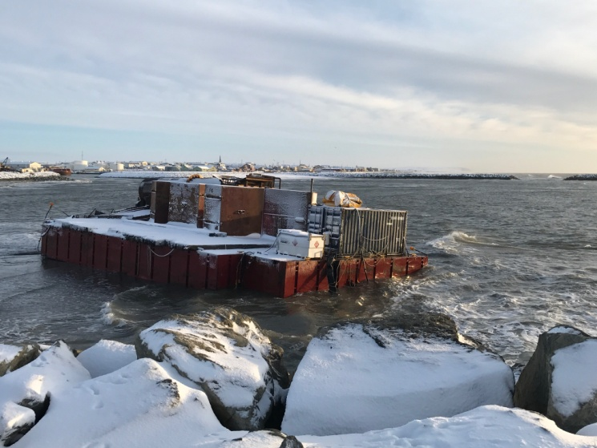
Communications & Community Involvement
Rapid and accurate information to the general public.
Ensure claims information is distributed to affected entities & personnel.
Address community questions & concerns.
Coordinate community involvement with the response.
Notes:
- The national contingency plan already has provisions for coordination with members of the national, area, or regional response teams. In addition to those, the FOSC has to coordinate with unlisted agencies such as a local fire department or law enforcement agency.
The FOSC is responsible for communicating information about an incident to the general public. This can range from informing personnel passing by on a small spill to holding press conferences and town hall meetings on large scale incidents (Ala Deepwater Horizon).
The responsible party is responsible for communicating oil spill damage claims information to the public. If there is a dispute over who the responsible party is, the Coast Guard National Pollution Fund Center can designate the source. If the responsible party (designated or admitted) is unwilling to advertise for claims, the National Pollution Fund Center will do so for them.

Slide 8
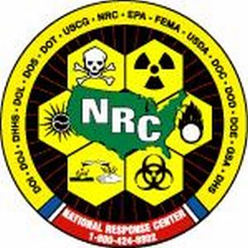
Special Teams
National Response Center (NRC)
Public Information Assist Team (PIAT)
Incident Management Assistance Team (IMAT)
National Pollution Funds Center

Slide 9
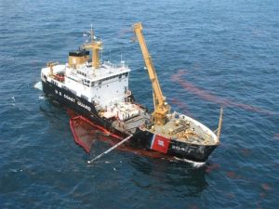
Safety Center Salvage Engineering Response Team (SERT)
Scientific Support Coordinator (SSC)
District Response Advisory Team (DRAT)

Slide 10
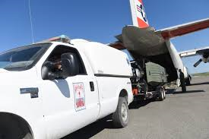
National Strike Teams
Navy Supervisor of Salvage and Diving (SUPSALV)
Shoreline Infrastructure Logistics Center (SILC)
Marine Safety Lab (MSL)

Slide 11
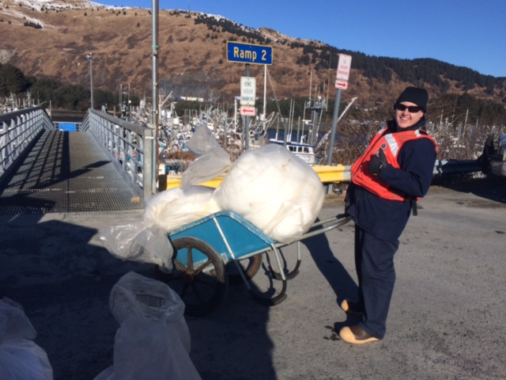
Questions?
National Response Center
Phone: 1-800-424-8802
Sector Anchorage FOSCR 24/7
Phone: 907-229-7142

