Slide 1
Alaska Department of Transportation & Public Facilities
Alaska Trucking Spill Management Workshop
Daniel V. Smith, Director DOT&PF, MSCVE
March/April 2017

Slide 2
Alaska Trucking Spill Management Workshop
Measurement Standards Commercial Vehicle Enforcement (MSCVE)
Daniel V. Smith, Director
DOT&PF, MSCVE
Carlos Rojas, Sgt.
Fairbanks Area Supervisor

Slide 3
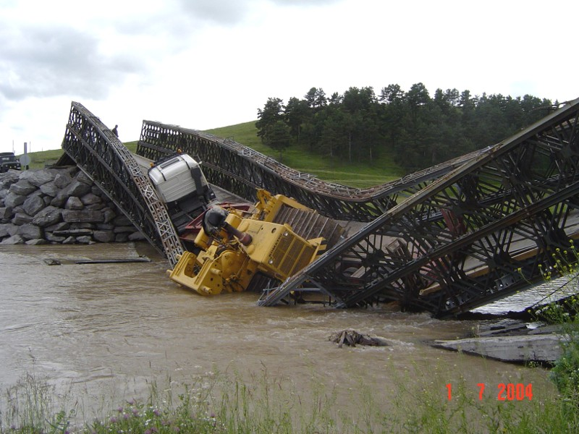
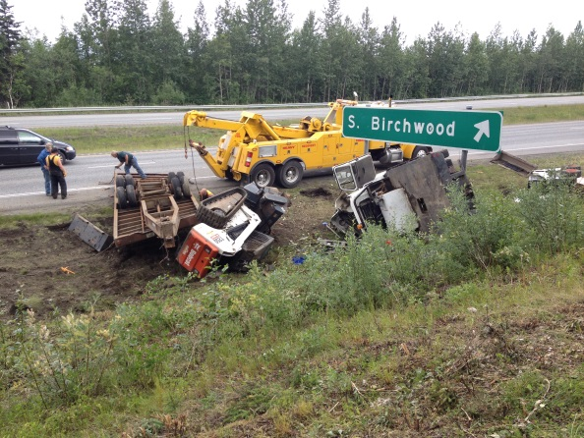
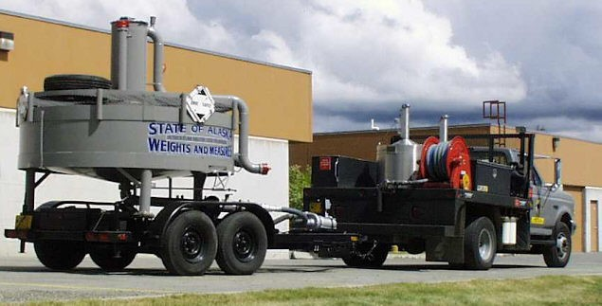
CVE Mission
Enhance Safety of the Motoring Public
Protect the Public Infrastructure

Slide 4
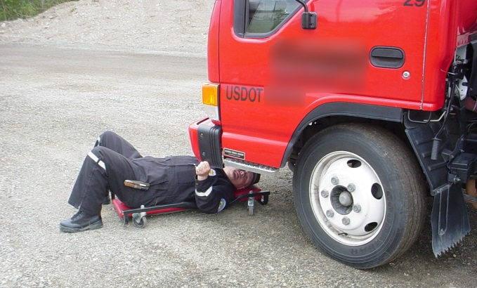
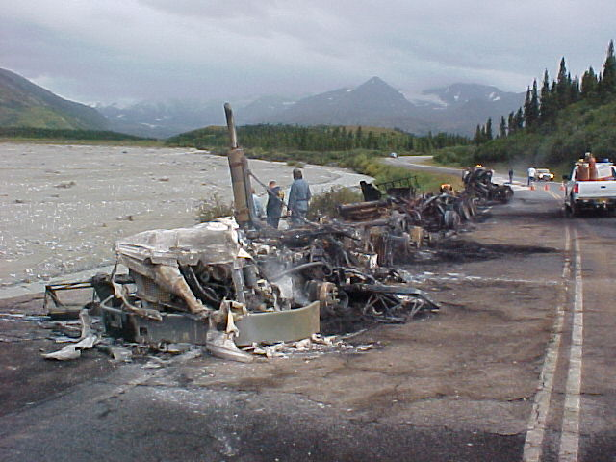
Safety Programs
Motor Carrier Safety Assistance Program (MCSAP)
Commercial Vehicle Safety Plan Emphasis Areas are
designed to Reduce Injuries and Save Lives
State CMV Program Objectives
CMV Crash Reduction
CMV Safety Improvement
CMV HazMat Safety
Passenger Transportation Safety
CMV Safety Data Quality
National Program Elements
Driver/Vehicle Inspections
Traffic Enforcement
Compliance Reviews/CSA Interventions
Public Education & Awareness
Data Collection

Slide 5
Commercial Vehicle Enforcement Inspections

Slide 6
Commercial Vehicle Enforcement Inspections Breakdown

Slide 7
Top Safety Violations Found During a Commercial Vehicle Inspection
Notes:
For comparison:
36.8% (182/495) of all HazMat inspections have a violation. 10.5% (52/495) of HazMat inspections have an OOS violation.
45.1% (3,278/7,266) of all non-HazMat inspections have a violation. 11.7% (847/7,266) of non-HazMat inspections have an OOS violation.

Slide 8

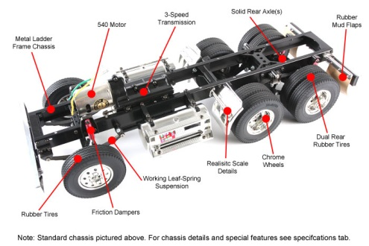
Top Safety Violations Found During a Commercial Vehicle Inspection

Slide 9
Alaska Trucking Spill Management Workshop
Reference Regulations
17 AAC 25.200, 17 AAC 25.210, and
17 AAC 25.220
Title 49 Code of Federal Regulations (49 CFR)

Slide 10
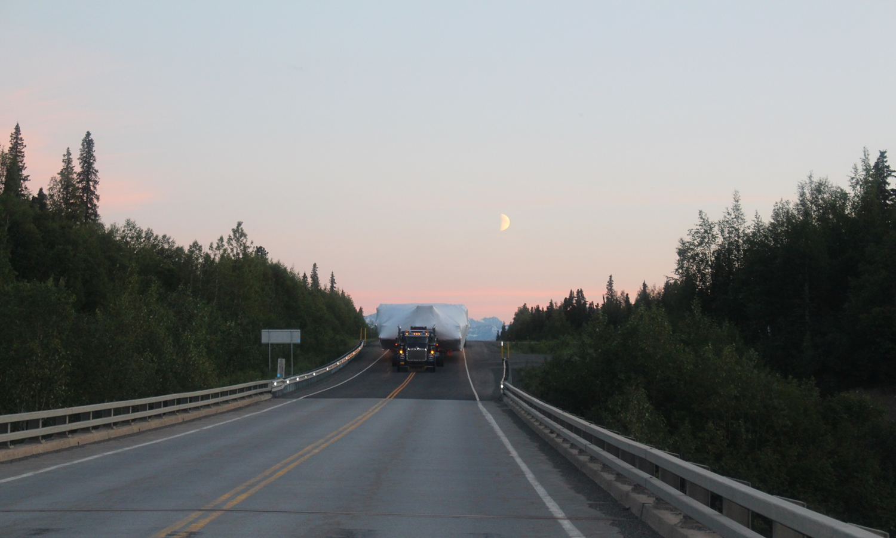
Definition
Reportable Crash 49 CFR 390.5 Definitions
Accident means—
(1) ...an occurrence involving a commercial motor vehicle operating on a highway in interstate or intrastate commerce which results in:
(i) A fatality;
(ii) Bodily injury to a person who, as a result of the injury, immediately receives medical treatment away from the scene of the accident; or
(iii) One or more motor vehicles incurring disabling damage as a result of the accident, requiring the motor vehicle(s) to be transported away from the scene by a tow truck or other motor vehicle.
Notes:
(2) The term accident does not include:
(i) An occurrence involving only boarding and alighting from a stationary motor vehicle; or
(ii) An occurrence involving only the loading or unloading of cargo. (2) The term accident does not include:
(i) An occurrence involving only boarding and alighting from a stationary motor vehicle; or
(ii) An occurrence involving only the loading or unloading of cargo.

Slide 11
49 CFR 171.15 & 171.16
(b) Reportable incident. A telephone report is required whenever any of the following occurs during the course of transportation in commerce (including loading, unloading, and temporary storage):
(1) As a direct result of a hazardous material—
(i) A person is killed;
(ii) A person receives an injury requiring admittance to a hospital;
(iii) The general public is evacuated for one hour or more;
(iv) A major transportation artery or facility is closed or shut down for one hour or more; or
(5) A situation exists of such a nature ( e.g. , a continuing danger to life exists at the scene of the incident) …

Slide 12
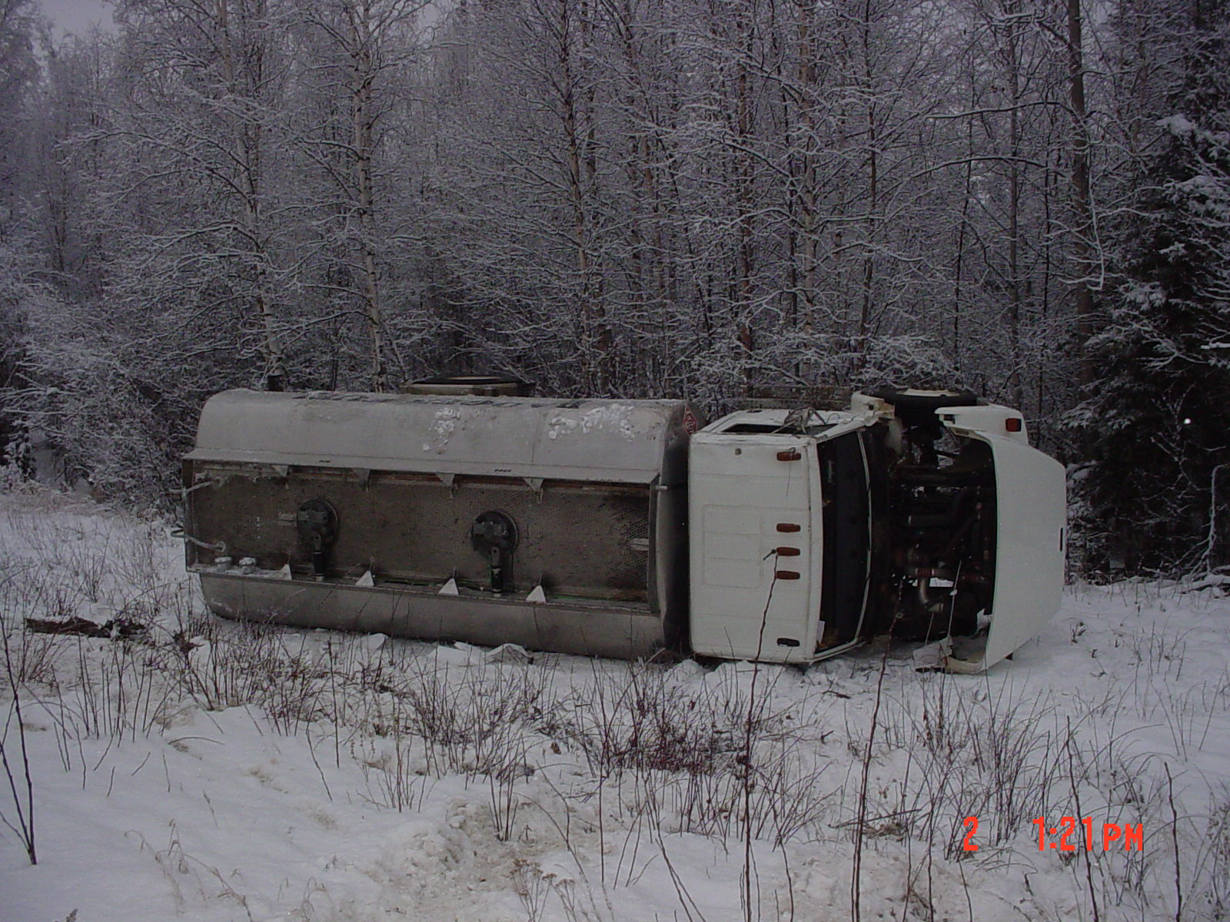
17 AAC 25.200
Transportation of Hazardous Materials, Hazardous
Substances, or Hazardous Waste

Slide 13
17 AAC 25.200(b)
(6) 49 C.F.R. 171.15(a) is revised to specify that the required notice shall also be given to the division;
(7) 49 C.F.R. 171.16(b) is revised to specify that the required notice shall also be given to the division;

Slide 14
Contacts and Links
AK DOT&PF/MSCVE
Commercial Vehicle Customer Service Center
Office Phone
907-365-1200
Office Fax
907-365-1221
Email at MSCVE@alaska.gov
Website: www.dot.alaska.gov/mscve

Slide 15
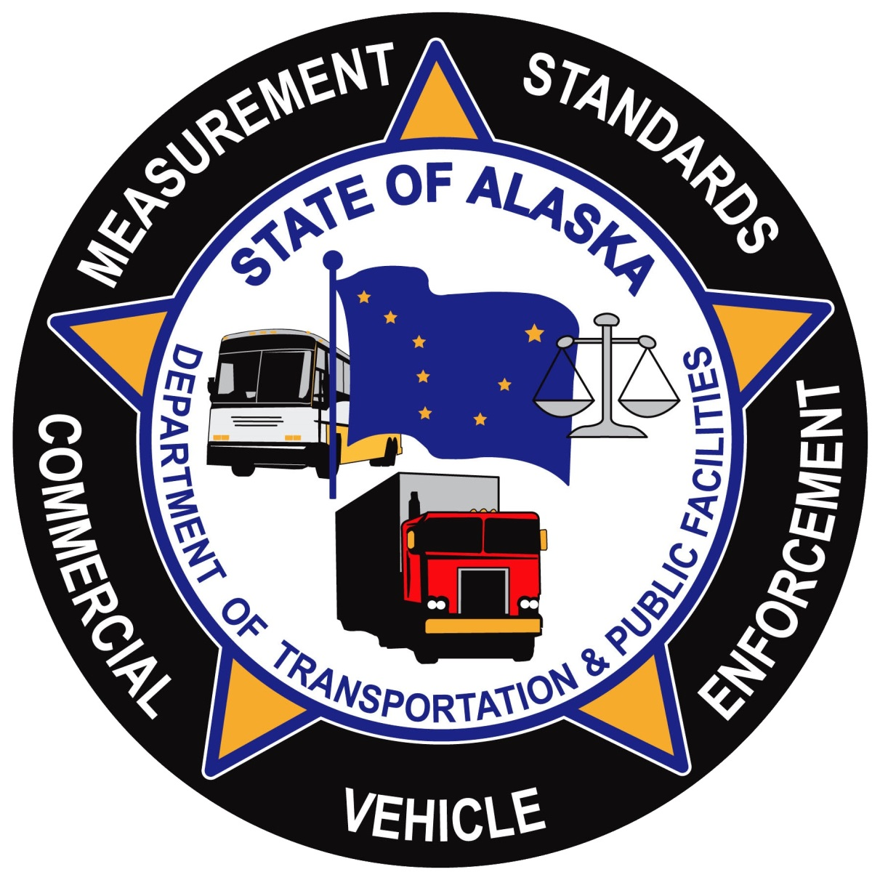
Questions?

