Slide 1
Fish Consumption in Alaska
Issue 1: What is the Population of Concern
Issue 2: What options does DEC have for developing FCRs?

Slide 2
What does the ADF&G data tell us?
ADF&G Presentation
Notes:
Neither approach addresses the population of concern question- Everyone may be unhappy or certain regions may be more affected than others

Slide 3
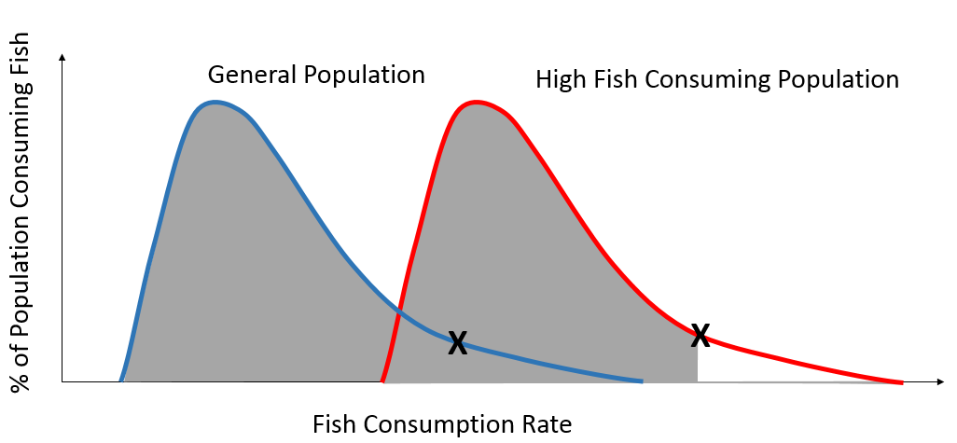
Issue 1: Population of Concern Noted in Issues 1-3
EPA 2000 Methodology provides three options for states
90th Percentile of general population
50th Percentile of sub-population (highly exposed)
Other Percentile (E.g., 90th of highly exposed)

Slide 4
Questions to address
Population of concern:
General v. Sub?
Rural v. Urban?
Specific Region/Users?
High Risk v. High Exposure
Who is at risk and just how much?

Slide 5
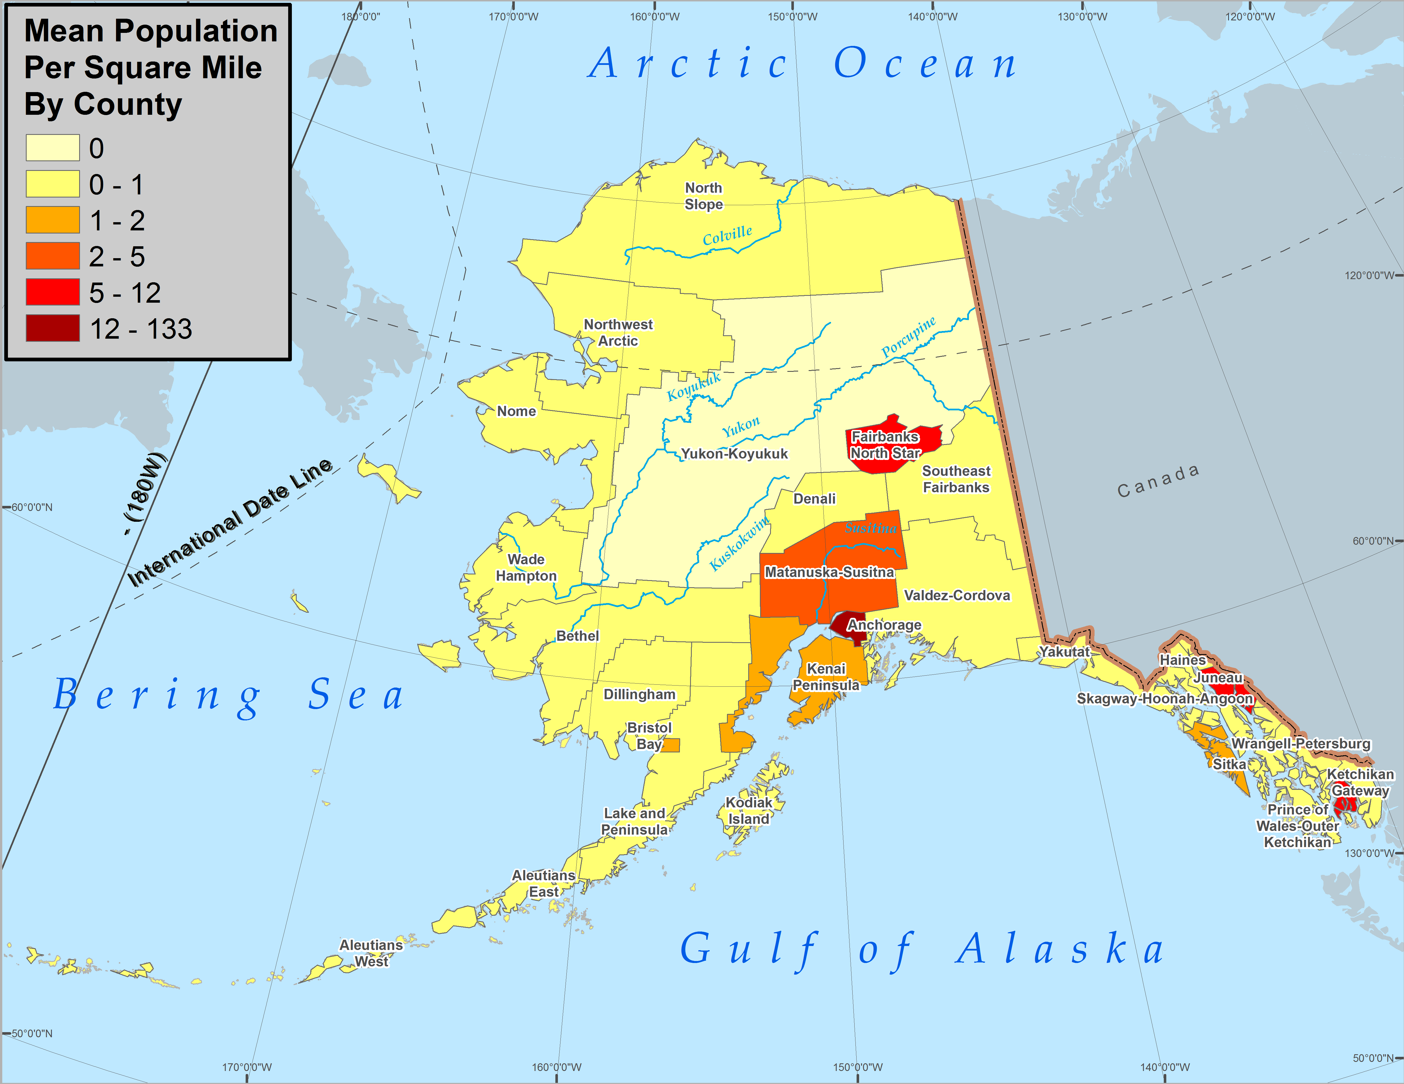
Issue 2. What options does Alaska have for developing fish consumption rates on a statewide/regional/SSC basis?
General support for a regional approach
Concern that ADF&G data may be dated
Questions remain regarding high consumption versus high exposure
Not clear if regional or statewide approach provides more protection to urban consumers
Need to look at geographic distribution of FCRs

Slide 6
Statewide v. Regional approach to development of a fish consumption rate?
Statewide v. Regional approach
Discussion
Reaction to ADF&G presentation?
Statewide- Would need to pick a value that represents protection across a broad range of consumers
Regional- More representative of a subgroup of consumers but is it equitable?
Is AK creating a double standard- what if you reside in one location but get your fish from another?

Slide 7
Recommendations
DEC does not necessary need consensus but it does need to determine the general preference.
Something along the lines of a “dissenting opinion” can be included in the Workgroup report.

Slide 8
Inclusion of Market Fish as part of the statewide/regional FCR
Market fish may be a significant source of fish consumption in urban areas
Less so in rural locations

Slide 9
Recommendations
Consensus?
Dissenting opinion?

Slide 10
Treatment of Marine Mammals
Tabled for discussion post-BAF/BCF conversation tomorrow

Slide 11
Treatment of Salmon
Most consumed fish in AK
Treated as RSC in the EPA 2000 methodology
Anadromous so the majority of body burden takes place outside of AK waters

Slide 12
Recommendations
Consensus?
Dissenting opinion?

Slide 13
Break

