Slide 1

CHAPTER 2
Operator Math
Notes:
Note: There are a variety of ways that the topic of math can be presented in an operator training program. This PowerPoint presentation generally follows the AWWA Water Treatment Grade 1 text, but alternative methods of presentation are discussed in the notes throughout the slide deck. The instructor should decide what is the best method of presentation for their purposes in advance of the class and adjust the slide deck accordingly.
Providing each attendee with the same type of scientific calculator is recommended. If the attendees will be using these on their exams, make sure the calculator is non-programmable and is not connected to the internet. One of the more common calculators used in Alaska is the TI30Xa.
The ABC Water Treatment Exam Formula and Conversion Factor Tables used in the ABC exams should be handed out to each attendee. Using those formulas will help the attendees to become more familiar with that formula and conversion table as this is what they will have on the ABC exam.

Slide 2
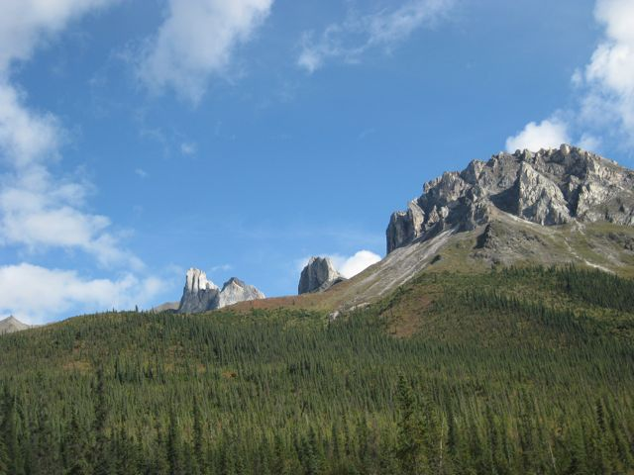
Powers and Scientific Notation
Powers Notation
5 x 5 = 5² (or 5 to the second power)
5³ = 5 x 5 x 5 (or 5 to the third power)
Units can also be raised to a power: ft x ft = ft²
Examples
Write the powers notation form of 3 x 3 x 3
Answer = 3³
What does 3³ equal?
Answer = 27
Notes:
Explain that an exponent is a mathematical operation that shows how many times an operation is repeated: 5² = 5 x 5, N³ = N x N x N
The exponential function key on a scientific calculator can help with this. The key notation is usually y^{x}. Other common exponent keys on most digital calculators are X² and X³ which are, in effect, dedicated y^{x} function keys.

Slide 3
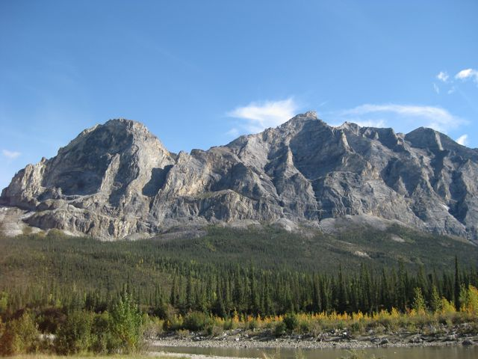
Powers and Scientific Notation
Scientific Notation
Expressing numbers as a unit or term multiplied by a power of 10
5.4 x 10¹ = (5.4)(10) = 54
Example: 2,500,000 gallons per day = 2.5 x 10⁶ gpd
The exponent can be negative: 3.62 x 10⁻² = (3.62) ➗ 1/(10 x 10) = 0.0362
Example
Write 0.00055 in scientific notation
Answer = 5.5 x 10⁻⁴

Slide 4
Dimensional Analysis
Dimensional analysis is a means of determining if a problem has been set up correctly: whether to multiply or divide by a conversion factor
Steps:
Express the units as a vertical fraction:
gal/ft³ = gal
ft³
To cancel terms arrange the fractions with similar terms in the numerator and denominator:
ft³ x gal = gal (note: ft³/ft³ = 1, any number or unit divided by itself = 1)
ft³
Notes:
Dimensional analysis is presented in the book as a units only system. If the numerical values or quantities to be converted are also included in the equation setup, this system can replace the “Box Method” of conversions presented on pages 61 – 72.
One advantage of using dimensional analysis for conversions is you don’t have to guess whether the answer is going to be larger or smaller than the starting value. Cancellation of the units shows positively whether the conversion value is to be multiplied by or divided into the starting value. To conserve time, a slightly expanded version of dimensional analysis can replace most of the box method discussion in the text.
This slide and additional examples of dimensional analysis are presented under the section on conversions later in this chapter.

Slide 5
Rounding and Estimating
Rounding and estimating are used to approximate the size of the anticipated answer to a mathematical problem
Rounding means replacing the final digits of a number with zeroes, thus expressing the number in even units of ones, tens, hundreds, or tenths, hundredths, thousandths, etc.
Examples: 97 would be expressed as 100, and 0.189 as 0.2
An ”approximately equal” sign is usually used: 0.189 ~ 0.2

Slide 6
Rounding
To round a number, select the unit that you wish to round off to
If the digit to the right of that number is less than 5, replace all of the numbers to the right with zeros:
Example: round 1.234501 to the hundredths (0.01) position = 1.230000 or 1.23 (the number to the right of the three is 4, which is less than 5, so ”round down”)
If the digit to the right of that number is 5 or greater, increase the number you are rounding by 1 and replace all of the numbers to the right with zeros
Example: round 56.86492 to the tenths position = 56.90000 or 56.9 (the number to the right of the 8 is 6, which is greater than 5, so “round up”)

Slide 7
Estimating
To estimate the approximate magnitude of an answer, round off all of the numbers except the first digit to zeros so only one digit remains
Example: What is the order of magnitude of 130 x 48?
Round 130 to ~100, and round 48 to ~50
Multiply 1 x 5 = 5, then add the number of zeros in the rounded numbers = 5,000 (the answer will be in the thousands magnitude)
The actual answer is 130 x 48 = 6,240
Example: What is the order of magnitude of 7,654 x 238?
Round 7,654 to ~ 8000, and round 238 to 200
Multiply 8 x 2 = 16, then add the number of zeros in the rounded numbers = 1,600,000 (the answer will be in the millions magnitude)
The actual answer is 7,654 x 238 = 1,821,652

Slide 8
Solving for the Unknown Value
For multiplication and division:
Use either the algebraic system or ”Pie Wheels” from ABC Exam Formula and Conversion Table
To use algebra:
Move the unknown (usually “x”) to the numerator if it is not already there. When moved from a denominator, cross the equal sign and move it to the numerator
Move all other numerical values and units to the opposite side of the equal sign, numerators to denominators, denominators to numerators in an X-pattern. Place multiplication signs between all values
See Example 6 on Page 47

Slide 9
Solving for the Unknown Value
For subtraction or addition:
To use algebra:
Move all values other than the unknown (usually “x”) to the opposite side of the equal sign. When a value is moved, change the sign from plus to minus or minus to plus
Once all of the numerical values are on one side of the equal sign, solve the problem
Example: 7 – 2 – 5 + x = 24 – 3
Rearrange: x = 24 – 3 – 7 + 2 + 5
x = 21

Slide 10
Ratios and Proportions
A ratio is the relationship between two numbers and may be written with a colon, e.g. 1:2 or as a fraction, e.g. ½
If two ratios are equal, then they are said to be in proportion or proportionate
To determine if two ratios are proportionate, cross multiply the numerators and denominators
Example: are 10/30 and 2/6 proportionate?
Multiply 10 x 6 = 60 and 30 x 2 = 60; 60 = 60
Yes, these two ratios are proportionate

Slide 11
Ratios and Proportions
A practical application is to determine how much chemical to add to a stock solution when the strength is to be changed or how much to reset a chemical pump to if the dosage is to be changed.
To set up a proportional problem, determine if the answer is going to be larger or smaller than the starting value. If it is smaller, the unknown value (x) should be placed in the numerator of one of the fractions being compared, and if it is larger the unknown value (x) is placed in the denominator.
The problem is then solved by rearranging the equation to solve for x.

Slide 12
Ratios and Proportions
Example: A chemical feed pump is dosing 75 ml/minute of chlorine solution to a flow rate of 250 gpm. If the flow rate is reduced to 185 gpm, what should the output of the chemical feed pump be adjusted to in ml/minute?
The answer will be smaller than the starting value, so set up the ratios as follows:
X = 185 Rearrange: X = 185 x 75
75 250 250
X = 55.5 ml/minute

Slide 13
Video Clip: Operator Math 1
www.awwa.org/wsovideoclips

Slide 14
Averages
The arithmetic average (or arithmetic mean) is equal to the sum of all values divided by the number of values being averaged
Example: The following pump operating hours from a well were recorded for one week: 5.6, 4.8, 6.3, 7.2, 5.9, 8.1, and 4.4. What is the average hours of pump operation per day?
5.6 + 4.8 + 6.3 + 7.2 + 5.9 + 8.1 + 4.4 = 42.3
42.3/7 = 6.042857
Round to the tenths position (which = the accuracy of the data) = 6.0 hours

Slide 15
Percent & Percent Removal
% = Percent or per centum (divided by 100)
Convert % to decimal fraction by dividing by 100
25% = 25/100 = 0.25
Convert a decimal fraction to % by dividing the fraction and multiplying by 100%
3/8 x 100% = 37.5%
Percent Removal
Called “Removal, %” in ABC Exam formula sheet
Removal, % = (In – Out)
------------- x 100% = % Removal
In

Slide 16
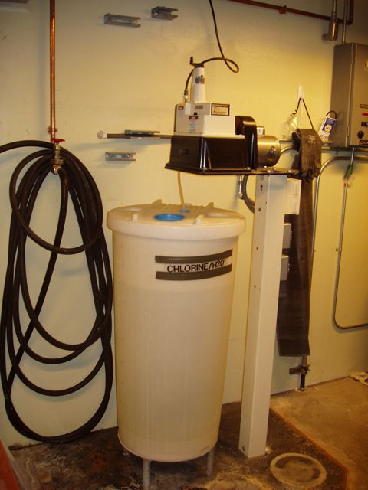
Percent & Percent Removal
A chlorine stock solution is being dosed at the rate of 4.7 gallons per day. What percent of a 50-gallon batch will be used in one week?
4.7 gpd x 7 days = 32.9 gallons
32.9 gallons x 100% = 65.8%
50 gallons

Slide 17
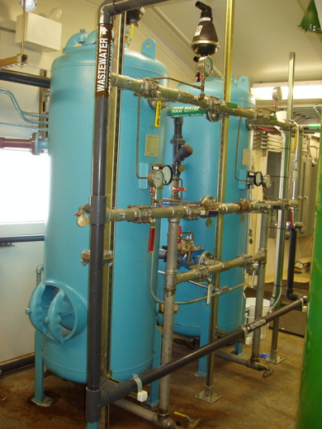
Percent & Percent Removal
A water treatment plant has 5.5 mg/L of iron in the raw water and 0.2 mg/L in the treated filtrate. What is the percent iron removal?
% Removal = (INF – EFF) x 100%
INF
(5.5 mg/L – 0.2 mg/L) x 100% = 96.4%
5.5 mg/L

Slide 18
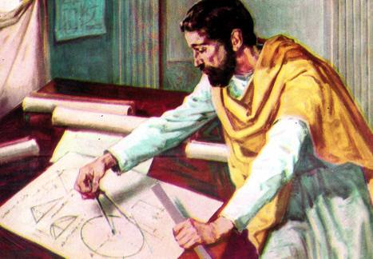
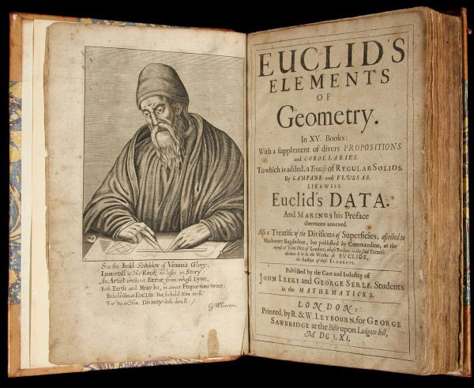
Euclid of Alexandria – 300 BC Known as the “Father of Geometry”
Greek: geo + metry = Earth Measurement
Euclid’s Elements of Geometry
13 volume text of geometry
For 2,000 years this was the second most printed publication in history after the Bible

Slide 19
Perimeter & Circumference
Perimeter = 24 ft + 24 ft + 16 ft + 16 ft = 80 ft
Circumference = π x 20 ft = 62.8 ft

Slide 20
Area
Area = 24 ft x 16 ft
= 384 ft²
Area = π x 10 ft x 10 ft
= π x (10 ft)²
= 314 ft²

Slide 21
Area of Circle = 78.5 = 0.785
Area of Square 100
Therefore, Area of Circle = 0.785 D²

Slide 22
Volume
Volume = 24 ft x 8 ft x 16 ft
= 3,072 ft³
Volume = 0.785 x (20 ft)² x 30 ft
= 9,420 ft³

Slide 23
Volume: Triangular Trough
Volume = base x height x length
2
Volume = 3 ft x 4 ft x 12 feet
2
Volume = 72 ft³

Slide 24
Conversions
To convert from one set of units to another, a conversion factor is needed. Obtain the correct conversion factor from a conversion table such as the one provided for the ABC exams.
To determine if the original value needs to be multiplied or divided by the conversion factor, use dimensional analysis.
An alternative to dimensional analysis is the ”box method” (see pages 61 through 72 of the text).

Slide 25
Dimensional Analysis
Dimensional analysis is a means of determining if a problem has been set up correctly: whether to multiply or divide by a conversion factor
Steps:
Express the units as a vertical fraction:
gal/ft³ = gal
ft³
To cancel terms arrange the fractions with similar terms in the numerator and denominator:
ft³ x gal = gal (note: ft³/ft³ = 1, any number or unit divided by itself = 1)
ft³
Notes:
This slide is repeated from earlier in this chapter.

Slide 26
Dimensional Analysis
Example 1: Convert 2,500 ft³ to gallons
Steps:
Express the first term as a vertical fraction:
2,500 ft³ = 2,500 ft³
1
Multiply by the appropriate conversion factor (7.48 gal/ft³):
2,500 ft³ x 7.48 gal = 2,500 x 7.48 gal = 18,700 gal
1 ft³
Notes:
Note: Use the conversion tables in the ABC Water System Exam Formulas and Conversion Factors. Each conversion factor is an equality: literally 1 ft³ = 7.48 gallons. This means that when the conversion equation is set up in the form of multiplying fractions, either term in the conversion factor can be the numerator or the denominator. It just needs to be arranged so the proper unit cancels out and the desired unit (the answer) remains in the numerator.

Slide 27
Dimensional Analysis
Example 2: Convert 100 feet of head to psi
Steps:
Express the first term as a vertical fraction:
100 ft = 100 ft
1
Multiply by the appropriate conversion factor (e.g. 2.31 ft = 1.0 psi):
100 ft x 1 psi = 100 x psi = 43.3 psi
1 2.31 ft 2.31
or using the conversion factor 1.0 ft = 0.433 psi:
100 ft x 0.433 psi = 100 x 0.433 psi = 43.3 psi
1 ft

Slide 28
Unit Conversions: Dimensional Analysis
Dimensional Analysis
Use the principal of a straight-line equation to cancel all unwanted units
The final units remaining should be what the question was being asked in the problem
When units cancel, the mathematical result is 1:
mg/L ft³ gpm
--------- = 1 ------ = 1 --------- = 1
mg/L ft³ gpm

Slide 29
Unit Conversion Examples
Use the Straight-Line Equation for Cancelling Units:
Convert 10 cubic feet (ft³) of water into gallons
Convert 4 ft³ per second into gpm
Convert 1,350 ft³ into cubic yards (yd³)
Convert 250,000 gpd into MGD
Convert 7.5 HP into kW
Convert 50,000 mg/L into % concentration
Notes:
This slide can be used to replace much of the box method conversion discussion.
Problem 2 can be used to demonstrate where the conversion from ft³ to gpm comes from: 1 ft³/second x 7.48 gallons/ft³ x 60 seconds/minute = 448.8 gpm/cfs.
Problem 3: the conversion of 27 ft³ to 1 yd³ is not in the 2017 ABC exam conversion table so the student will need to calculate that from 3³.
Problem 4: moving the decimal point 6 positions to the left solves this quickly without a calculator.
Problem 6: the students can either divide 50,000 (PPM) by one million and multiply by 100% or use the ABC exam conversion factor of 1% = 10,000 mg/L.

Slide 30
Metric System Conversions
Metric conversions are all done in decimals (powers of 10)
See Table 2-1 on Page 73 for a list of the standard metric prefixes and their numerical values
Example: what is the weight of one liter of water in milligrams?
1 liter = 1,000 ml
1 ml weighs 1 gram = 1,000 mg
1,000 ml x 1,000 mg = 1,000,000 mg/L
Note: this is why parts per million is the same as mg/L in water

Slide 31
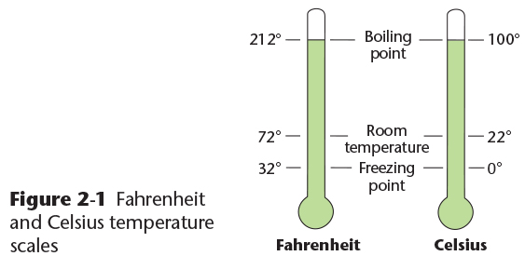
Temperature Conversions
Copyright © 2016 the American Water Works Association

Slide 32
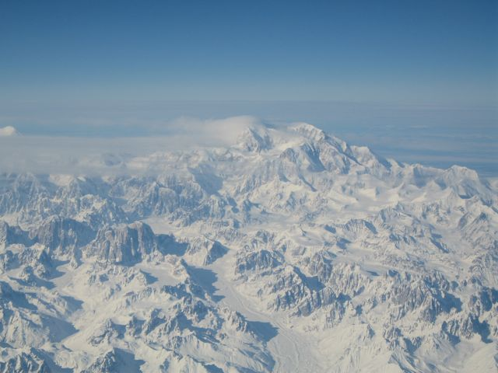
Temperature Conversions
Degrees C = (°F – 32)
1.8
Convert 40 °F to °C
Degrees F = (°C x 1.8) + 32
Convert 20 °C to °F
°C = (40 °F – 32)
1.8
= 8
1.8
= 4.4 °C
°F = (20 °C x 1.8) + 32
= 68 °C
Convert -40 °F to °C
Convert -40 °C to °F
°C = (-40 °F – 32)
1.8
= -72
1.8
= -40 °C
°F = (-40 °C x 1.8) + 32
= -40 °C

Slide 33
Dosage Formula
Also called the “feed rate” formula, the “mass” or “loading rate” formula, and the “pounds” formula
Feed Rate (lb/Day) = mg/L x MGD x 8.34 lb/gallon
% purity (decimal percentage)
Mass (lb) = mg/L x MG x 8.34 lb/gallon
Loading Rate (lb/day) = mg/L x MGD x 8.34 lb/gallon
Note: if necessary, correct the mass or loading rate result with the decimal percent purity of the chemical

Slide 34
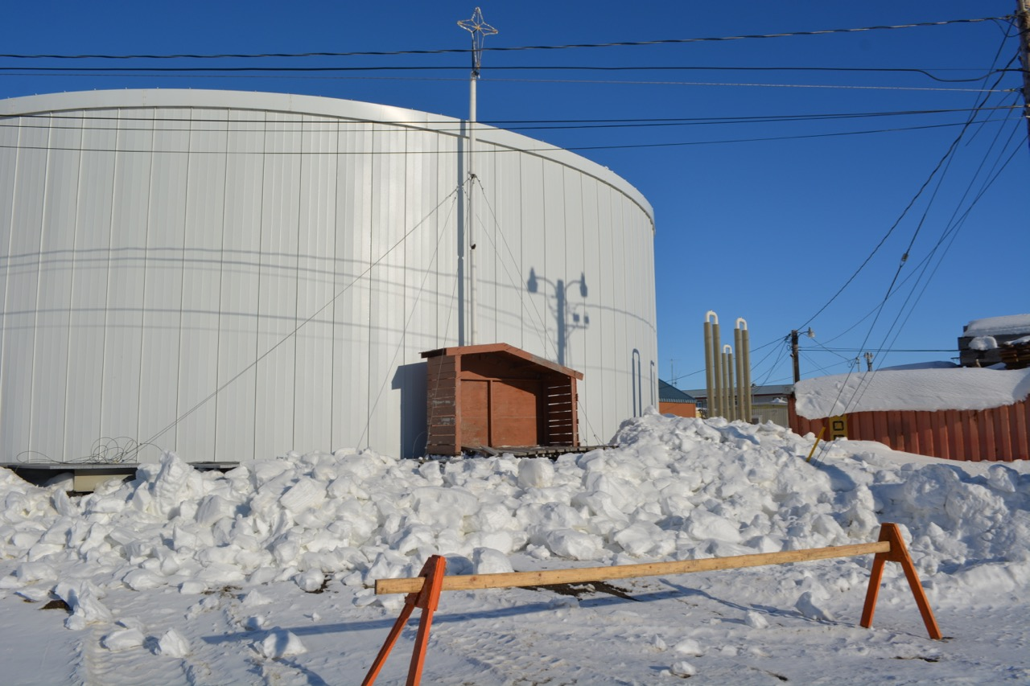
Dosage (Mass) Problem
A 500,000-gallon water storage tank is to be disinfected with 10 mg/L of chlorine. How many pounds of 73% powdered calcium hypochlorite is needed to disinfect the tank?
lb = mg/L x MG x 8.34 lb/gallon
Percent purity
lb = 10 mg/L x 0.5 MG x 8.34 lb/gallon
0.73
lb = 57.12 lb of 73% calcium hypochlorite

Slide 35
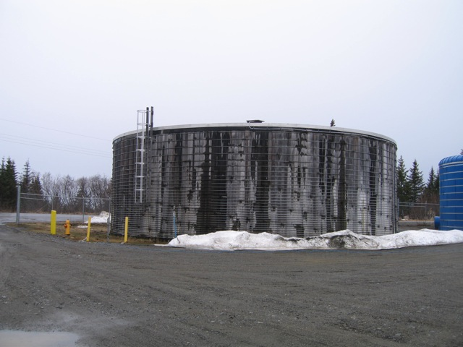
Interactive Class Exercise: Operator Math
The class should be organized into work groups of 3 to 4 attendees with at least one member who is working at or is familiar with a water utility in their area
Each group should identify a water storage vessel (tank, reservoir, etc.) from their selected system, and estimate the dimensions
The estimated dimensions should then used to calculate the total volume of water that vessel can hold
Each group should have one person report back to the class with their findings and show their calculation on a flip chart or white board
Notes:
Total time for exercise: 15 minutes; about half for preparing the examples and half for reporting to the class
One method to save time is to give each work group a flip chart sheet so they can write out their calculation and have it ready for the final presentation

Slide 36
Video Clip: Operator Math 2
www.awwa.org/wsovideoclips

