Slide 1

CHAPTER 4
Water Sources and Treatment Options

Slide 2
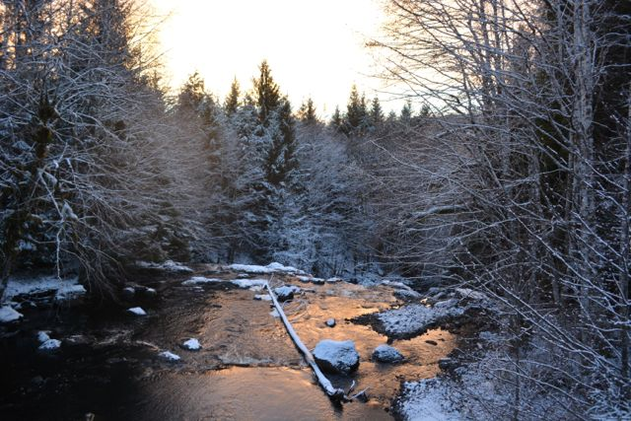
Water Supply Hydrology
Hydrology: The science dealing with the properties, distribution, and circulation of water and its constituents in the atmosphere, on the earth’s surface, and below the earth’s surface.
The Hydrologic Cycle: The movement of water to and from the surface of the earth.

Slide 3
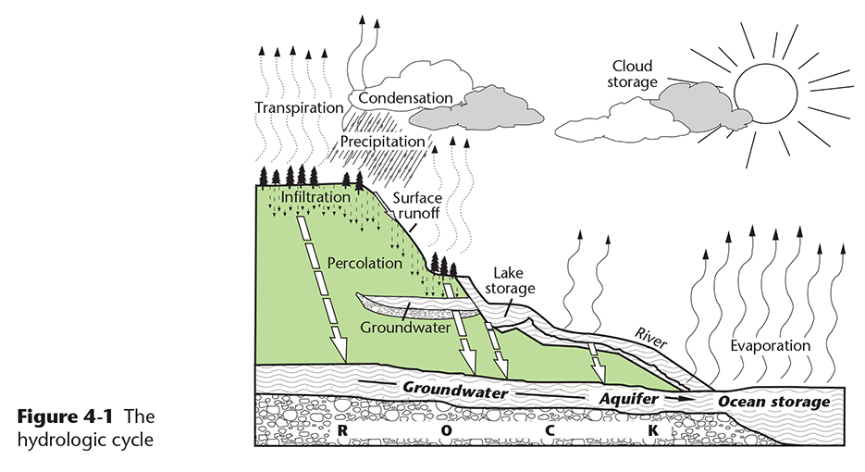
The Hydrologic Cycle
Copyright © 2016 the American Water Works Association

Slide 4
The Hydrologic Cycle: Terminology
Evaporation – water moving from the surface to the atmosphere
Transpiration – water released from plants to the atmosphere
Evapotranspiration – combination of evaporation and transpiration
Sublimation – ice and snow evaporating directly into the atmosphere
Advection – water movement in the atmosphere by air currents
Condensation – formation of water droplets
Precipitation – rain, snow, sleet, hail, etc.
Notes:
Evapotranspiration is a term occasionally used in exam questions that is the combination of the terms evaporation and transpiration

Slide 5
The Hydrologic Cycle: Terminology
Interception – precipitation that encounters plants rather than soil
Infiltration – precipitation that soaks into the ground
Subsurface Flow – movement of water through the soil
Runoff – water that flows over the surface of the ground
Channel Flow – runoff that collects in streams and rivers
Storage – water that is stored in surface lakes and reservoirs, frozen in snow and ice, or held in subsurface aquifers (saturated zones)
Snowmelt – water released as snow and ice packs melt in the spring

Slide 6
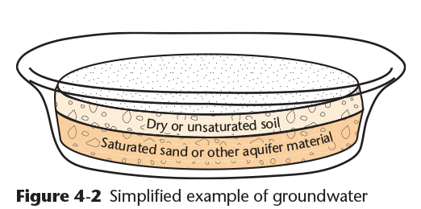
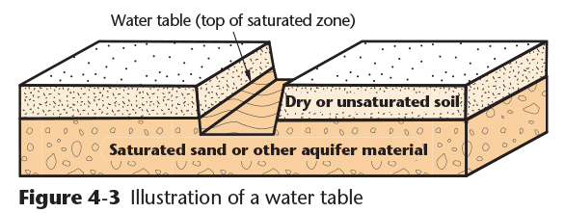
Groundwater
Groundwater accumulates as infiltration water percolates down to a water table
An aquifer is a saturated subsurface zone
The water table is the surface of the saturated layer in an aquifer
Copyright © 2016 the American Water Works Association

Slide 7
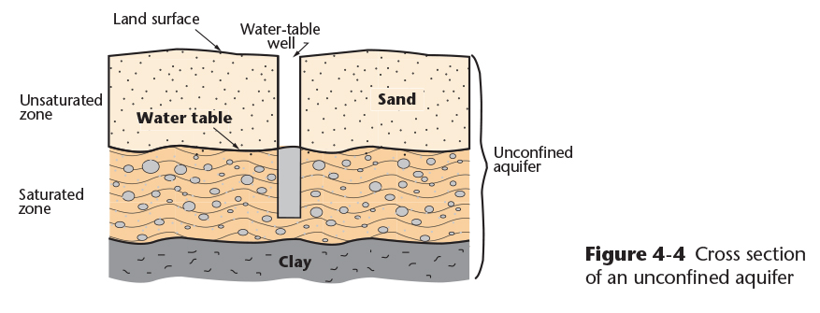
Aquifers and Confining Beds
Unconfined Aquifers:
The surface of the saturated zone is free to rise or fall with precipitation and snowmelt events
The top of the saturated zone is called the water table
Copyright © 2016 the American Water Works Association

Slide 8
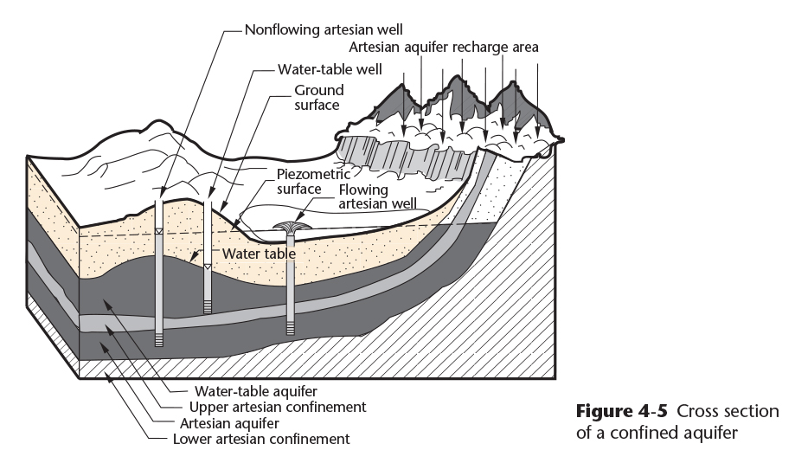
Aquifers and Confining Beds
Confined (Artesian) Aquifers:
A permeable layer is confined between upper and lower layers with low permeability
The confining layers are called aquitards or aquicludes, and consist of bedrock, clay, or permafrost
Artesian aquifers are recharged from a higher elevation and are under pressure
The height to which water rises in an artesian aquifer is called the piezometric surface
Copyright © 2016 the American Water Works Association
Notes:
A number of artesian aquifers in Alaska are located beneath confining permafrost layers such as in the Yukon-Kuskokwim Delta (Bethel area) where the aquifer is beneath ~300 feet of continuous permafrost

Slide 9
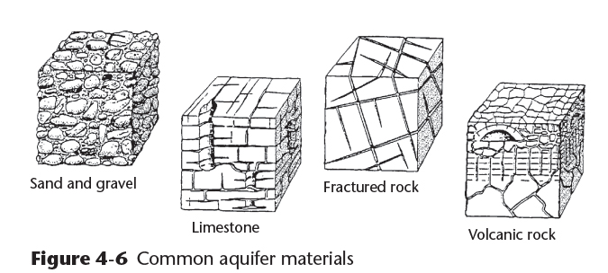
Aquifer Materials
Aquifers are made up of a variety of water-bearing materials (Figure 4-6)
Porosity: the amount of water that the material in the aquifer can hold
Permeability: the ease with which water flows through the aquifer materials (also known as hydraulic conductivity)
Copyright © 2016 the American Water Works Association
Notes:
Note: permeability also impacts the rate at which an aquifer recharges while a well is being pumped and after the pump has been shut down.

Slide 10
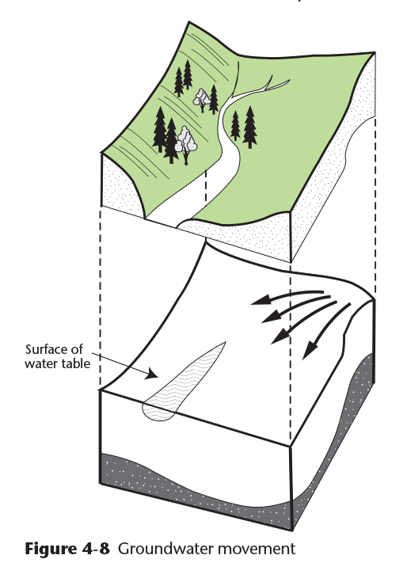
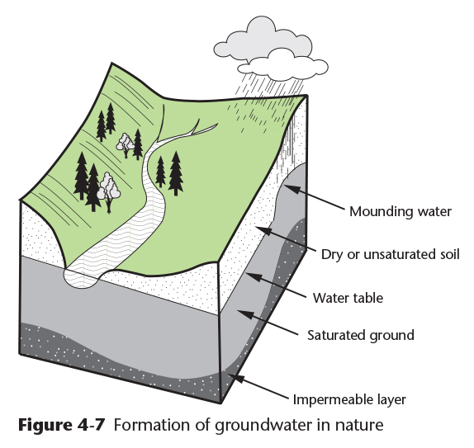
Groundwater Movement
Water moves downhill (down gradient) in an aquifer and may be at different levels as in Figure 4-7
Water may flow into a stream if the water table is higher than the stream stage level (elevation) as shown in Figure 4-8
Copyright © 2016 the American Water Works Association
Copyright © 2016 the American Water Works Association
Notes:
Some aquifers in Alaska are “perched” aquifers, located above a permafrost layer. If the permafrost thaws the aquifers may disappear, draining out through the newly thawed zone.

Slide 11
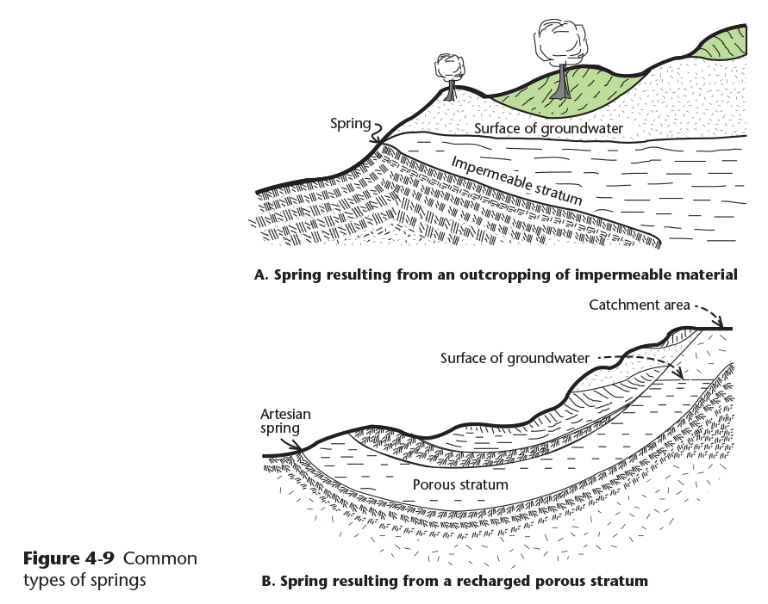
Springs
Springs occur where the water table intersects the surface of the ground – hydrologists refer to this as “daylighting”
Springs may be true groundwater, being recharged from a more distance source, or groundwater under the influence of surface water, being recharged from a nearby location
Copyright © 2016 the American Water Works Association

Slide 12
Video Clip: Aquifers
www.awwa.org/wsovideoclips

Slide 13
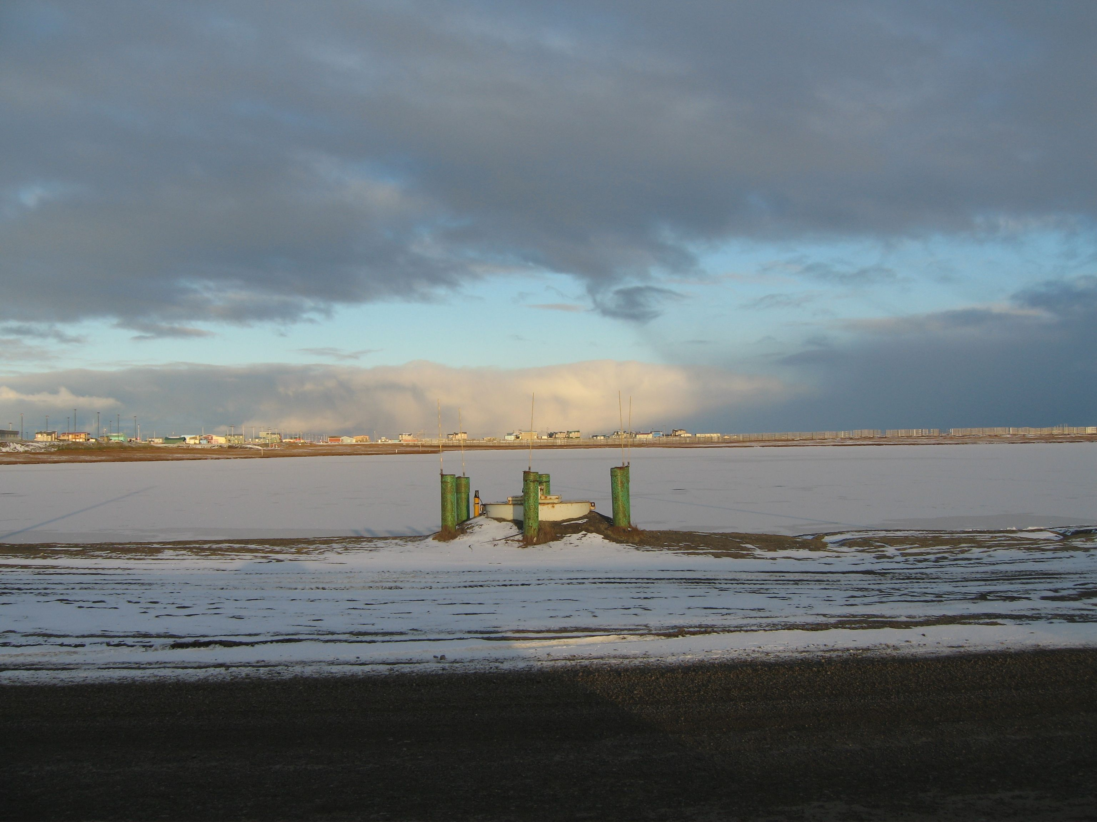
Surface Water
Surface water is water that is in contact with the atmosphere and results from overland flow
Surface water includes lakes, streams, rivers, surface impoundments (reservoirs), shallow springs and wells, sea water
Volume and chemical quality varies with the season and weather (precipitation events, snowmelt, wind action, ice scouring, etc.)
Contaminants can flow into the surface water from the ground during runoff, and can accumulate from activities in and around the watershed (see Table 4-1 for the chemical composition of rain water)
Notes:
Background photo: Isatkoak Reservoir – Barrow Utilities & Electric Coop, Inc. (BUECI). The salinity of this supply increases significantly during the winter as fresh water is lost to ice formation.

Slide 14
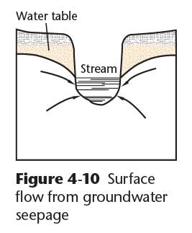
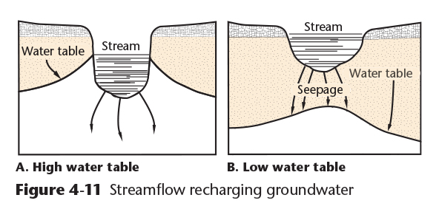
Groundwater Augmentation of Surface Water
If the water table is higher than the stream, groundwater flows into the stream. This is referred to as a “gaining stream.” (Figure 4-10)
If the water table is lower than the stream, water flows from the stream into the aquifer. This is a ”losing stream.” (Figure 4-11)
Copyright © 2016 the American Water Works Association

Slide 15
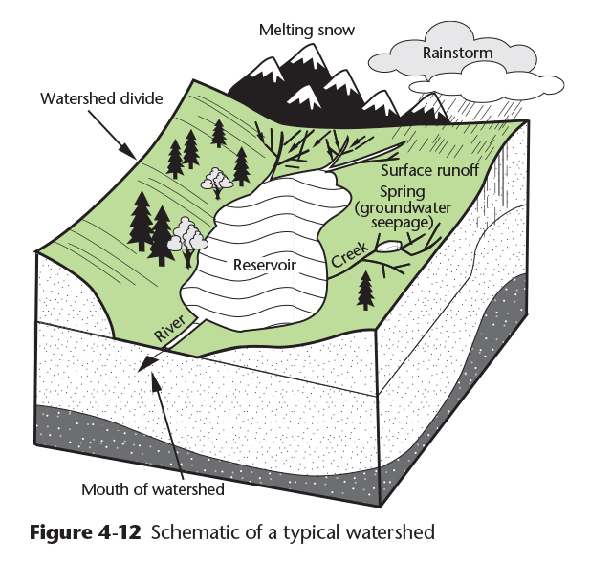
Surface Runoff
The drainage basin or watershed is the land surface that contributes water to the streams and water bodies in that area
Watercourses include naturally-occurring creeks, streams, and rivers and human constructed ditches, channels, canals, aqueducts, conduits, tunnels and storm sewers
Copyright © 2016 the American Water Works Association

Slide 16
Video Clip: Surface Water Sources
www.awwa.org/wsovideoclips

Slide 17
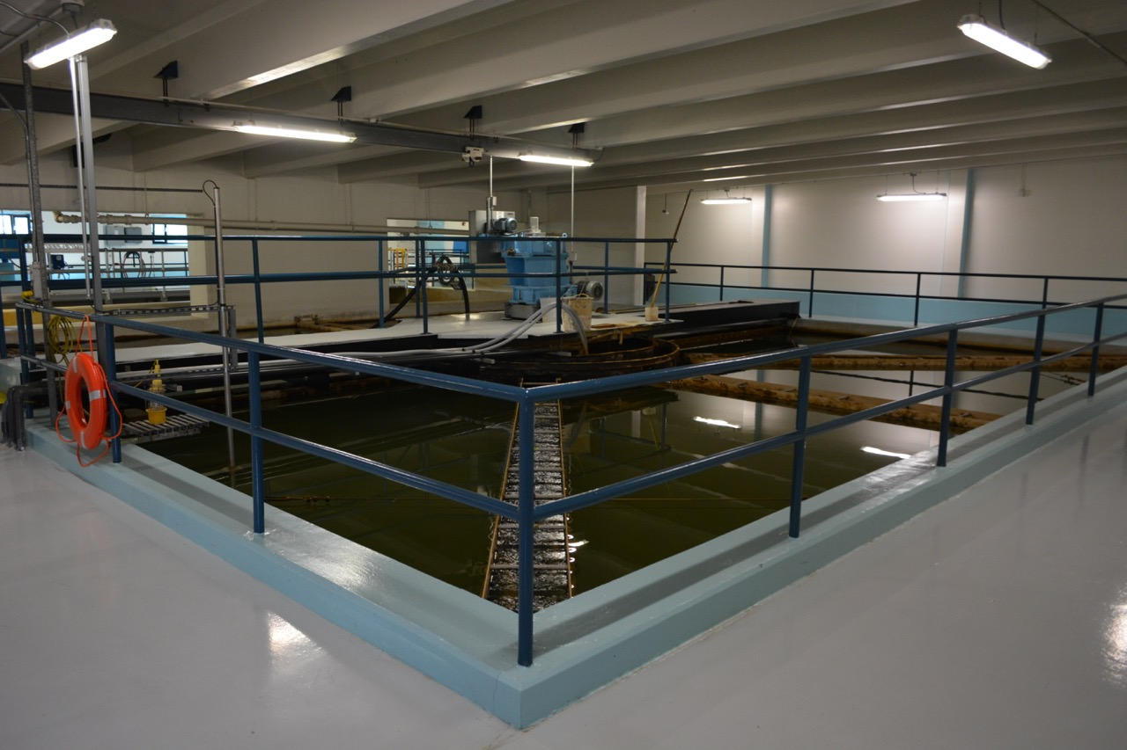
Introduction to Water Treatment
Health-Related Treatment: water is treated to the requirements of the safe drinking water act for microbiological, chemical, and radiological contaminants that have health effects
The resulting water is referred to as “Potable”
Aesthetic-Related Treatment: water is treated for secondary contaminants that affect the appearance, taste, odor, and other non health-related qualities of water
The resulting water is referred to as “Palatable”
Treatment Required by Regulation: the Safe Drinking Water Act requires minimum levels of treatment for different types of water sources such as surface water and groundwater
Notes:
Background photo: Golden Heart Utilities (GHU) 8-MGD lime softening groundwater treatment plant in Fairbanks – solids contact basin #2 operating.

Slide 18
Water Treatment Process Selection
Water Treatment Design Considerations:
Water supply source: groundwater versus surface water
Required finished water quality
Capital and operating costs
Process footprint versus land availability
Residuals disposal
Applicability to the multiple-barrier approach

Slide 19
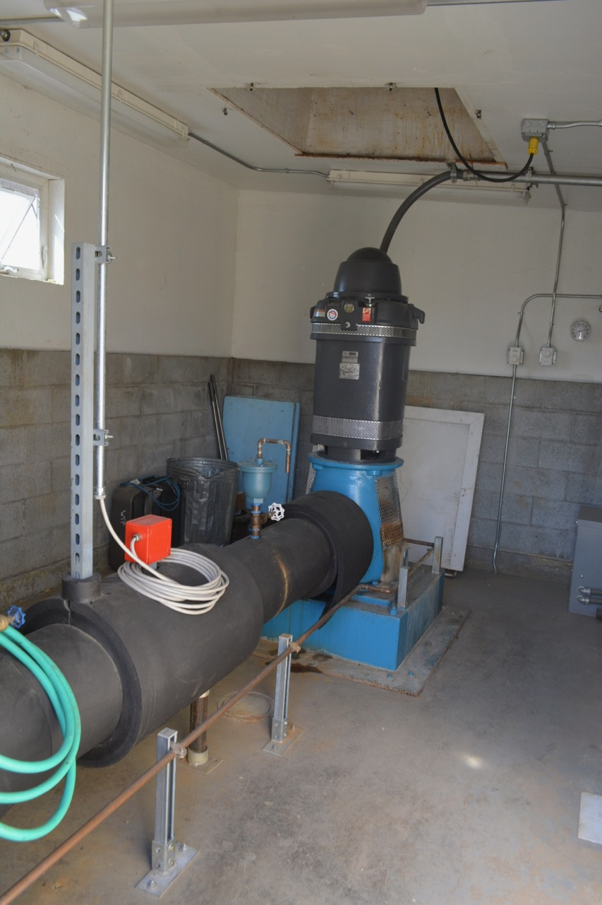
Groundwater Sources
Advantages:
Microbiological content is lower than surface water
Quality and temperature remain relatively constant
Disadvantages:
Higher mineral content (e.g. higher hardness levels, iron and manganese)
Persistent contaminants may be present in aquifers (e.g. fuels, solvents, synthetic organic chemicals)
Pumping costs are usually higher than surface water
Virus removal (disinfection) may be required by the Groundwater Rule
Groundwater well with a vertical turbine pump

Slide 20
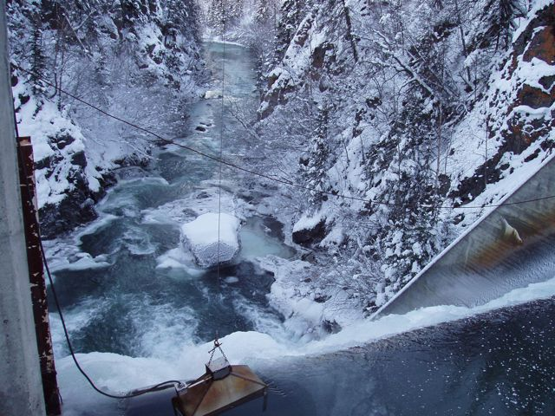
Surface Water Sources
Advantages:
Usually more accessible than groundwater, lower pumping costs
Information on quantity and quality is easier to obtain than groundwater
Disadvantages:
More easily contaminated than groundwater
Susceptible to algae blooms that can cause tastes, odors, and some toxicity
Quality and quantity can change rapidly requiring treatment adjustments
All surface water must be treated in accordance with the Surface Water Treatment Rules
Surface water reservoir gravity dam spillway

Slide 21
Multiple-Barrier Approach
The Multiple-Barrier Approach provides a relatively fail-safe system to water quality management for water utilities through the following elements:
Source water (watershed) protection
Provide appropriate and adequate treatment such as filtration and disinfection for surface water sources
Maintain water quality throughout the storage and distribution system
Provide adequate monitoring for regulated water quality parameters to ensure treated water is potable and palatable
Professional system operations including good business management and operator certification

Slide 22
Selection of Treatment Methods
The types of treatment methods used depends on the type and quality of source water, and may include any of the following, which will be reviewed in future chapters of this course:
Air stripping, aeration, and or chemical oxidation
Coagulation process, mixing and flocculation
Ion exchange
Chemical precipitation
Membrane processes
Disinfection
Absorption
Proper disposal of treatment residuals and waste streams

