Slide 1

CHAPTER 5
Groundwater Quality and Wells

Slide 2
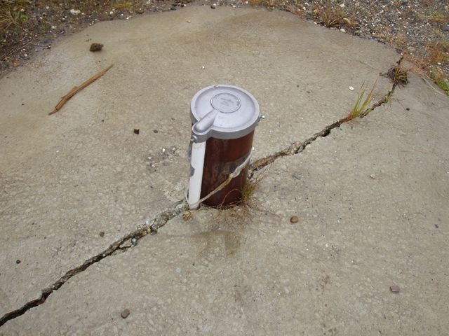
Groundwater Quality
Groundwater is usually less vulnerable to impacts from direct contamination than surface water sources, but may be affected by:
  Leaking underground storage tanks containing fuel and other chemicals
  Spills of chemicals that migrate into the aquifers
  Underground injection of wastes
  Inadequate well protection measures
  Leachate from sanitary landfills
  Overuse of fertilizer on crops and lawns

Slide 3
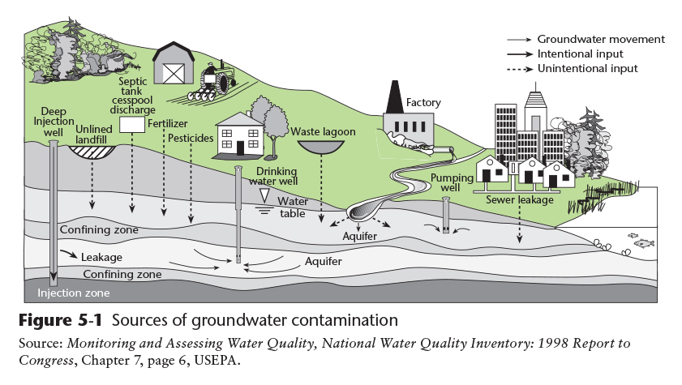
Aquifer Contamination
Copyright © 2016 the American Water Works Association

Slide 4
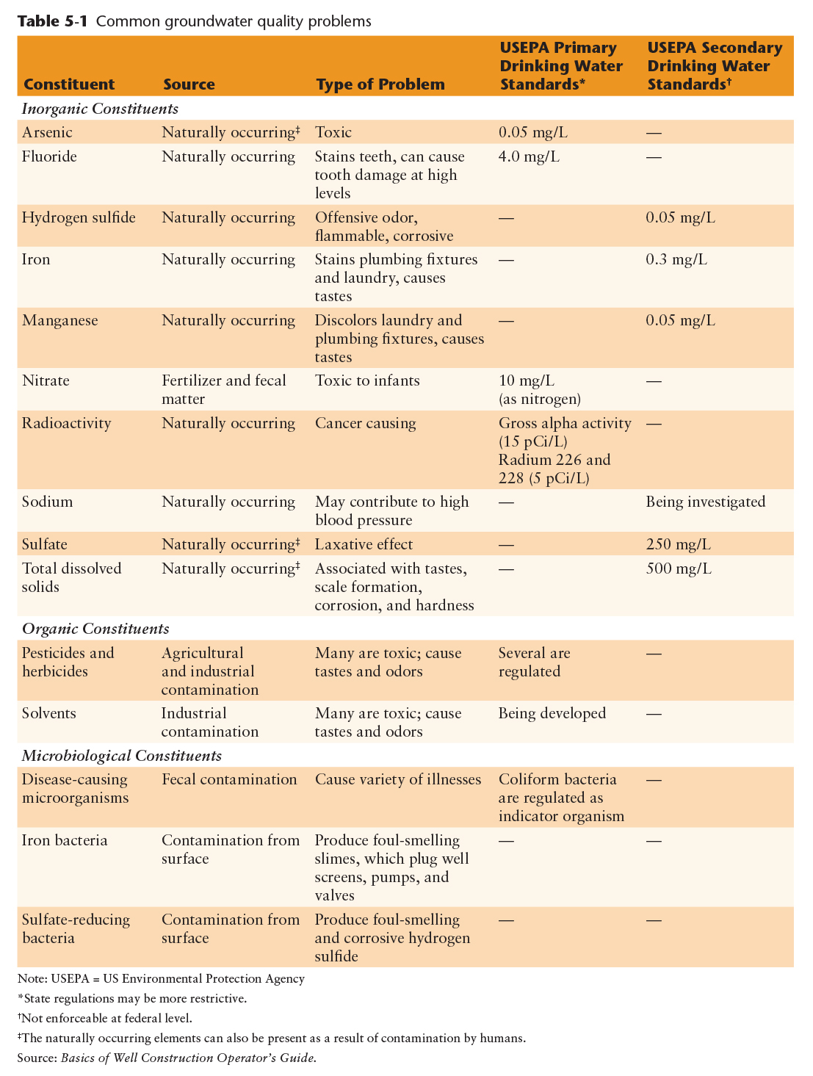
Chemical Characteristics of Groundwater
Groundwater aquifers can become contaminated from minerals leached from the rocks and soil in the aquifer or from surface contaminants that infiltrate into the ground such as persistent synthetic organic chemicals, fuels, and fertilizer
In coastal areas, salty seawater can be drawn into an aquifer as wells are pumped
Copyright © 2016 the American Water Works Association

Slide 5
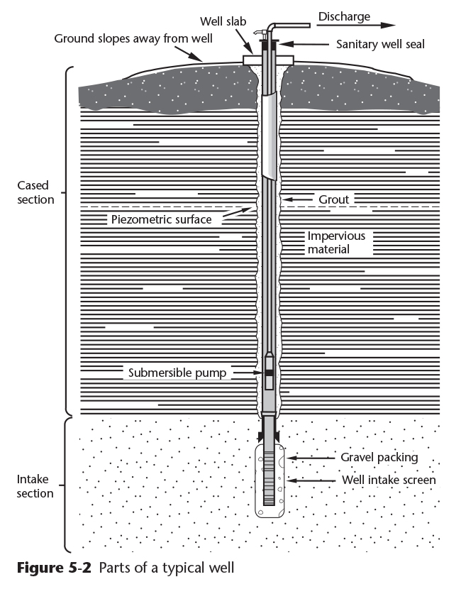
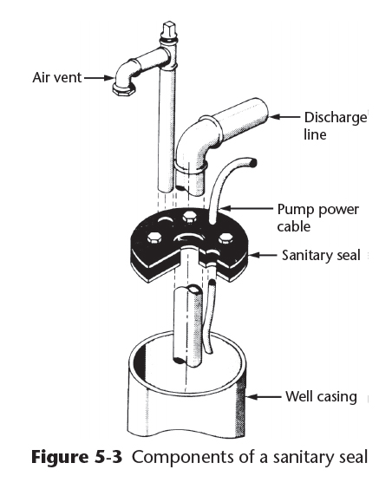
Water Well Terminology
Parts of a Well:
  Sanitary seal
  Well Casing
  Well Screen
  Well Slab
  Air Vent
  Well Pump
  Discharge Line
Copyright © 2016 the American Water Works Association

Slide 6
Well Terms
Static Water Level: top of the zone of saturation (water table)
Pumping Water Level: the level to which the water table is drawn down inside the casing during pumping
  Depth will vary with the pumping rate
Drawdown: the difference in feet of depth between the static water level and the pumping water level
Cone of Depression: a cone-shaped area around the well, usually in an unconfined aquifer that is drawn down during pumping
  The top of the cone is the static water level and the bottom is the pumping water level

Slide 7
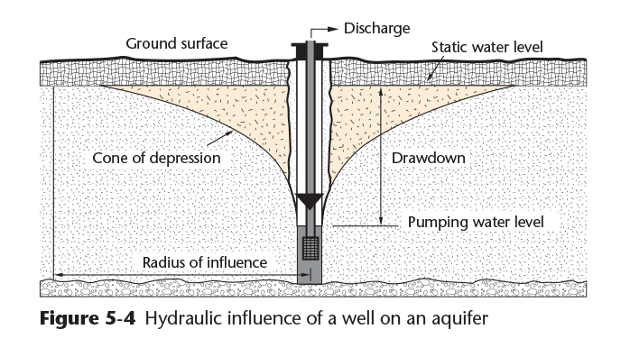
Well Terms
Copyright © 2016 the American Water Works Association

Slide 8
Well Terms
Zone of Influence: the area of the top of the cone of depression in the water table
  The size of the zone of influence is dependent on the well pumping rate and the porosity and conductivity of the aquifer
  Multiple wells in a well field can have overlapping cones of depression (Figure 5-5)
Residual Drawdown: if the level to which the water rises inside the well after pumping has stopped is less than the original static water level, the difference is called residual drawdown

Slide 9
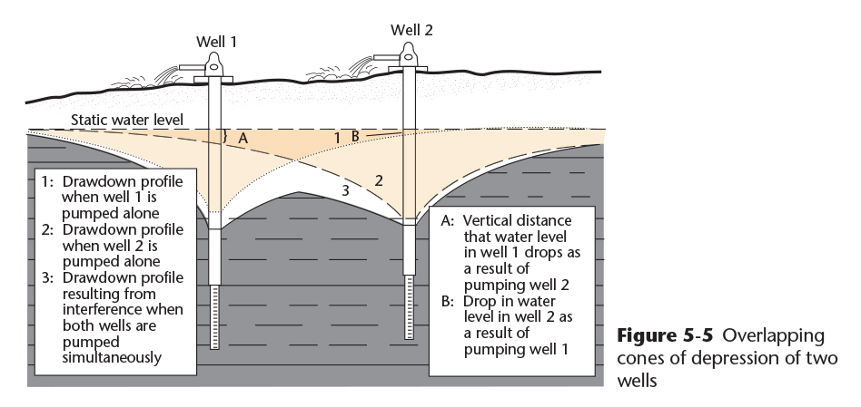
Well Terms
Copyright © 2016 the American Water Works Association

Slide 10
Well Terms
Well Yield: the rate at which a well can produce water over a long period of time in gallons per minute (gpm), gallons per hour (gph), or cubic feet per second (cfs)
Over pumping of aquifers can result in a loss of well yield over time – many aquifers in the United States have been over pumped and the water levels have declined in aquifers on a local or regional basis
  See Figure 5-6 on Page 126
Specific Capacity: a measure of well yield in gpm per foot of drawdown
  Example: 500 gpm ➗ 50 feet of drawdown = 10 gpm/foot

Slide 11
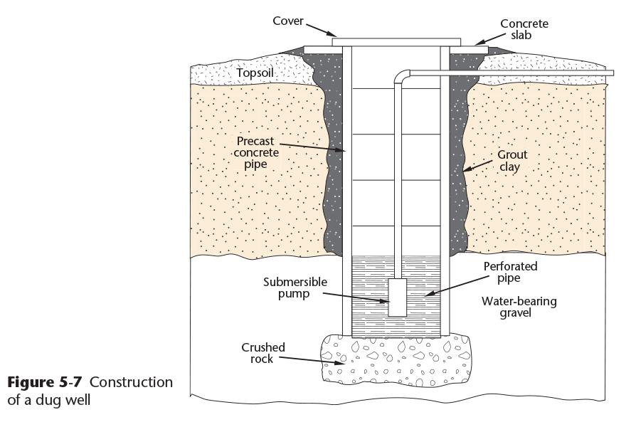
Types of Wells
Wells are classified by their method of construction:
Dug wells (Figure 5-7)
  Labor intensive, can be easily contaminated
Bored wells
  Drilled with an auger bit
Driven Wells
Jetted Wells
  Use high pressure water and a cutting knife, cased during excavation
Drilled Wells
Copyright © 2016 the American Water Works Association

Slide 12
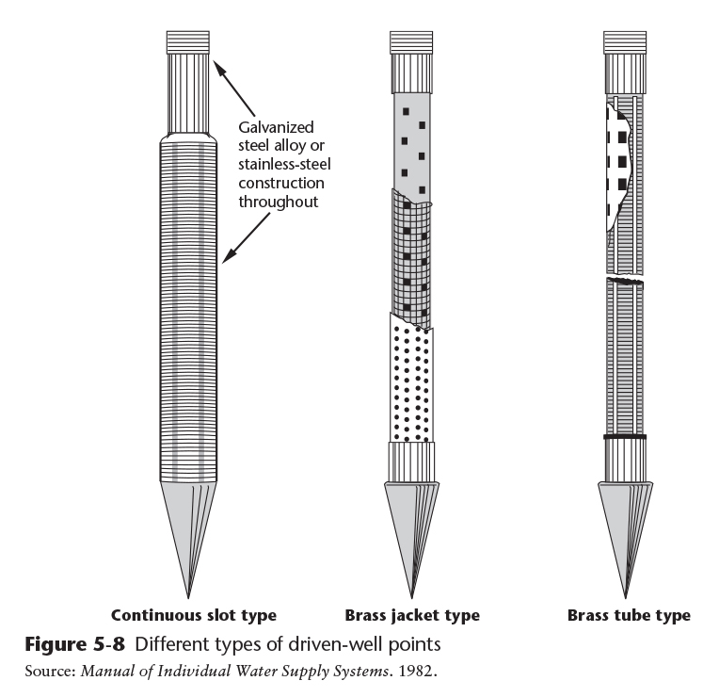
Types of Wells
Driven wells are simple to install, but are limited to a maximum depth of about 30 to 40 feet
Figure 5-8 shows various types of well points used in driven wells
Copyright © 2016 the American Water Works Association
Notes:
Driven wells are very common in Alaska in areas where the water table is relatively close to the surface such as the Mat-Su Valley and the Tanana Valley (Fairbanks). These can be susceptible to contamination from septic tank drain fields and other surface activities in the vicinity of the well.

Slide 13
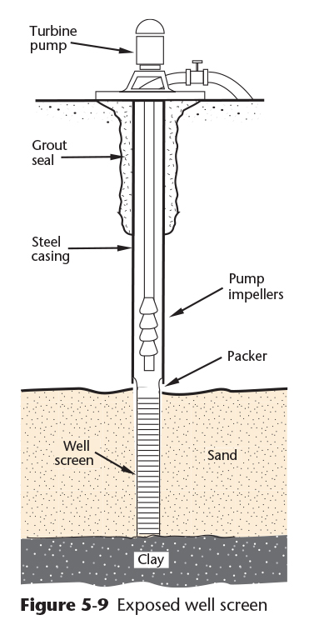
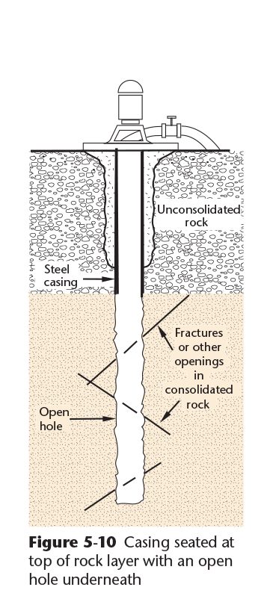
Drilled Wells
Cable-Tool Method
Percussion method using a club-like chisel edge
After 3-6 feet is drilled, a bailer is used to remove the cuttings
The casing will be lowered into the drilled hole as the well is developed
A well screen is placed when the well is completed in sand and gravel (Figure 5-9) or an open-bottom hole can be used in bedrock (Figure 5-10)
Copyright © 2016 the American Water Works Association

Slide 14
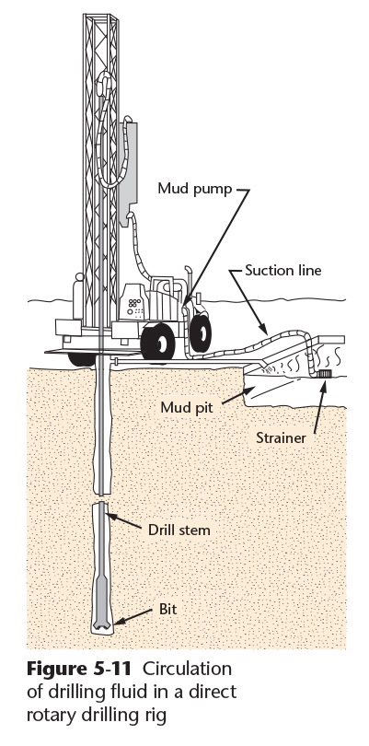
Drilled Wells
Rotary Hydraulic Method
A cylinder-shaped bit is spun on the bottom of sections of drill pipe. After 3-6 feet is drilled, a bailer is used to remove the cuttings
Drilling fluid, usually a slurry of clay and water, is circulated during drilling to remove the cuttings (Figure 5-11)
The clay in the drilling fluid and the pressure of the pumped fluid helps to prevent cave-in of the well while it is being drilled
Copyright © 2016 the American Water Works Association
Notes:
A common clay material used in the drilling fluid is bentonite

Slide 15
Drilled Wells
Reverse-Circulation Rotary Method
High pressure water is circulated to remove the cuttings in the opposite direction that occurs in rotary hydraulic drilling
Useful for aquifers that would plug if clay was used in the fluid
California Method
A bit and bailer is used to dig into unconsolidated materials, and sheet metal is used to case the well while it is being drilled
Rotary Air Method
Similar to rotary hydraulic method, but compressed air is used to remove the cuttings
This method is only used in stable bedrock

Slide 16
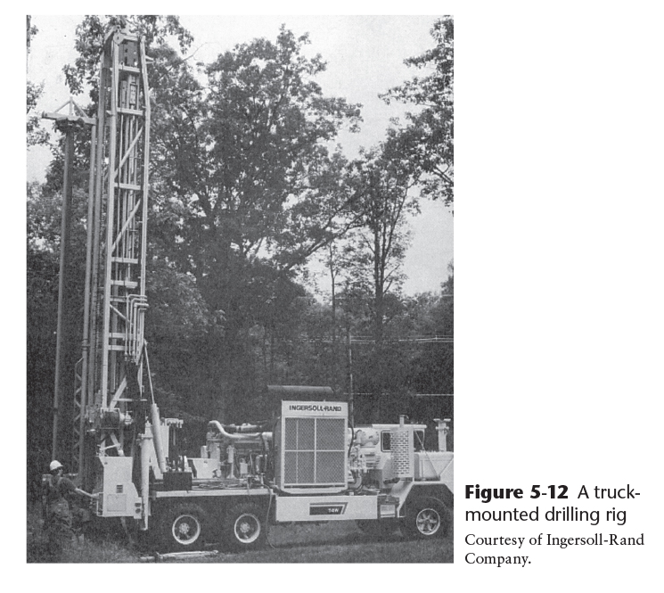
Drilled Wells
Down-the-Hole Hammer Method
A pneumatic hammer is used in this method to drill wells into rock
Compressed air is used to operate the hammer and to remove the cuttings
This is often the fastest method of drilling a well (Figure 5-12)
Copyright © 2016 the American Water Works Association

Slide 17
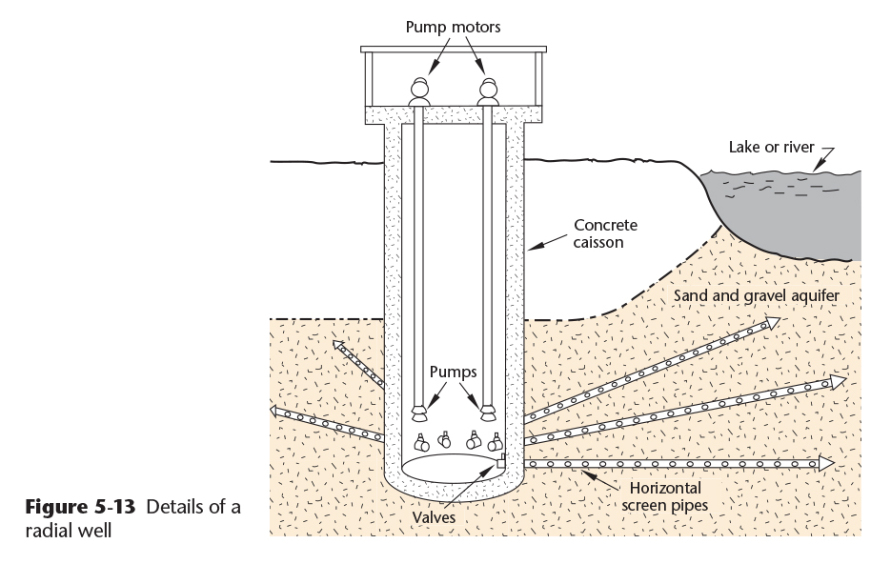
Special Types of Wells
Radial Wells are commonly constructed near the shore of a lake or river from high-yield aquifers (Figure 5-13)
The central vertical caisson is installed first, then horizontal wells are drilled into the aquifer through the caisson walls
Bedrock Wells are installed in fractured, porous bedrock rather than from a saturated aquifer
Copyright © 2016 the American Water Works Association

Slide 18
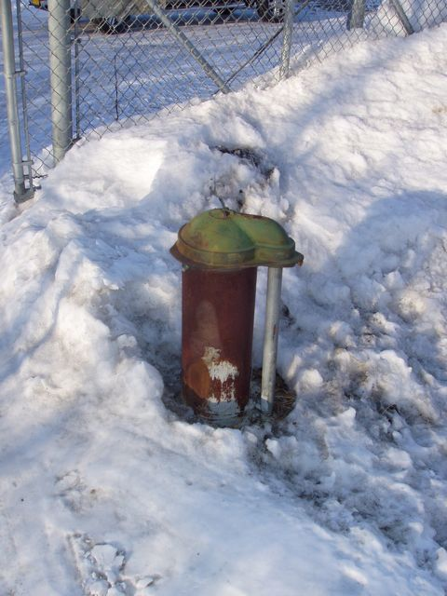
Well Construction Procedures
Well Components
Well Casings
  Usually made of steel, plastic, or fiberglass
  Lines the hole from the surface to the aquifer to prevent cave ins
Gravel Pack
Well Screens
Grouting
An Interior Alaskan Groundwater Well

Slide 19
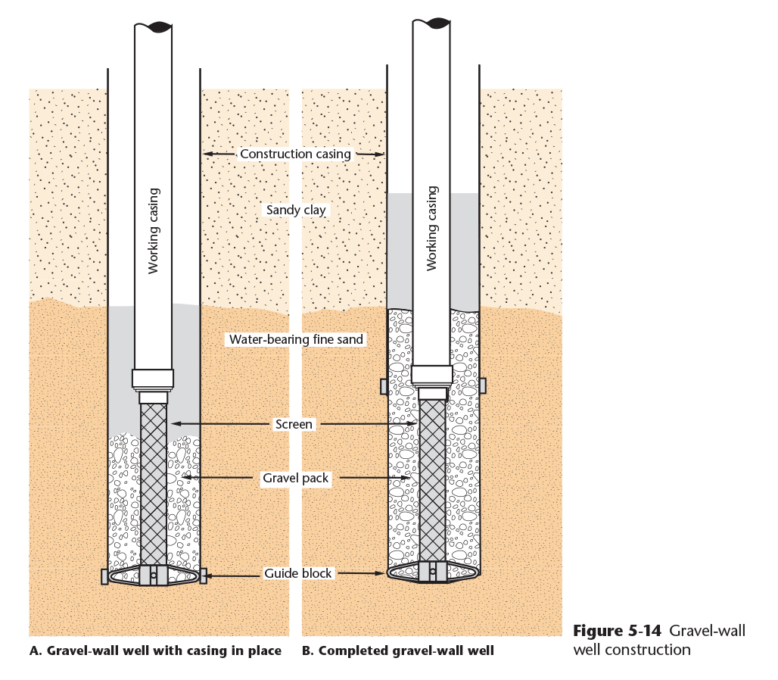
Well Construction Procedures
Gravel Pack
Used in aquifers comprised of fine sand and other small uniform particle-size material
Figure 5-14 shows how the gravel is set in place – inside a larger casing that is raised to the level of the screen once the gravel has been added
The size of the gravel is engineered to retain the size of sand in the aquifer
Copyright © 2016 the American Water Works Association

Slide 20
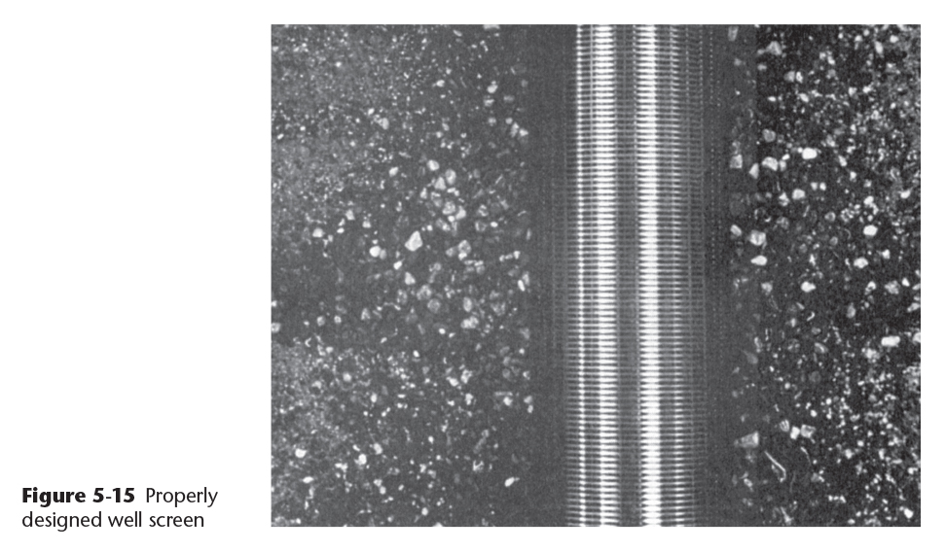
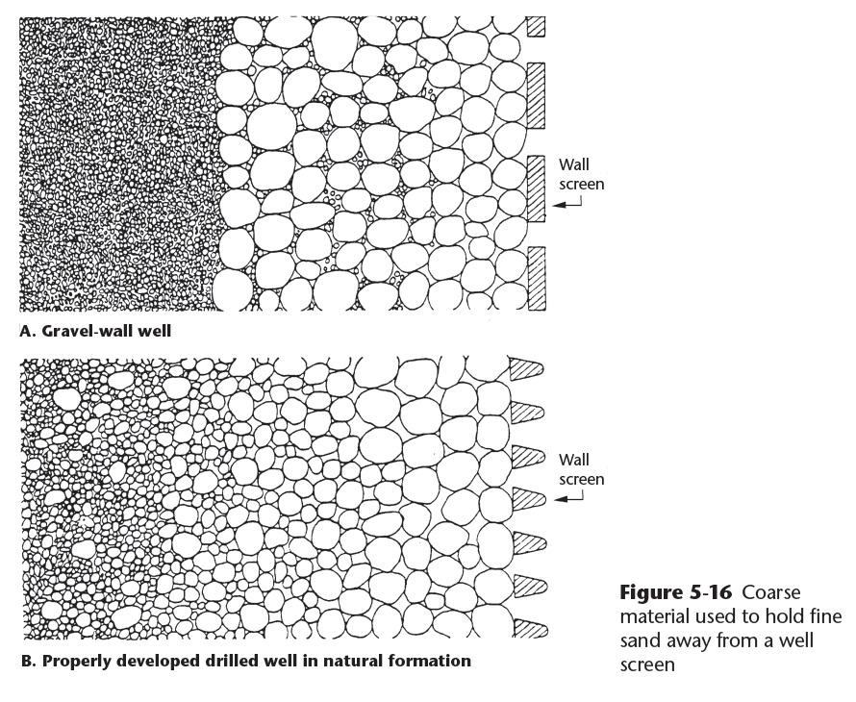
Well Construction Procedures
Well Screens
Slotted well screens, often made of stainless steel triangular wedge wire, are used to allow maximum flow of water while keeping the aquifer material in place
During development, some of the fines are produced (flushed out) leaving a natural gravel pack around the screen (see Figures 5 -15 and 5-16)
Copyright © 2016 the American Water Works Association
Notes:
Well screens are typically manufactured in 10 foot long sections with the screen slot widths engineered to the particle size of the aquifer material to be retained in place. If the instructor has a small section of wedge wire screen available, it can be shown to the attendees.

Slide 21
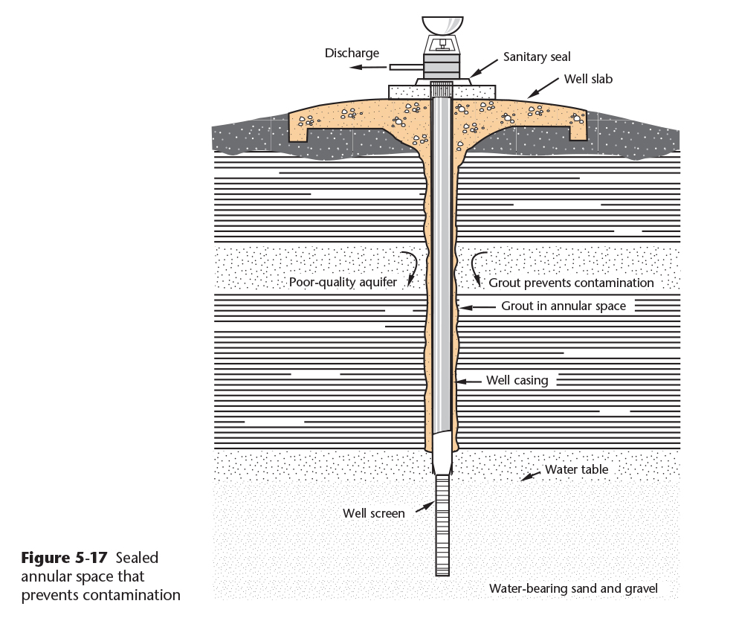
Well Construction Procedures
Grouting
Wells are grouted with cement or clay (e.g. bentonite) to:
  Seal the annular space outside the casing from surface water contamination
  Seal unwanted water-bearing strata
  Protect the casing exterior from corrosion
  Restrain unstable materials from collapsing into the well
Copyright © 2016 the American Water Works Association
Notes:
The State of Alaska requires 10 feet of the first 20 feet of annular space between the bore hole and the casing to be grouted with cement or expanding clay (e.g. bentonite).

Slide 22
Well Construction Procedures
Pumping Tests
After the well has been completed and flushed out, a pumping test is performed to demonstrate the continuous yield of the aquifer
  The pumping test is performed at a constant rate for at least 24 hours on a confined aquifer and 72 hours on an unconfined aquifer
  Drawdown is measured at one minute intervals for the first hour of the test, then at 10 minute intervals thereafter
Sanitary Considerations
In shallow, unconfined aquifers a 2-foot thick by 50 foot radius clay layer can be placed around the well and a concrete well pad set above that to prevent surface water from entering the area around the well
Disinfection procedures for wells is described in AWWA C654
  Typically 50 mg/L of chlorine residual is used during the disinfection procedure

Slide 23
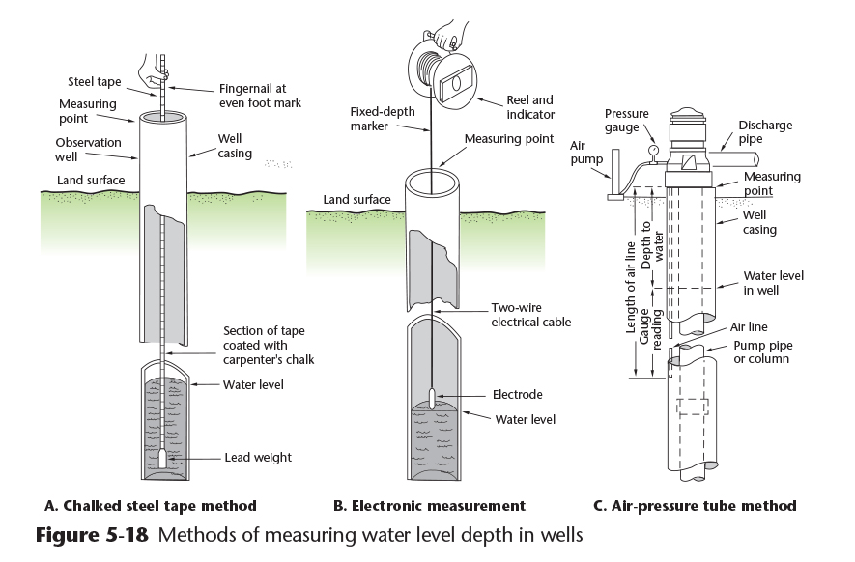
Aquifer Performance
Aquifer Evaluation
Aquifer drawdown and recovery rates can be evaluated using test wells around the main well
Methods of measuring water levels in wells are shown in Figure 5-18
Copyright © 2016 the American Water Works Association

Slide 24
Video Clip: Water Wells/Groundwater
www.awwa.org/wsovideoclips

Slide 25
Well Operation and Maintenance
Routine well testing:
  Static water level after the pump has been idle for a period of time
  Pumping water level
  Drawdown
  Well production
  Well yield
  Time required for recovery after pumping
  Specific capacity
  Periodic microbiological samples
Routine maintenance of pump, well screen, other equipment
  The most common reason for well failure is screen plugging
  Chemical cleaning of screens and well disinfection may be required

Slide 26
Well Abandonment
Purposes for proper well abandonment:
  Eliminate a physical hazard
  Prevent groundwater contamination
  Conserve the aquifer
  Prevent mixing of desirable and undesirable water between aquifers
Well abandonment process:
  Removal of pump, discharge piping, well screen, and casing if possible
  Sealing with concrete, bentonite, or a mixture of these
  Often best performed by a drilling contractor
Notes:
Proper well abandonment is a requirement of the ADEC drinking water regulations (18AAC 80) and is an item reviewed during sanitary surveys of the water system.

Slide 27
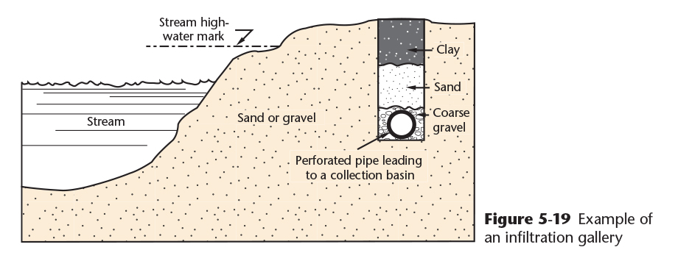
Springs and Infiltration Galleries
Springs occur where an aquifer “daylights” (is exposed at the surface)
  Shallow springs that originate from a surface water source may vary in quality and quantity throughout the year and during precipitation events and may need to be treated as surface water
Infiltration galleries collect water from lakes, streams, and rivers
  Intake structure uses the natural sand and gravel as a prefilter (Figure 5-19)
  Will likely be treated as surface water
Copyright © 2016 the American Water Works Association
Notes:
Infiltration galleries are used in areas of continuous permafrost in Alaska where “thaw bulbs” under rivers and “thaw bowls” occur under lakes.

