Slide 1

CHAPTER 7
Treatment Plant Pretreatment

Slide 2
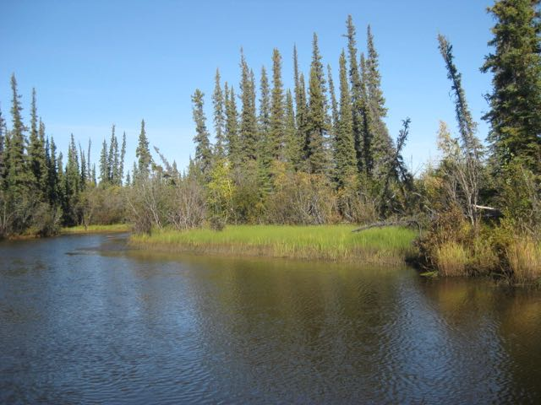
Preliminary Treatment
Preliminary Treatment (Pretreatment) includes:
Screening – for the removal of larger debris such as leaves, twigs, fish
Presedimentation – for the removal of heavier solids such as sand and grit
Microstraining – for the removal of smaller solids such as algae

Slide 3
Screening
Coarse screens located on intake structures are called trash racks or debris racks
Prevents clogging of the intake by removing sticks, logs, and other large debris
Finer screens may be used at the entrance to the treatment plant to remove smaller material that passed through the coarse screens
Bar screens are made of welded steel bars classified by opening size:
Fine screens: ¹/₁₆ to ½ inch spacing
Medium screens: ½ to 1 inch spacing
Coarse screens: 1¼ to 4 inch spacing

Slide 4
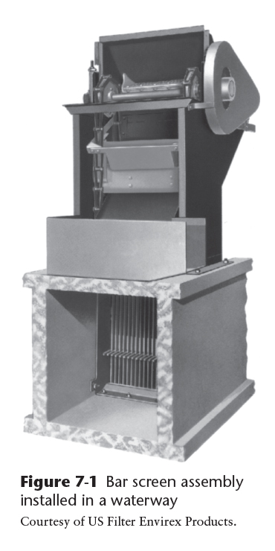
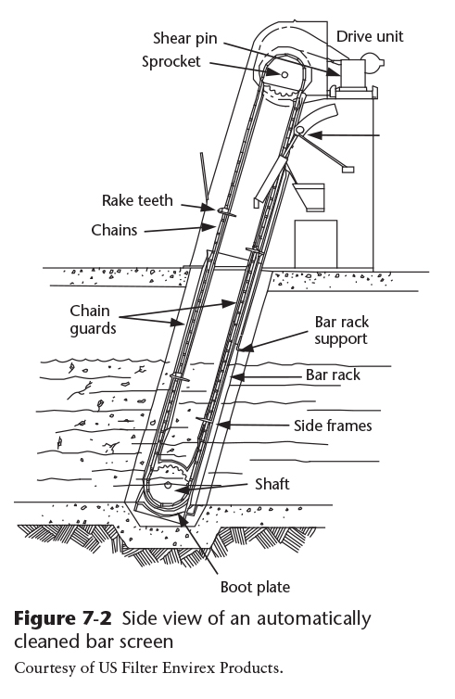
Bar Screens
Bar screens are usually installed in the waterway at an angle of 60 to 80° from horizontal to facilitate cleaning
Bar screens can be either a manual or automatic cleaning design
Copyright © 2016 the American Water Works Association

Slide 5
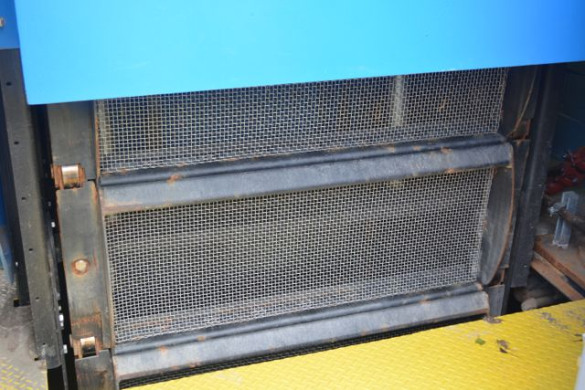
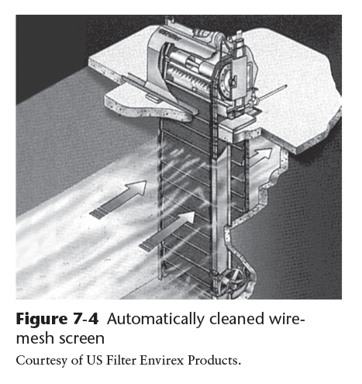
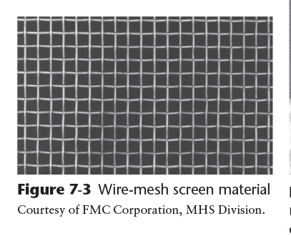
Wire Mesh Screens
Wire mesh screens or traveling water screens are made of fabric or woven stainless steel mesh with openings ranging from ¹/₆₀ to ³/₈ inch (0.4 to 10 mm)
Usually mechanically cleaned (Figure 7-4)
Copyright © 2016 the American Water Works Association
Notes:
Background photo: closeup view of an automatic screen similar to the one in Figure 7-4 used at the intake to a water treatment plant from a gravity dam in Alaska. Name of facility withheld on security request from utility.

Slide 6
Maintenance of Screening Equipment
Clogging and corrosion are problems associated with screening
Routine cleaning is required for manual systems
Routine preventive maintenance is required for automatic systems
Mechanical screens are equipped with circuit breakers and shear pins for emergency shutdown (See Figure 7-2, page 181)
Suggested records for screening equipment
Dates of inspections
Amount of material removed from screens
Records of unusual types of debris and water conditions

Slide 7
Presedimentation
Presedimentation is used to remove sand and other heavy gritty material that can damage pump impellers, prevent valves from closing properly, and clog filtration equipment. Systems include:
Presedimentation impoundments
Sand traps
Mechanical sand-and-grit removal devices

Slide 8
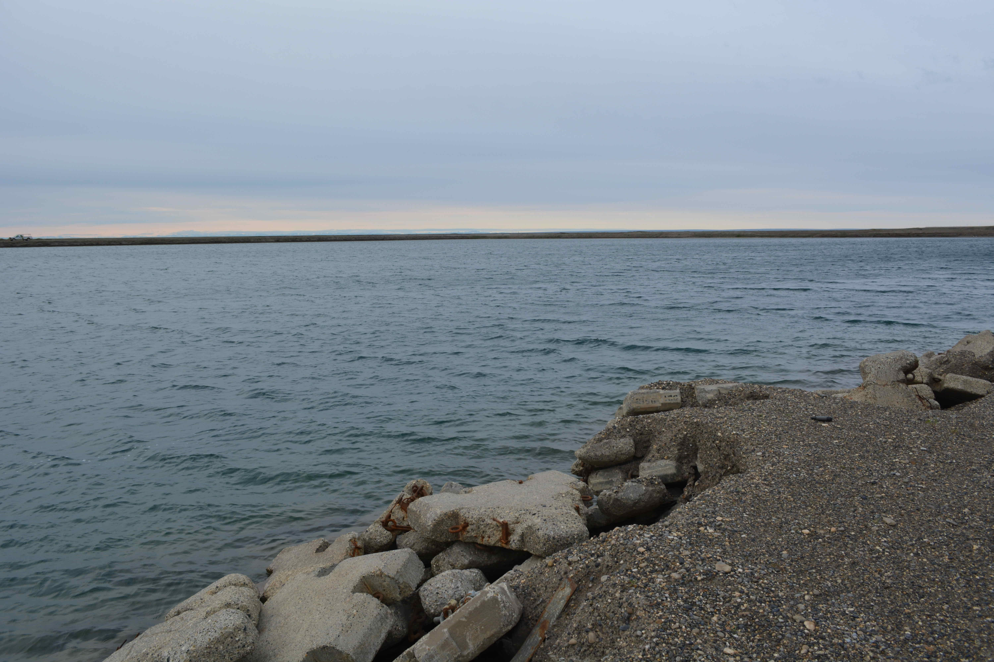
Presedimentation Impoundments
Commonly used for river supplies with heavy silt loads
Constructed of earth or concrete
Storage can be many months of system capacity
Potential issues with aquatic plants and stagnation
Storage and presedimentation basin on the North Slope
This basin is filled annually from a river

Slide 9
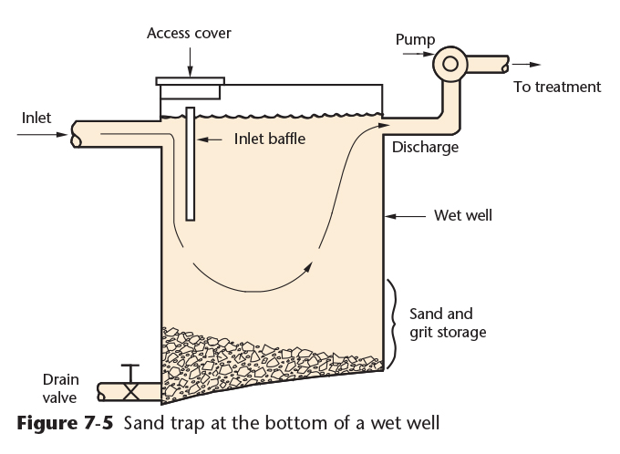
Sand Traps
Sand traps are depressions in the bottom of structures used to collect sand and grit
Baffles may be used to reduce the velocity of the water to improve settling
A grit removal system is provided at the bottom
Copyright © 2016 the American Water Works Association

Slide 10
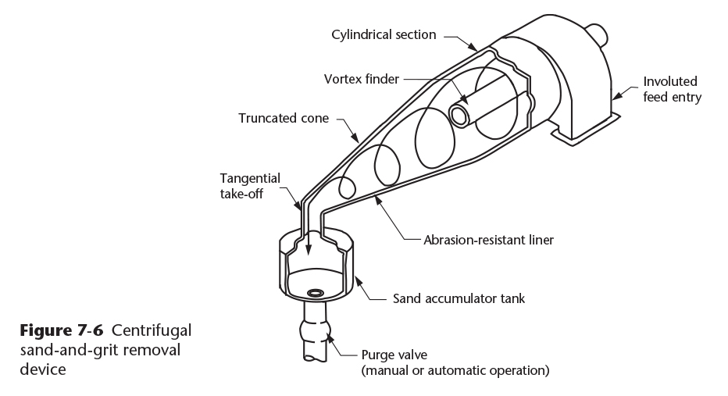
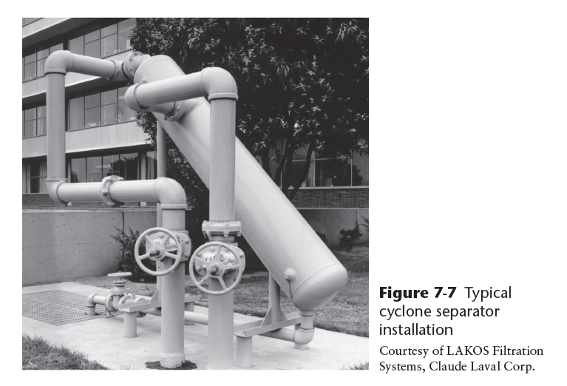
Mechanical Sand-and-Grit Removal Devices
Separation of sand and grit is accomplished with a centrifugal motion of the water to achieve a proper settling velocity inside the device
Sometimes referred to as cyclone degritters (e.g. Figure 7-7)
Copyright © 2016 the American Water Works Association
Notes:
The optimal velocity for grit removal is the same as in wastewater influent pretreatment: ~1 foot per second

Slide 11
Plate and tube Settlers
Plate or tube settlers are shallow-depth sedimentation enhancement systems designed to allow more rapid separation of solids from water
The plates or tubes are angled between approximately 7.5 and 60° depending on the settling velocity of the particles to be removed
Settled water exits the top and sand and grit is removed from the bottom
Schematic of a commercial tube settler unit

Slide 12
Operation and Maintenance of Presedimentation Systems
Presedimentation systems should be tested and cleaned regularly
Impoundments may have to be dewatered and dredged
Cyclone separators and plate or tube settlers remove sediment automatically, but the grit removal system should be routinely checked for proper operation
Suggested record keeping for presedimentation systems:
Date of sampling and testing
Amount of suspended solids in the raw water and the effluent in mg/L or ml/L if settleability tests with an Imhoff cone are used
Cleaning date, time required and amount of material removed
1-Liter Imhoff Cones for 1-hour settleable solids test

Slide 13
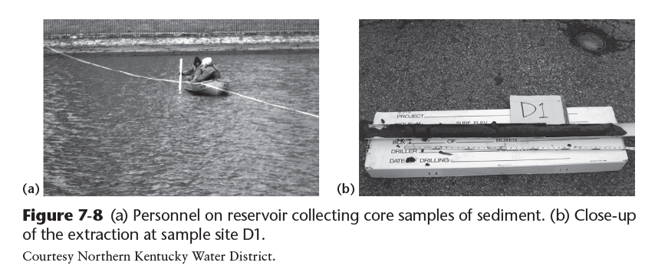
Sediment sampling from a Presedimentation Basin
Copyright © 2016 the American Water Works Association

Slide 14
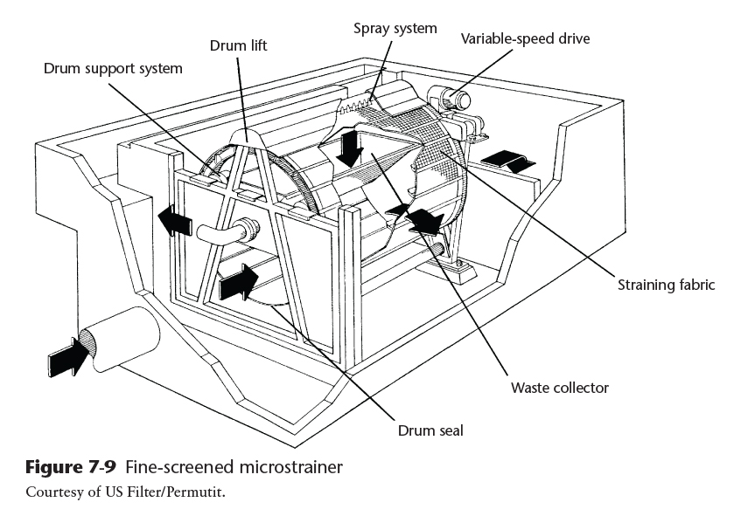
Microstraining
Microstrainers are very fine screens typically used to remove algae
Usually a rotating drum with a fine mesh fabric or stainless-steel screen
Up to 160,000 openings per in²
Live algae are easier to remove than dead algae, so prechlorination is not recommended
Copyright © 2016 the American Water Works Association
Notes:
See page 188 for a comment on peroxidation. This topic will be discussed further in Chapters 12 and 17.

