Slide 1

CHAPTER 9
Sedimentation and Clarifiers

Slide 2
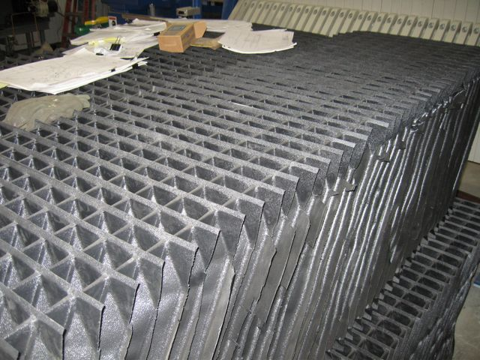
Process Description
Sedimentation (or “clarification”) removes most of the particles from the water formed during coagulation and flocculation prior to sand filtration
The primary process is gravity settling in a sedimentation (settling) basin or tank
Also used to remove chemical precipitates formed during lime softening (see Chapter 16)
Monitoring of the influent (incoming) and effluent (outgoing) water is used to determine process efficiency
Turbidity tests are a common monitoring parameter
Settling basins are designed for slow flow rates with a minimum of turbulence to prevent high velocity currents from inhibiting settling
Short-circuiting: high velocity currents that inhibit proper settling
Notes:
Background photo: closeup of a tube settler bundle in a package water treatment plant

Slide 3
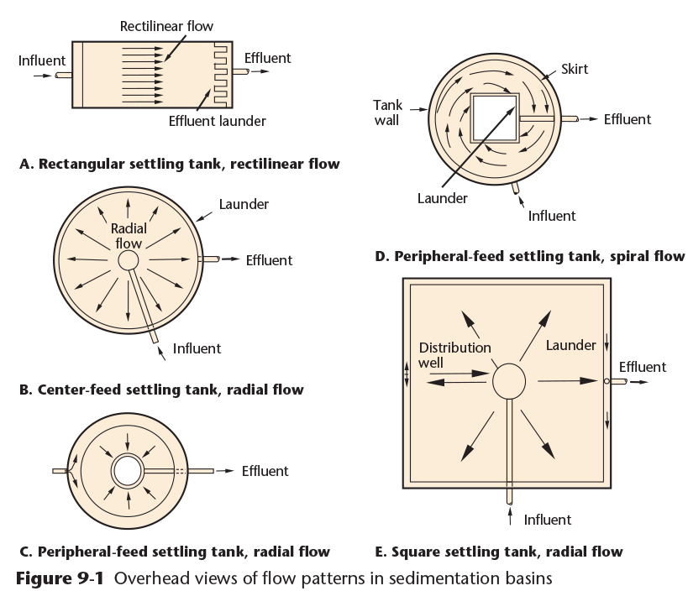
Sedimentation Facilities
Types of Basins:
Conventional rectangular basins
Conventional center-feed basins – circular or square, using radial flow
Peripheral-Feed basins
Spiral-Flow basins
Copyright © 2016 the American Water Works Association

Slide 4
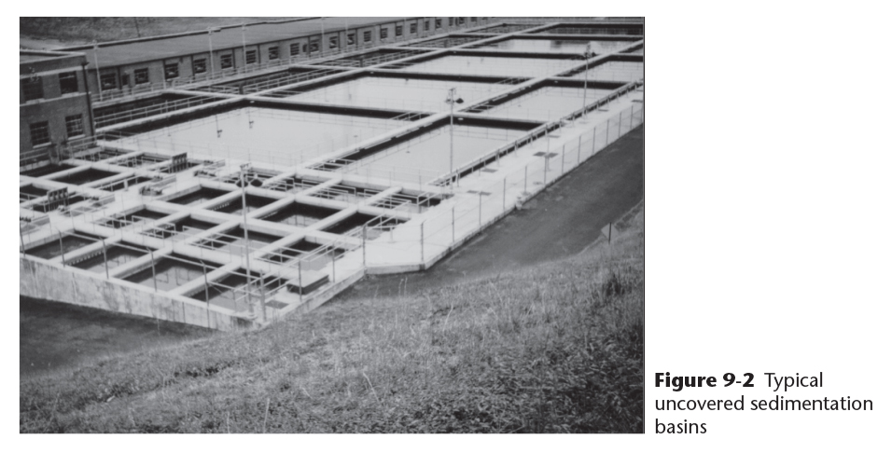
Rectangular Sedimentation Basins
Copyright © 2016 the American Water Works Association

Slide 5
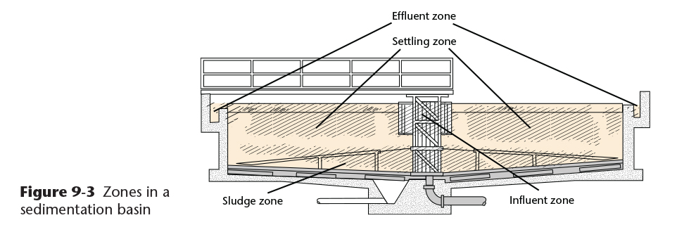
Sedimentation Basin Zones
Copyright © 2016 the American Water Works Association
Influent Zone – decreases velocity of incoming water
Settling Zone – quiescent settling area where particles settle
Effluent Zone – provides a smooth transition from the settling zone to the effluent channels
Sludge Zone – receives and manages the settled solids at the bottom of the basin

Slide 6
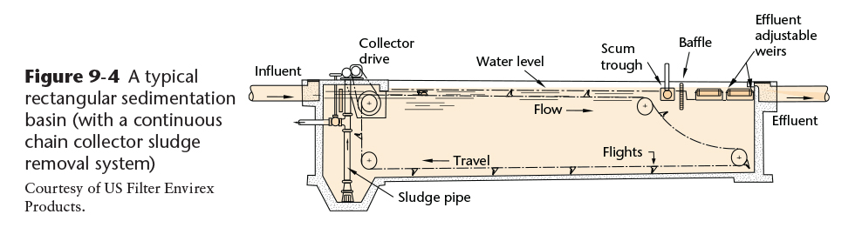
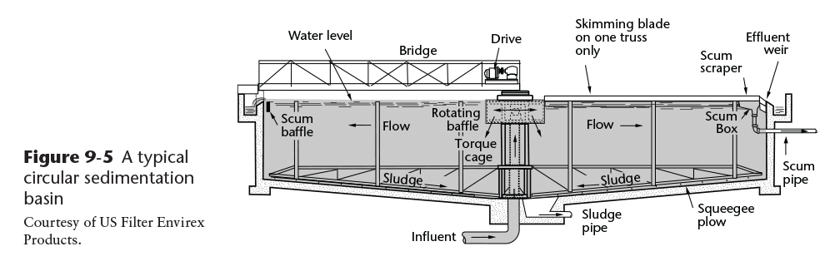
Parts of a Sedimentation Basin
Copyright © 2016 the American Water Works Association

Slide 7
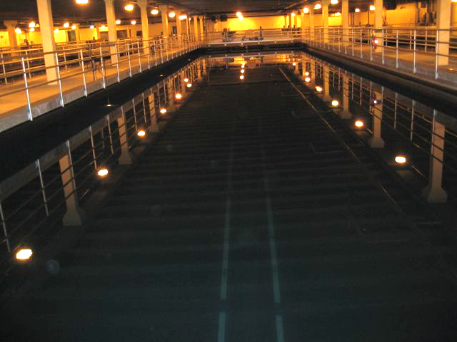
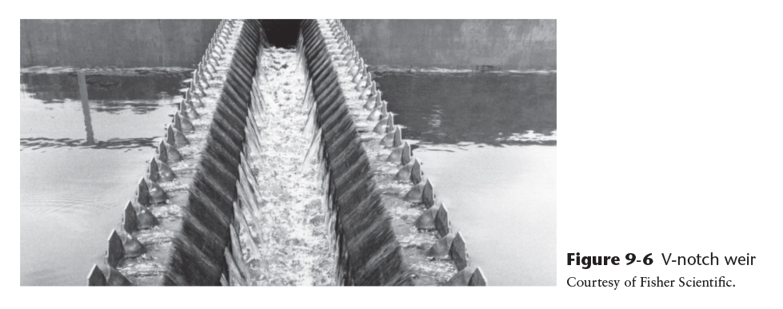
Sedimentation Basin Weirs and Launders
Effluent weirs may be located at the circumference of a circular clarifier, at the end of a rectangular clarifier, or across the top of the clarifier
Weir plates can be flat or V-notched
Effluent troughs are also called launder channels
Copyright © 2016 the American Water Works Association
Notes:
Background photo – picture of a large clarifier in a conventional surface water treatment plant in southcentral Alaska

Slide 8
Shallow-Depth Sedimentation
Shallow Basins:
Reduce the settling time of solids being separated
May be constructed in multiple levels
Designed on the principal that surface area is more important than depth
Plate and Tube Settlers:
Usually constructed in modules
Plates or tubes may be constructed of steel, fiberglass, or plastic (Figure 9-7)
Set in at an angle from horizontal, ranging from 7° to over 60° (Figure 9-8)
Steep angles (>50°) are self-cleaning (Figure 9-9)
Plates or tubes are only a few inches apart and 3 to 6 feet in length (Figure 9-10)
Plate settlers are also called Lamella®️ Plates (Figure 9-11)

Slide 9
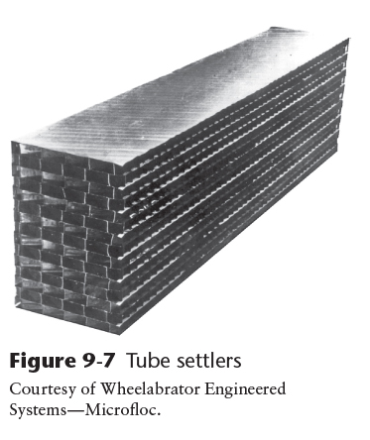
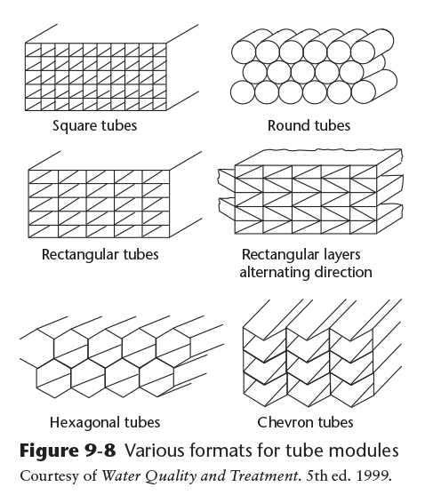
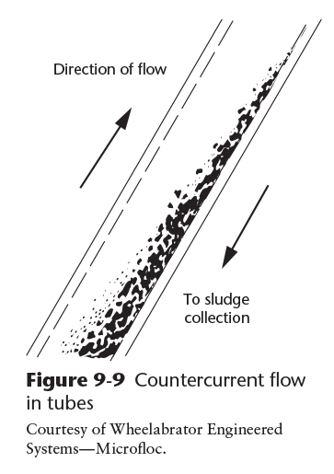
Tube Settlers
Copyright © 2016 the American Water Works Association

Slide 10
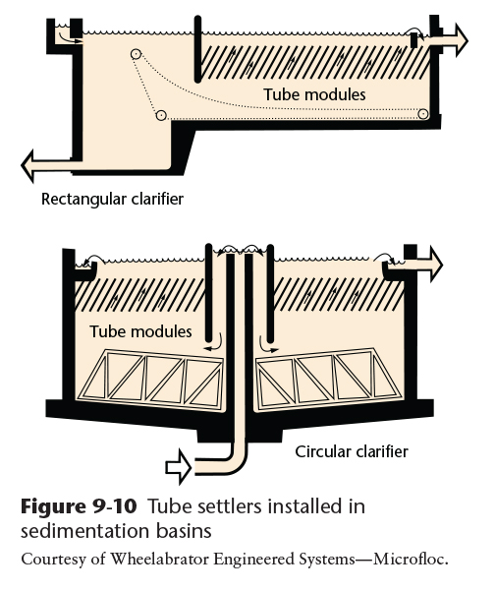
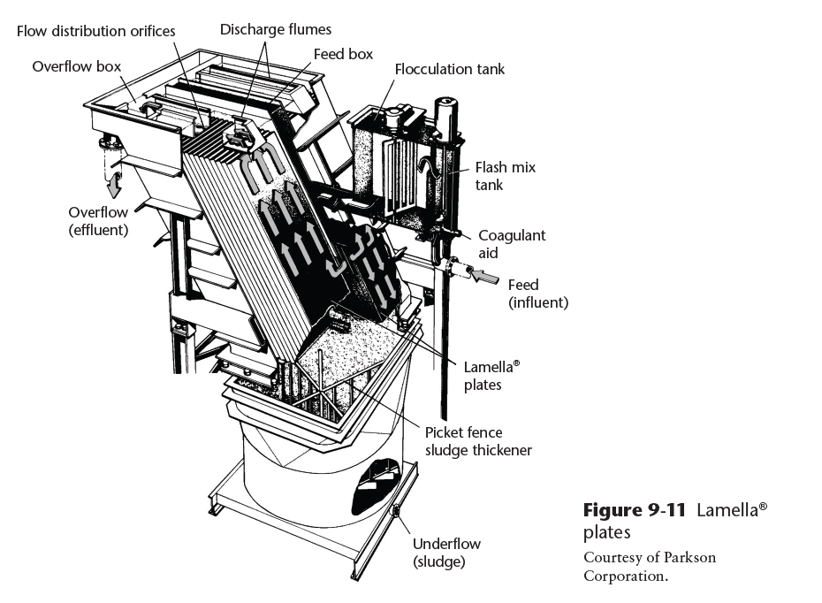
Tube Settlers and Lamella®️ Plates
Copyright © 2016 the American Water Works Association

Slide 11
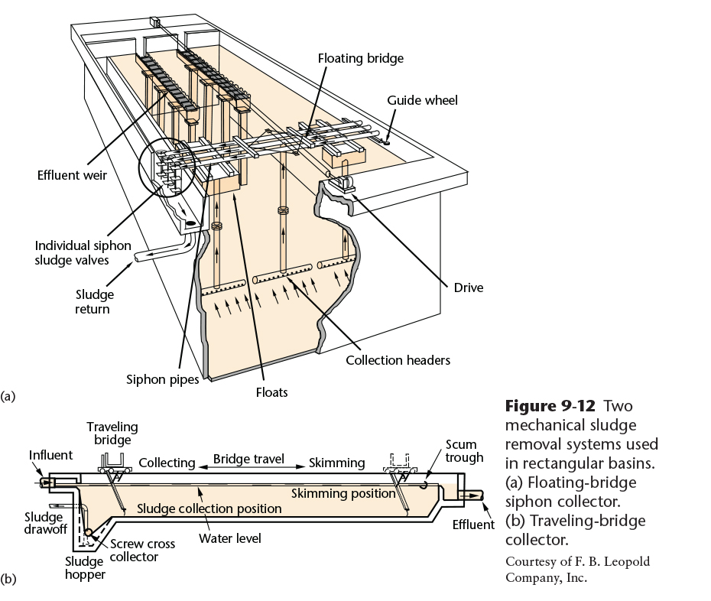
Sludge Removal
Settled solids must be removed from the bottom of the sedimentation basin before they get too thick and to prevent resuspension of the particles
If the sludge remains in the bottom of the sedimentation basin too long, tastes and odors can develop
Copyright © 2016 the American Water Works Association

Slide 12
Video Clip: Sedimentation and Clarifiers
www.awwa.org/wsovideoclips

