Slide 1

CHAPTER 10
Filtration Fundamentals

Slide 2
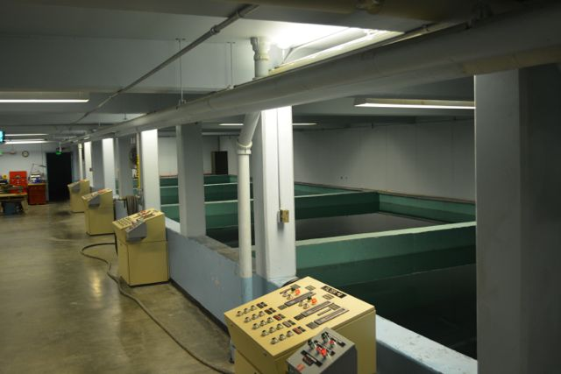
Process Description
Filtration naturally removes suspended solids as groundwater percolates through the sand and gravel in an aquifer
Filtration is used for the removal of both naturally-occurring particulate matter in surface water and residual floc that was not removed during sedimentation in clarifiers
  Filtration of surface water is necessary because of the high probability of contamination from surface runoff
A bed of granular filter media is used to remove and store the particulate matter
  Common filter media materials include sand, anthracite, activated carbon, garnet sand, and gravel
The filter media is cleaned during backwashing – reversing the flow of water backwards through the filter
Notes:
Background photo: View of the filter gallery at the Fort Richardson (JBER) water treatment plant

Slide 3
Turbidity Removal
Visible turbidity or cloudiness in water is objectionable to consumers
Turbidity particles can also interfere with disinfection, shielding pathogenic microorganisms from the effects of disinfection
Some turbidity particles can create taste and odor problems in the distribution system
Removal of turbidity by filtration is a required process in most surface water treatment facilities

Slide 4
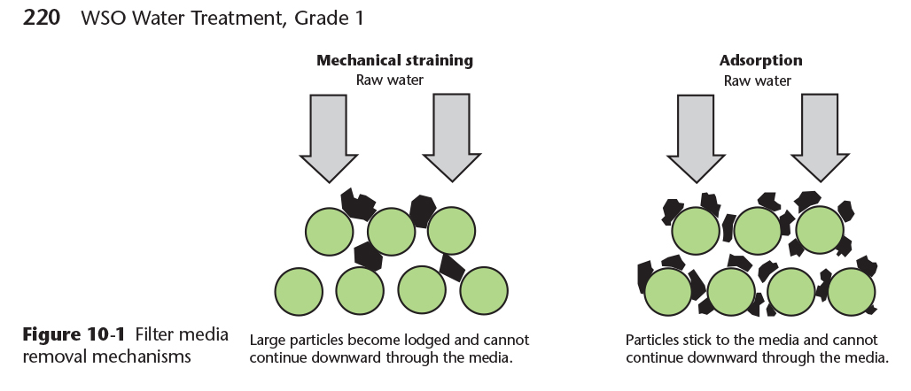
The Filtration Process
Filtration is accomplished through a combination of processes including mechanical straining and adsorption of charged particles onto the surface of the filter media
Copyright © 2016 the American Water Works Association

Slide 5
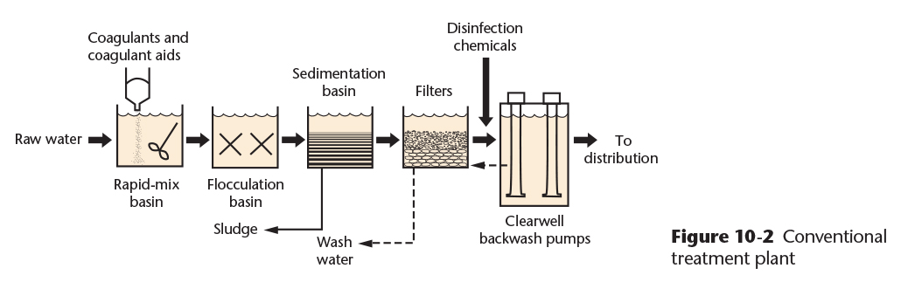
Approaches to Filtration
Conventional Treatment: The combined processes of coagulation, flocculation, sedimentation, and filtration (Figure 10-2) is one of the most common water treatment plant designs and can treat water with a wide variety of turbidity levels
Copyright © 2016 the American Water Works Association

Slide 6
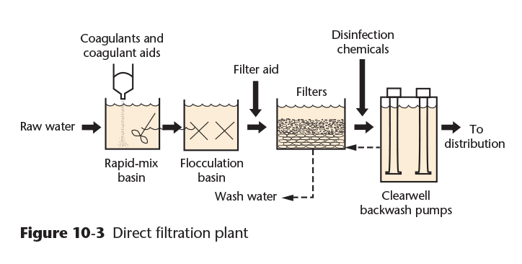
Approaches to Filtration
Direct Filtration: Direct filtration uses coagulation and flocculation, but does not have a sedimentation basin prior to filtration. This process can only be used on water with relatively low turbidity concentrations. It requires close monitoring to prevent overloading the filters with turbidity and chemical precipitates.
Copyright © 2016 the American Water Works Association

Slide 7
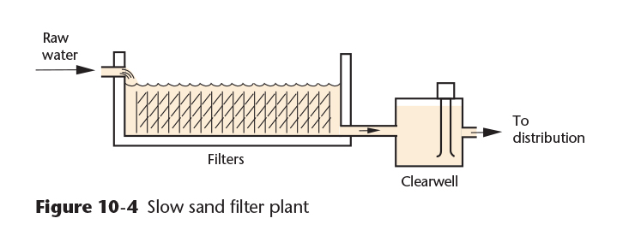
Approaches to Filtration
Slow Sand Filtration: Slow sand filters are an older type of filtration system, having been introduced into the United States in 1872 and used in Europe prior to that. Low turbidity water is fed without chemicals to the top of the sand and a biofilm forms that is the primary treatment mechanism. These filters are not backwashed, but are mechanically cleaned by raking off the biological layer when the flow slows.
Copyright © 2016 the American Water Works Association
Notes:
The City of Wrangel in Southeast Alaska uses a slow sand filtration system rated at 1.3 MGD. A smaller slow sand filter serves the Ranger Station at Glacier Bay near Gustavus.

Slide 8
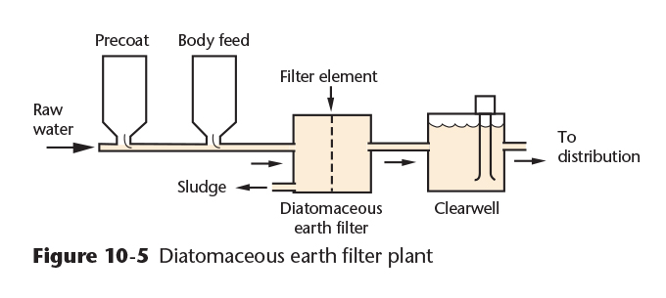
Approaches to Filtration
Diatomaceous Earth Filtration: Diatomaceous earth (DE) is a chalky silica material that is fed onto a filter element, forming a coating that filters the water. DE filters are backwashed and then recoated with a precoat. A continuous body feed of DE is applied as filtration progresses, until a backwash is required.
Copyright © 2016 the American Water Works Association
Notes:
The Village of Quinahagaq in southwest Alaska uses a DE filtration system treating surface water from a river.

Slide 9
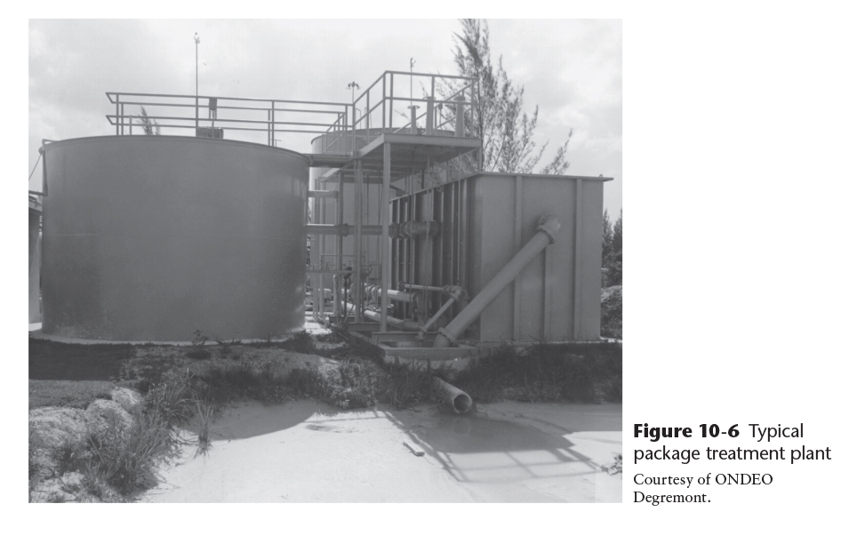
Approaches to Filtration
Package Treatment Plants: Small, prefabricated, units that traditionally have included a coagulation-flocculation unit, sedimentation tank, and a filtration unit. These may be constructed in a single package or in multiple tanks that are joined together in the field (Figure 10-6). Other treatment processes are now available as package plants.
Copyright © 2016 the American Water Works Association
Notes:
Package water treatment plants are very popular in Alaska, with dozens of installations used in small communities. They are also widely used in oil and gas industry, mining, and seafood processing personnel camps and in the tourism industry serving hotels and lodges. The total number of package water treatment plants that have been used in Alaska is in the hundreds.

Slide 10
Approaches to Filtration
Biological Treatment: In biological treatment, beneficial microorganisms are allowed to grow on a filter medium. The microorganisms will consume organic matter that could form disinfection by-products such as trihalomethane (TTHM) compounds after disinfection with chlorine.
The treated water is usually less susceptible to bacterial growth in the distribution system than conventionally treated water, and often has less taste and odor problems and has a lower chlorine demand.
Notes:
The Wrangel slow sand filtration treatment plant uses a biological pretreatment process ahead of the slow sand filters to remove organic carbon that could form disinfection by-products.

Slide 11
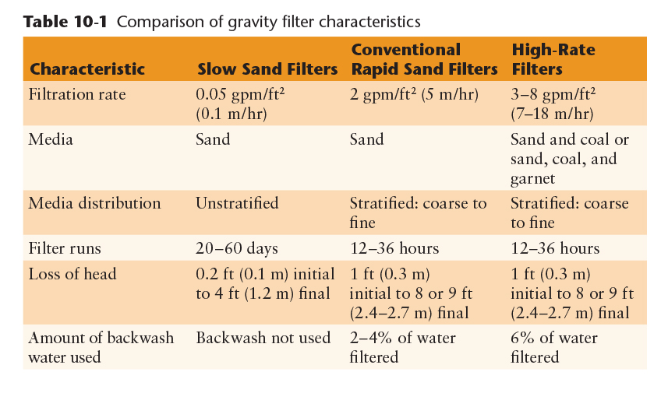
Types of Gravity Filters
Copyright © 2016 the American Water Works Association

Slide 12
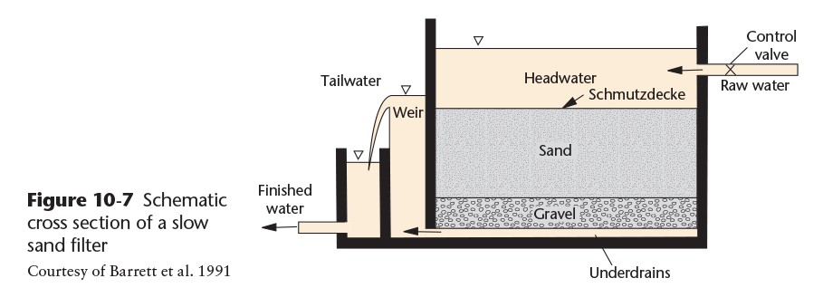
Slow Sand Filters
Slow Sand Filtration: The biological layer is called a “Schmutzdecke,” which is a German word meaning “dirty layer.” The Schmutzdecke is formed from naturally occurring turbidity, organic matter, and microorganisms that are removed on the surface of the filter. This layer is scraped off when the flow rate slows too much.
Copyright © 2016 the American Water Works Association

Slide 13
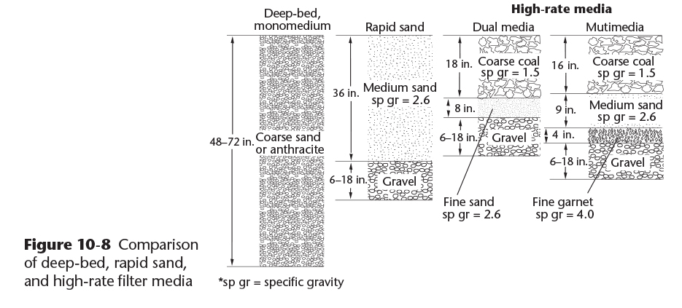
Rapid Sand Filters
Conventional Rapid Sand Filters: Operate at much higher filtration rates than slow sand filters (see Table 10-1), and are cleaned by backwashing.
High-Rate Filters: Dual-media or multimedia filters designed to operate at rates up to four times higher than conventional rapid sand filters.
Copyright © 2016 the American Water Works Association

Slide 14
Rapid Sand Filters
Deep-Bed, Monomedium Filters: only a single filter medium is used, sand or anthracite with filter depths of 48 to 72 inches. Backwashed with a concurrent upflow of water and air.
Copyright © 2016 the American Water Works Association

Slide 15
Video Clip: Filtration and Filtration Processes
www.awwa.org/wsovideoclips

