Slide 1

Operator Certification Program Updates
Department of Environmental Conservation
Operator Training & Certification Program
Martin Suzuki
Dan DeSloover
Ken Smith

Slide 2
Purpose
To give you an update on some of the changes to the Operator Certification Program

Slide 3
What’s New?
Changes to the exam/certification process
Online Operator Profiles
Fee Increases
New ABC exams

Slide 4
Changes to the Exam/Certification Process
Exams FIRST
  Applications are no longer being reviewed to take exams
  Anyone can take the Provisional Level/Level 1 exam
  Exams must be taken in sequential order
  Certification not necessary to take the next level exam
  One page exam registration form submitted to take exams or online registration through your operator record
  Online exams are available in 12 Alaska college/university testing centers
  Written exams are available in any Alaska community with some restrictions

Slide 5
Changes to the Exam/Certification Process
Online Exams
  Deadline is the first of each month with exam authorization starting on the 22nd of the same month with 100 days to take exam
  Only available at 12 college/university testing centers
    Testing Centers charge an exam proctoring fee ($30 - $50)
  Register through your online record or mail in the registration form with exam fees
  Email notification of exam authorization
  If exam is not taken by the 100 day deadline, the exam fee is forfeited
Notes:
Testing Centers: Anchorage, Barrow, Cordova, Fairbanks, Homer, Juneau, Kenai, Ketchikan, Klawock, Kodiak, Sitka, Valdez

Slide 6
Changes to the Exam/Certification Process
Written Exams
  In communities with online testing centers, available in April and October with registration deadlines on March 1st and September 1st
  In communities with no online testing centers, available on-demand, no registration deadlines
  Register through your online record or mail in the registration form with exam fees
Notes:
Testing Centers: Anchorage, Barrow, Cordova, Fairbanks, Homer, Juneau, Kenai, Ketchikan, Klawock, Kodiak, Sitka, Valdez

Slide 7
Changes to the Exam/Certification Process
I passed an exam, what next?
  Apply for certification – no deadlines, apply anytime
    Mail in the application with the $100 application fee
    If the application fee is paid online, we’ll accept emailed applications
    Apply through your online operator profile
  Wait until eligibility requirements have been met for certification, then apply for certification
  Register to take the next level exam
  Exams score are valid for as long as you hold a valid certificate in the same system type or for three years if you hold no certificate in the same system type

Slide 8
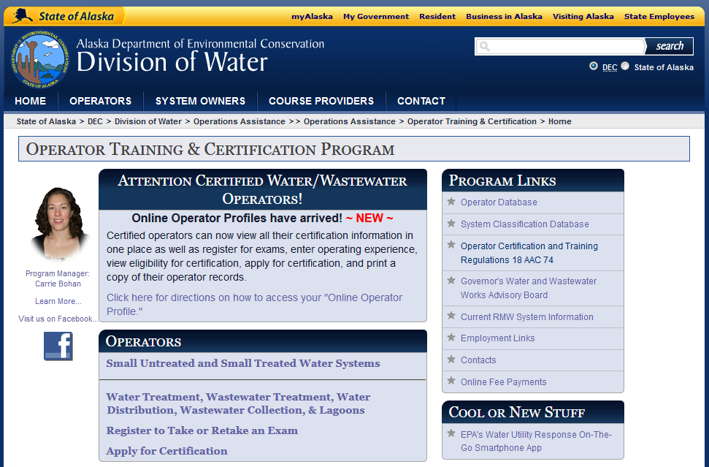
New Online Operator Profiles
New way to access your operator record
Go to http://dec.alaska.gov/water/opcert/index.htm

Slide 9
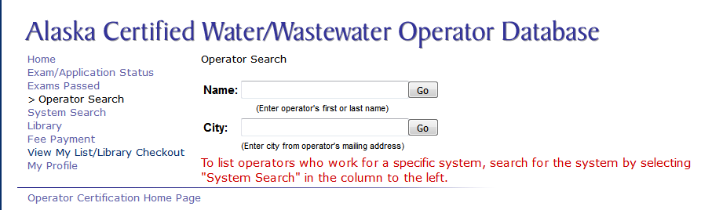
New Online Operator Profiles

Slide 10
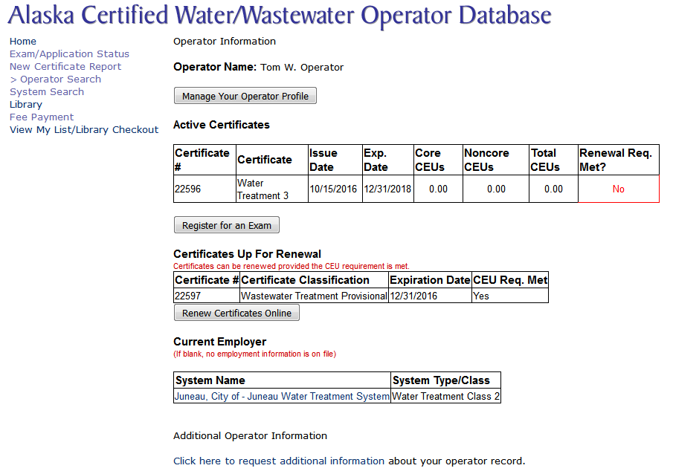
New Online Operator Profiles

Slide 11
New Online Operator Profiles
myAlaska validation to connect to your operator record
  Need to be PFD validated
If not an Alaska resident or not PFD validated, create a myAlaska account first then contact OpCert to associate your myAlaska account to your operator record

Slide 12
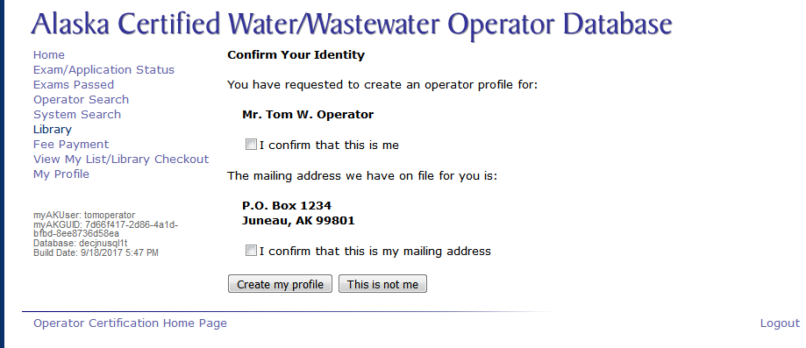
New Online Operator Profiles

Slide 13
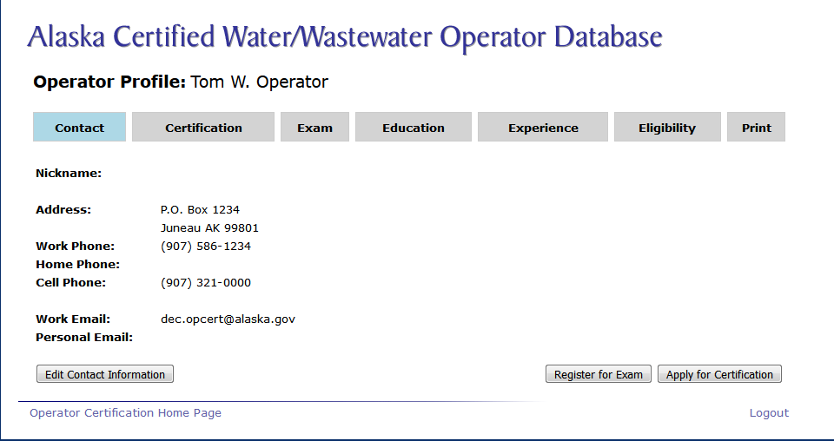

New Online Operator Profiles

Slide 14
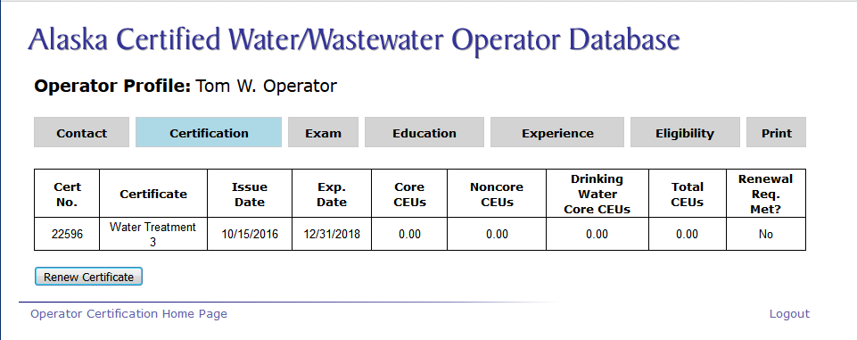

New Online Operator Profiles

Slide 15
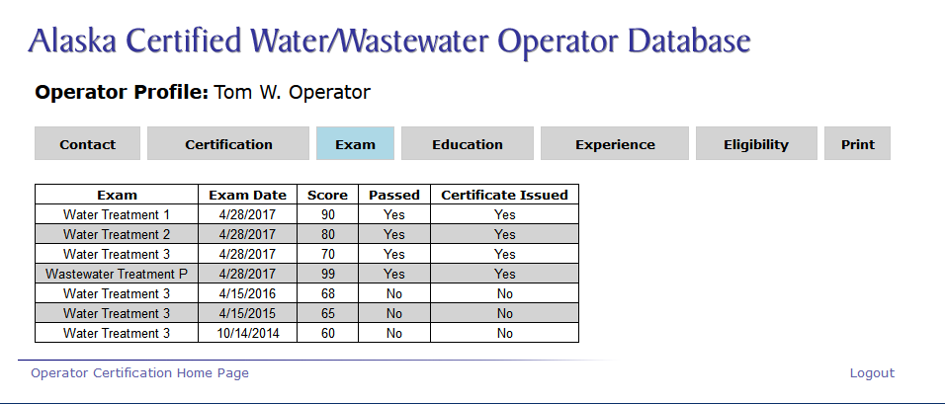
New Online Operator Profiles

Slide 16
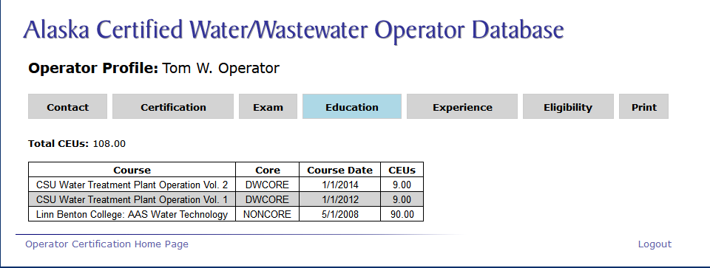
New Online Operator Profiles

Slide 17
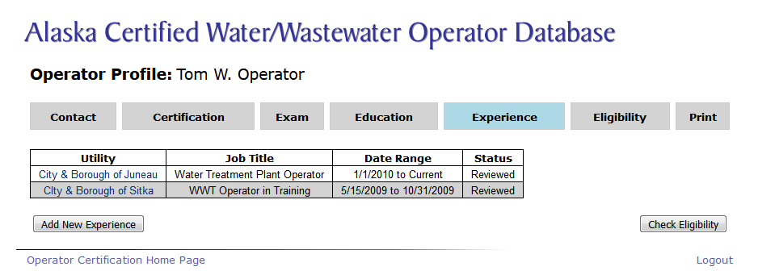
New Online Operator Profiles

Slide 18
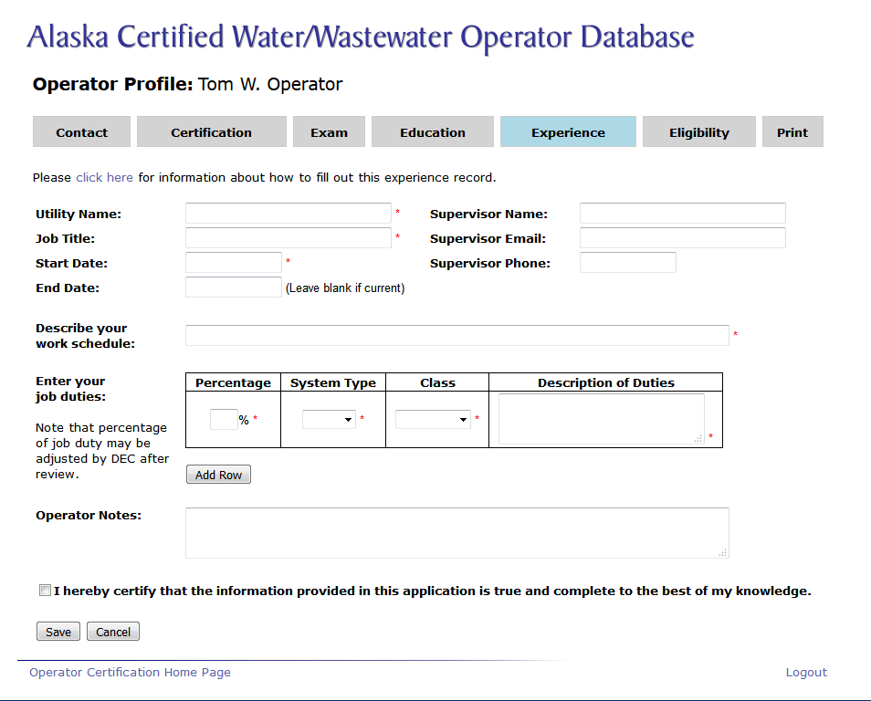
New Online Operator Profiles

Slide 19
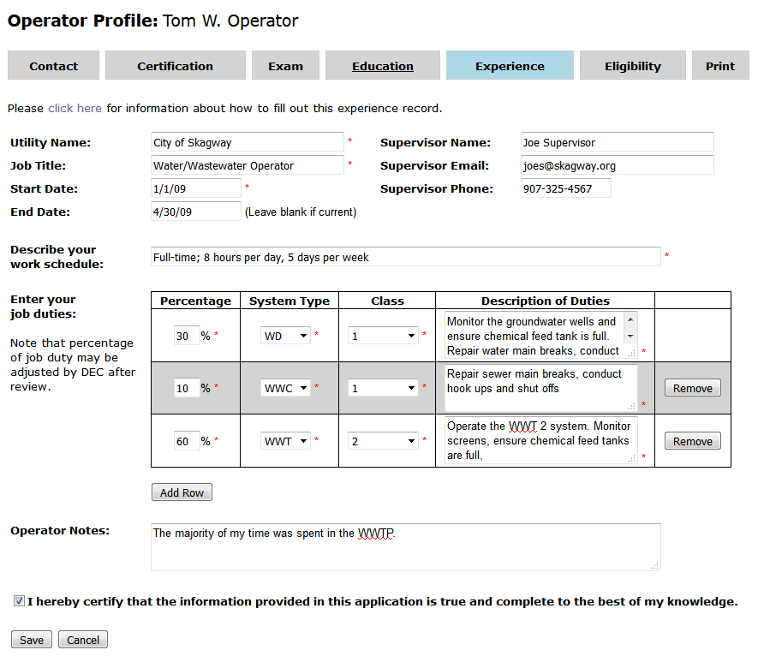

New Online Operator Profiles

Slide 20
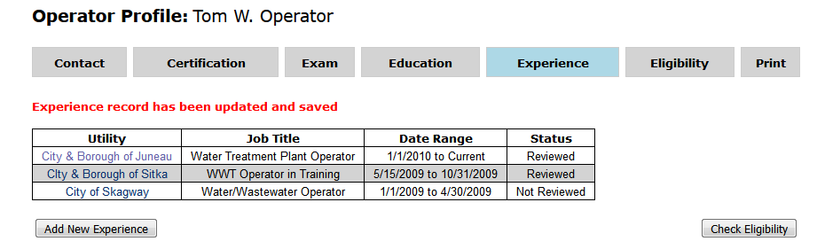
New Online Operator Profiles

Slide 21
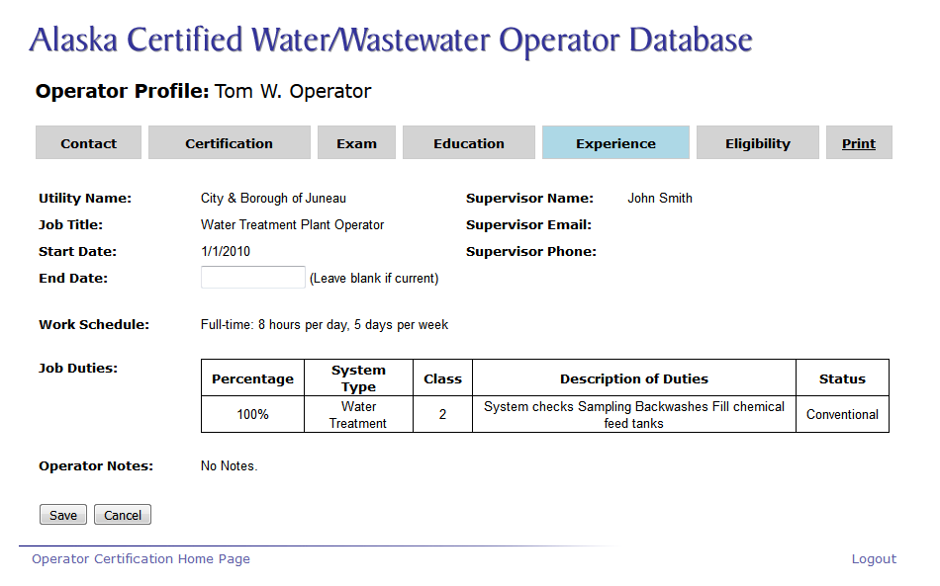
New Online Operator Profiles

Slide 22
New Online Operator Profiles

Slide 23
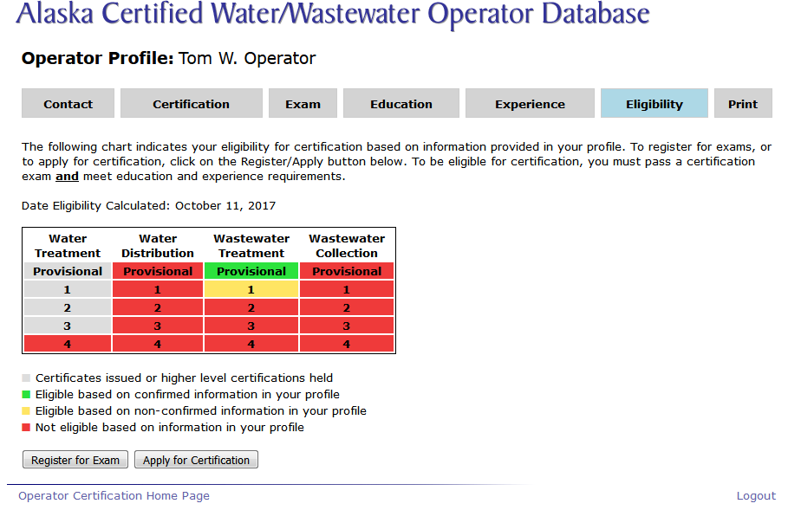
New Online Operator Profiles

Slide 24
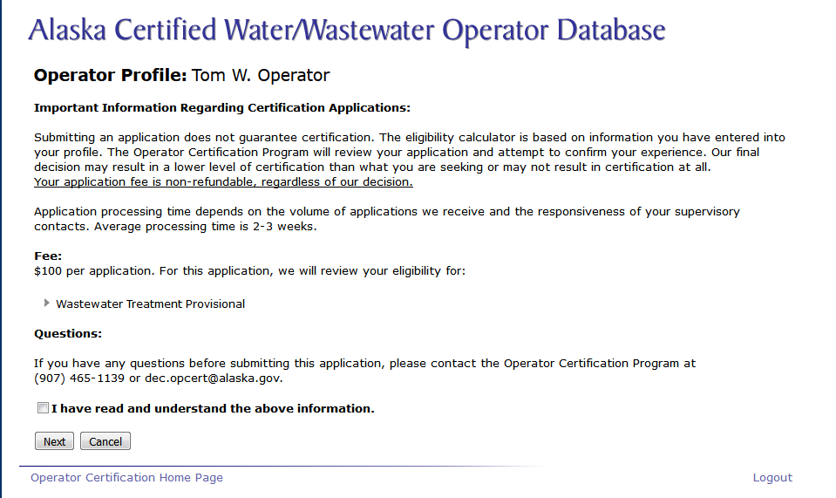
New Online Operator Profiles

Slide 25
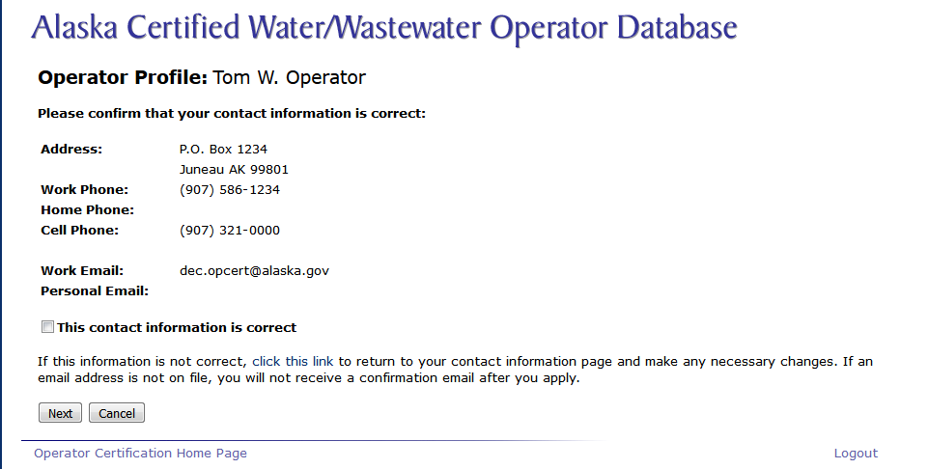
New Online Operator Profiles

Slide 26
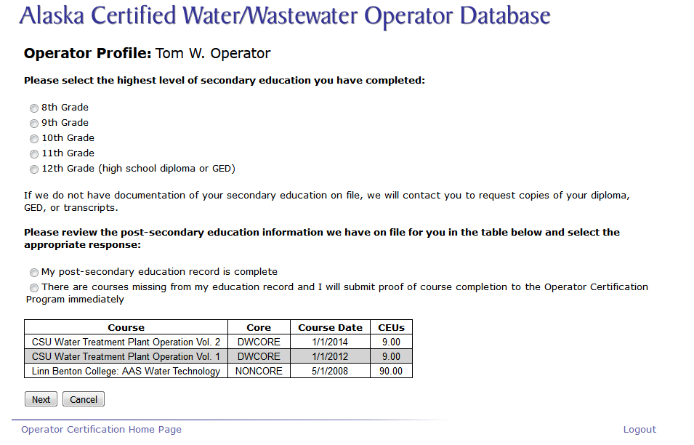
New Online Operator Profiles

Slide 27
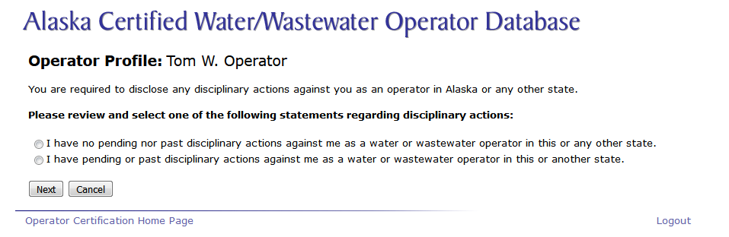
New Online Operator Profiles

Slide 28
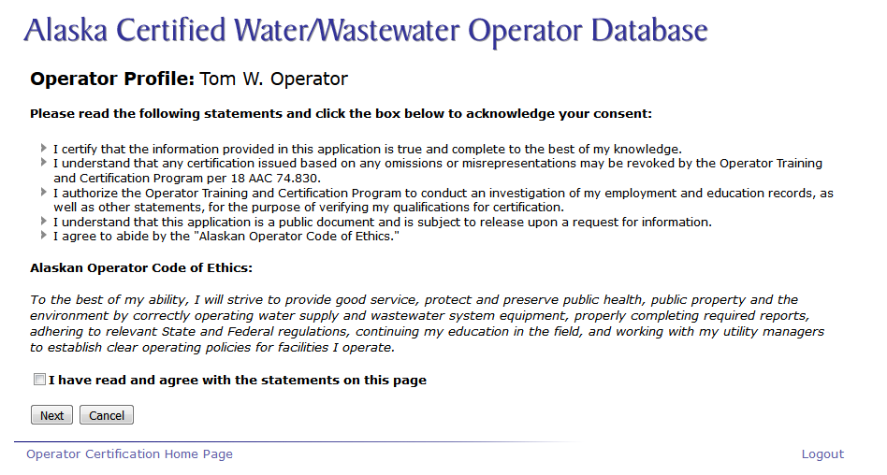
New Online Operator Profiles

Slide 29
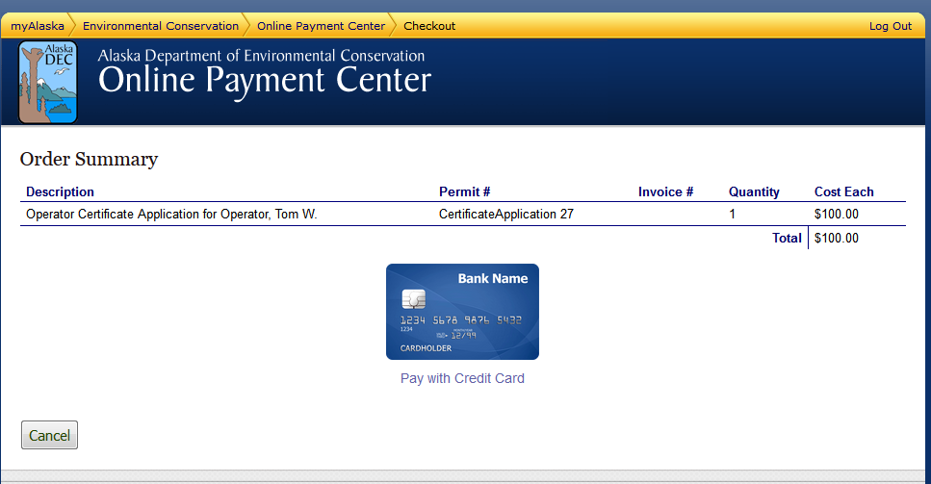
New Online Operator Profiles

Slide 30
New Online Operator Profiles

Slide 31
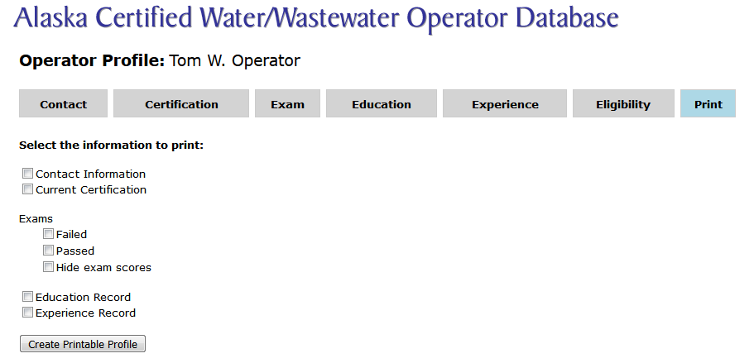
New Online Operator Profiles

Slide 32
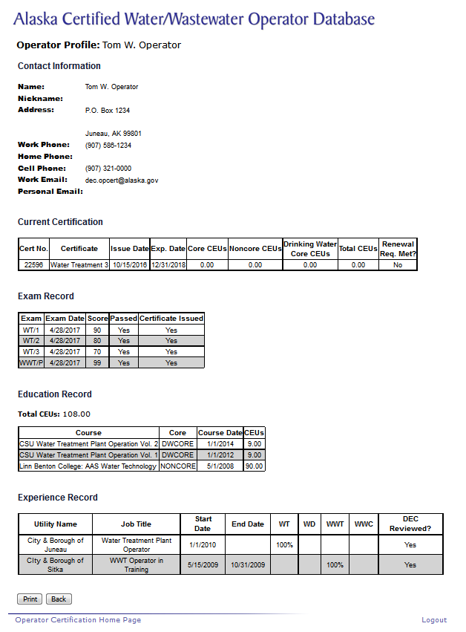
New Online Operator Profiles

Slide 33
Some of the Fee Increases
Exam Fee: $150/exam
Application Fee: $100
Renewal Fees
  January 1 – December 31 of expiration year: $100/certificate
  After expiration:
    January 1 – March 30: $150/certificate
    April 1 – December 31: $300/certificate
Certificate Replacement Fee: $50/certificate
Reciprocity Fee: $300 includes certificates if eligible

Slide 34
New ABC Exams
Exam development
  Job analysis surveys conducted 2014 – 2015
    About 7,000 stakeholders participated of which 261 were Alaskan operators
  More than 1,000 new test questions were written during 2016
    Ben Stacy participated in the WT subject matter experts committee
  Exams were reviewed by the subject matter experts
  Exams were pilot tested by operators in May 2017
  Pilot test results were released in August 2017
  Implementation of new exams started on October 1, 2017

Slide 35
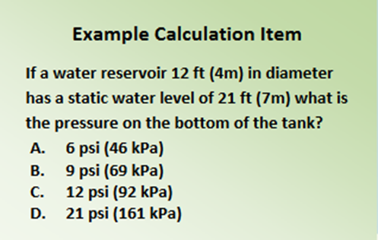
New ABC Exams
NEW EXAMS?????
  110 multiple choice questions, only 100 are graded
  3 hours to take online exam, 3 ½ hours to take written exam
  No regulation questions
  Math questions in both imperial and metric units

Slide 36
Exam Preparation
What to study
Study materials

Slide 37
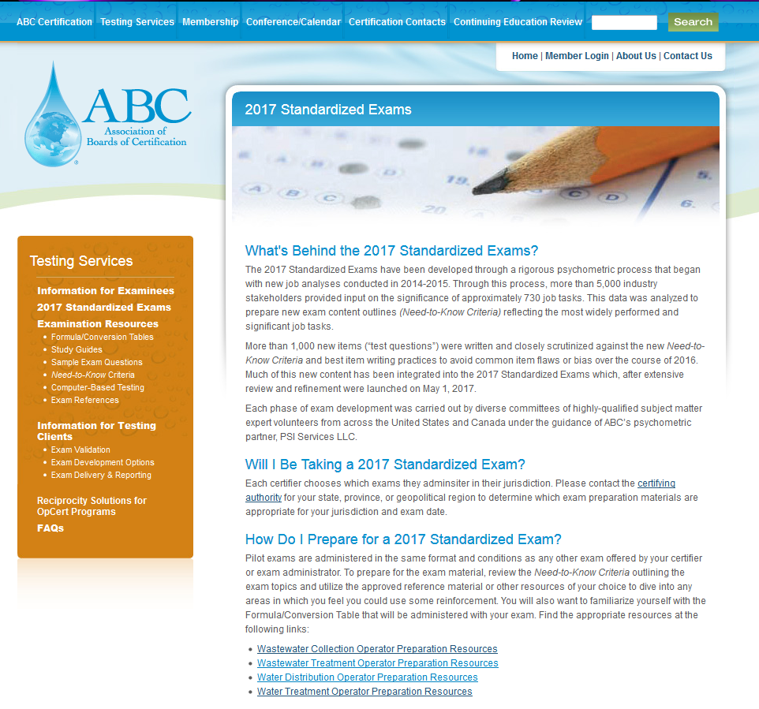
Exam Preparation
Go to ABC’s website for the new 2017 standardized exams at http://www.abccert.org/testing_services/2017StandardizedExamPilot.asp

Slide 38
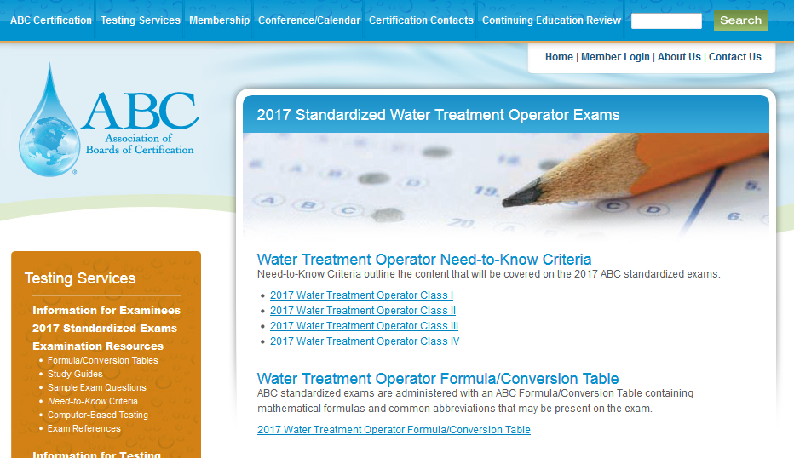
Exam Preparation

Slide 39
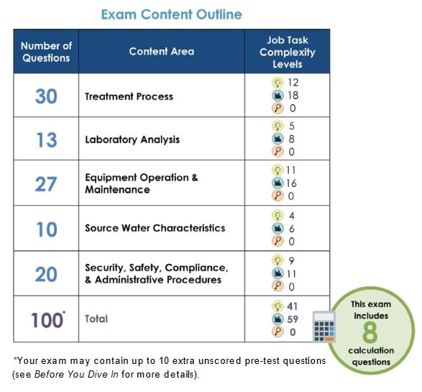
Updated Need-to-Know Criteria
Water Treatment 1
Three question complexity levels
Shows the number of calculation questions in each exam
The number of calculation questions range from 8 (WT1) to 18 (WWT4)

Slide 40
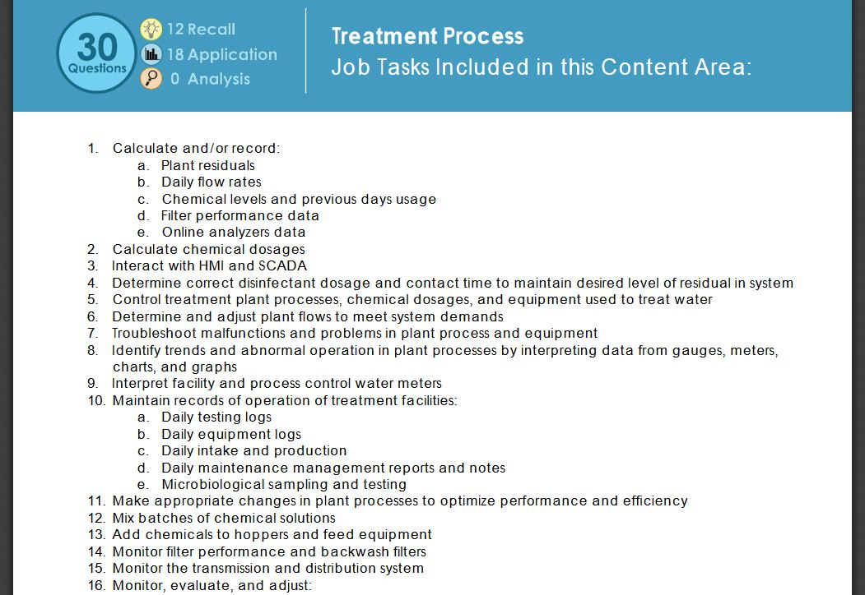
Updated Need-to-Know Criteria
Water Treatment 1

Slide 41
Exam Preparation

Slide 42
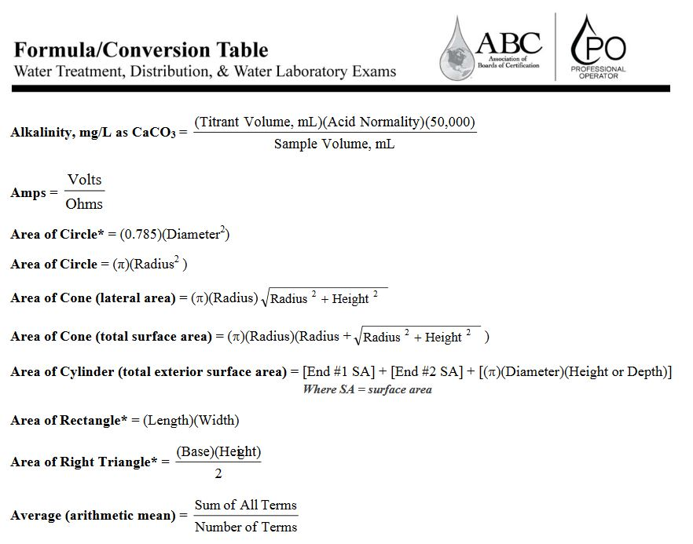
Exam Preparation
Get to know the formula sheets!
Any calculations or conversions you will need are there
Some common formulas have different names, for example the “pounds formula” is called “loading rate” on the formula sheet

Slide 43
Study Materials Water Treatment Exams
AWWA WSO Water Treatment Series, Grade 1, Grade 2, Grades 3-4
AWWA WSO Water Distribution Series, Grades 1-2, Grades 3-4
CSUS Water Treatment Plant Operation, Volume 1 and 2

Slide 44
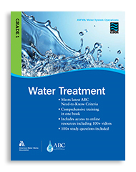
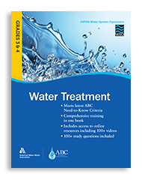
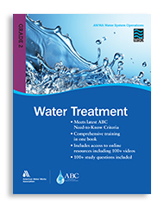
Materials for Water Treatment

Slide 45
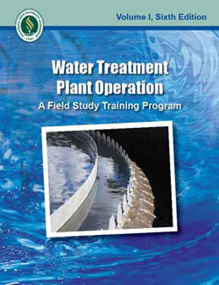
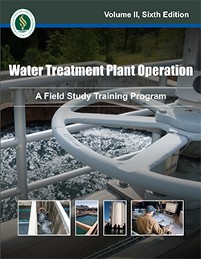
Materials for Water Treatment

Slide 46
Study Materials for Water Distribution Exams
AWWA WSO Water Distribution Series, Grades 1-2, Grades 3-4
CSUS Water Distribution System Operation and Maintenance
CSUS Small Water System Operation and Maintenance
CSUS Water Treatment Plant Operation, Volume 1 and 2

Slide 47
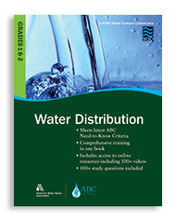
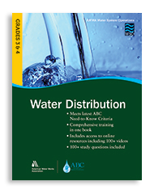
Materials for Water Treatment

Slide 48
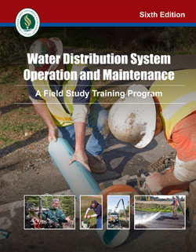
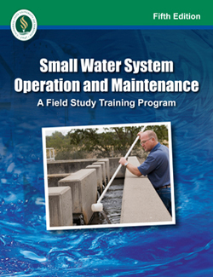
Study Materials for Water Distribution

Slide 49
Study Materials for Wastewater Treatment
CSUS Operation of Wastewater Treatment Plants, Volume 1 and 2
CSUS Advanced Waste Treatment
WEF Basic Laboratory Procedures for the Operator-Analyst
WEF Activated Sludge – Manual of Practice OM-9
WEF Chlorination/Dechlorination Handbook
WEF Operation of Extended Aeration Package Plants
WEF Operation of Municipal Wastewater Treatment Plants
WEF Operation of Nutrient Removal Facilities
WEF Wastewater Biology: The Microlife

Slide 50
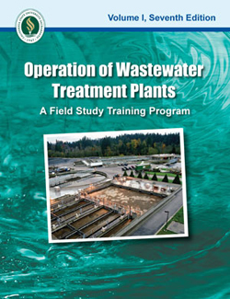
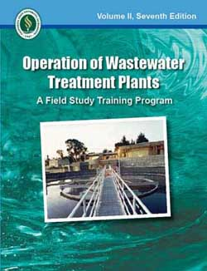
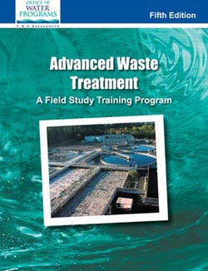
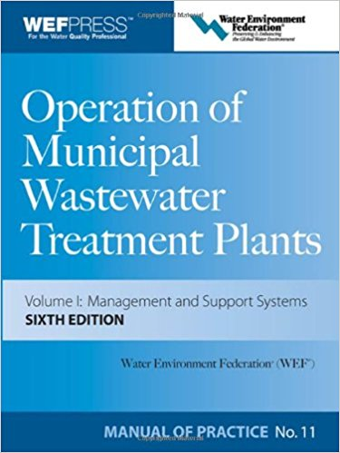
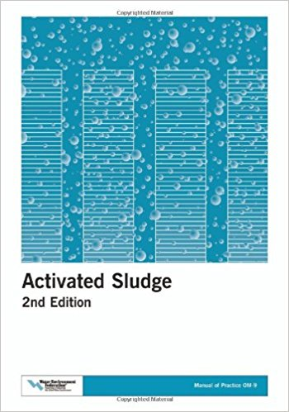
Study Materials for WWT

Slide 51
Study Materials for Wastewater Collection
CSUS Operation and Maintenance of Wastewater Collection Systems, Volume 1 and 2
CSUS Operation of Wastewater Treatment Plants, Volume 1 and 2
WEF Existing Sewer Evaluation and Rehabilitation
WEF Operation of Municipal Wastewater Treatment Plants
WEF Wastewater Collection Systems Management

Slide 52
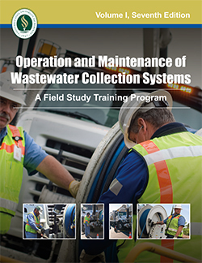
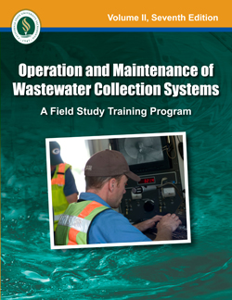
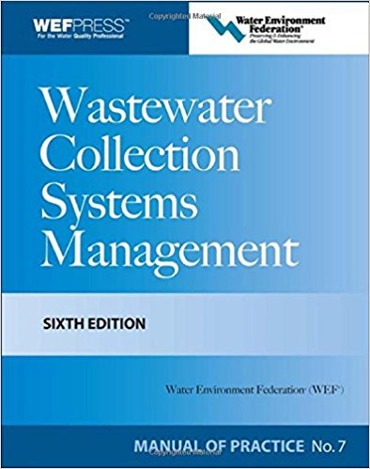
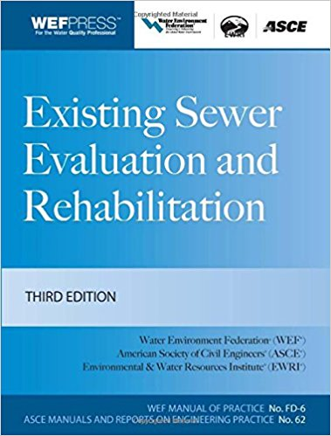
Study Materials for WWC

Slide 53
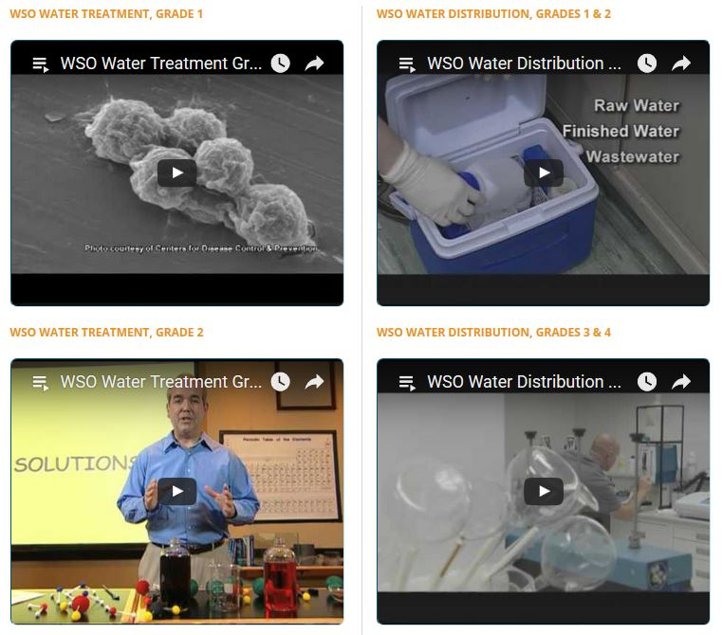
Video Study Materials
Free video study materials available on AWWA’s website
Includes math and chemistry videos

Slide 54
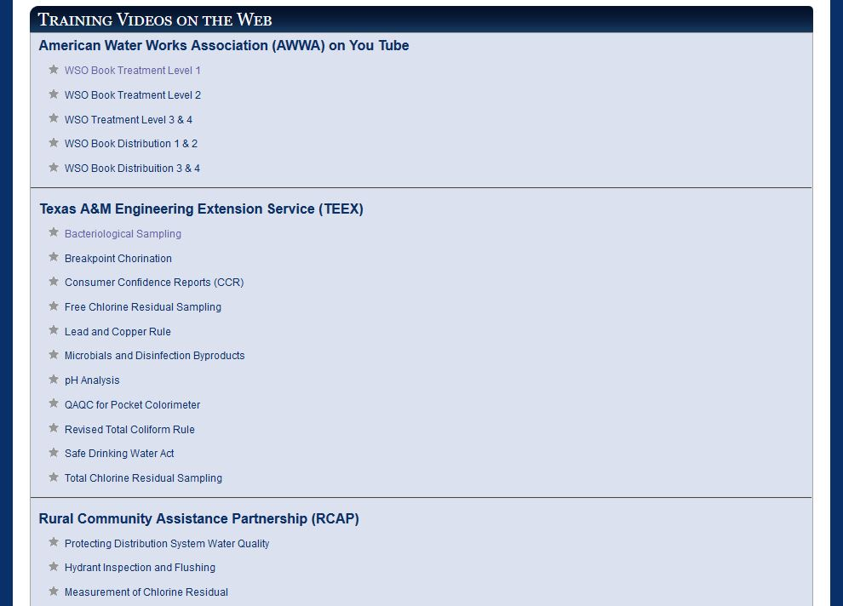
Video Study Materials
OpCert Program’s website has a page with many training videos
Includes both water and wastewater material
http://dec.alaska.gov/water/opcert/othertraining.html

Slide 55
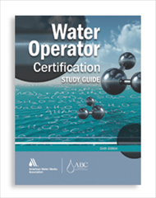
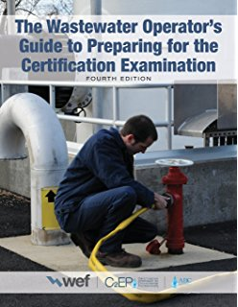

Study Guides

Slide 56

Exam Results
Mastery Report

Slide 57
Questions?
How to contact us:
Phone: (907) 465-1139
E-mail: dec.opcert@alaska.gov
Website: http://dec.alaska.gov/water/opcert/index.htm
Martin Suzuki
Dan DeSloover
Ken Smith – Always ask for Ken!
Laramie Maki

